Slide 1

Describing Places
Module 5
Module 5. Describing Places
1
Notes:
(Date of slide or last update given at the top of the notes for each slide)

Slide 2
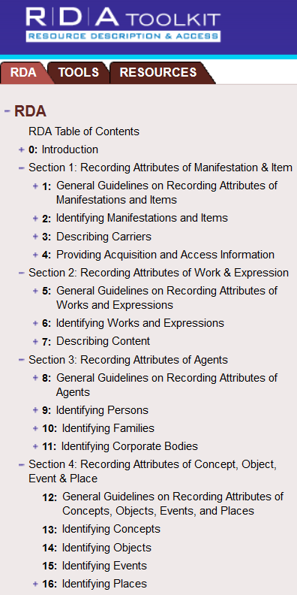
RDA Chapter 16
(in conjunction with chapters 8 and 11)
Notes:
March 21, 2017: updated screenshot, removed reference to Chapter 12 on slide given RDA Toolkit Restructure and Redesign project, revised speaker notes.
Typically, guidelines for describing places in authority records would be found in RDA chapters 12 and 16, but chapter 12 has not been developed, and chapter 16 is not complete. At the present time, chapter 16 only provides general guidelines and instructions on choosing and recording preferred and variant names for places. The only places currently covered are the same kinds of places that were covered by chapter 25 of AACR2, i.e., places that could be considered capable of authorship, or in RDA parlance, places that can be associated with group 1 entities as creators, contributors, etc. of/to works, expressions, manifestations, or items. The section on constructing access points for places is not yet developed in RDA. For names of places used as the names of governments, RDA refers catalogers to chapter 11 (11.2.2.5.4 for the preferred name and 11.13.1.1 for construction of access points). However, there are several LC-PCC Policy Statements for 16.4 that deal with access points for places.
Since all the places we are covering in this module are considered jurisdictions, and jurisdictions are corporate bodies, all of the appropriate guidelines in chapters 8 and 11 apply to them as well as what is in chapter 16. The core elements in chapter 11 apply, and other elements applicable to corporate bodies (e.g., associated place, associated date, associated institution, language of the body, corporate history) can also be recorded for places.

Slide 3
Places as creators of works or associated with works
Names of places commonly used as the names of governments (see 11.2.2.5.4) and communities that are not governments (e.g., city sections)
Governments create laws, constitutions, regulations, etc.; sign treaties; have officials and employees; have subordinate executive, legislative, and judicial bodies; issue reports and position statements; create cartographic resources; have court rules; etc.
Government officials create official communications
Notes:
May 1, 2013
19.2.1.1.1 lists the cases in which corporate bodies (including governments and governmental bodies) are considered to be creators. 19.2.1.1.2 details when government and religious officials are considered to be creators. The names of places are used to represent a government as a corporate body, and form the first part of the authorized access points for government bodies recorded subordinately, including some government agencies, legislative bodies, courts, armed forces, and government officials (heads of state, heads of government, or ruling executive bodies), embassies, consulates, etc., and delegations to international or intergovernmental bodies.

Slide 4
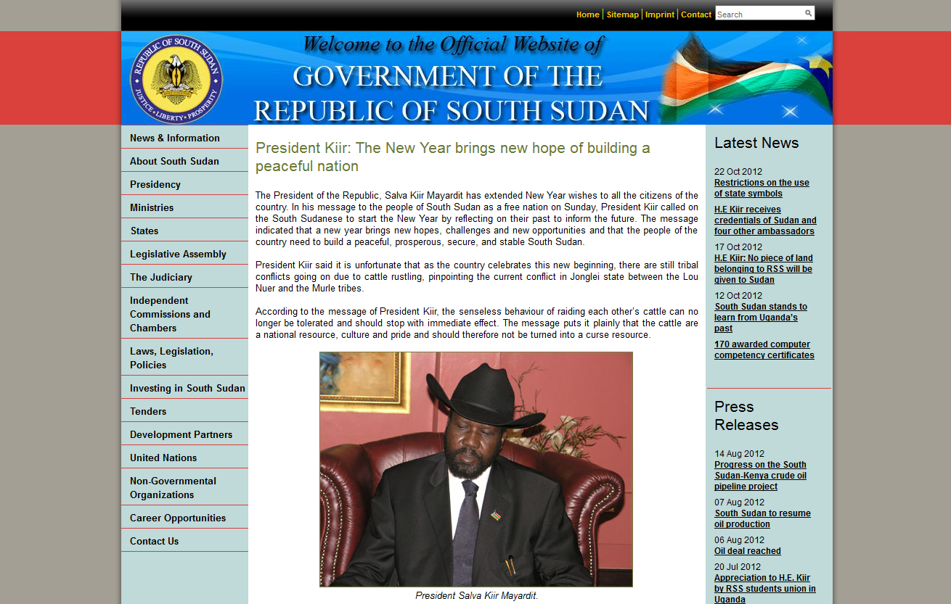
RDA authorized access point: South Sudan
Notes:
May 1, 2013
ANIMATED SLIDE
The next few slides illustrate examples of resources created by governments or governmental bodies.
This is the official website of the Government of the Republic of South Sudan.
110 1_ South Sudan.
245 10 Official website of the Government of the Republic of South Sudan.
[Source: Government of the Republic of South Sudan website: http://www.goss.org/]

Slide 5
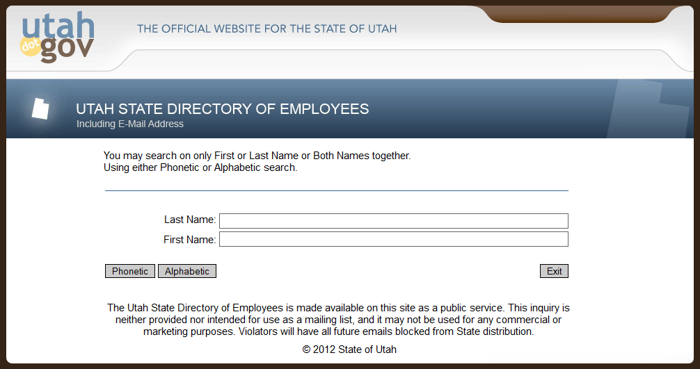
RDA authorized access point: Utah
Notes:
May 1, 2013
ANIMATED SLIDE
This work is a directory of Utah state employees. The creator is the state of Utah.
110 1_ Utah.
245 10 Utah state directory of employees.
[Source: Utah.gov: http://web.state.ut.us/phone.htm]

Slide 6

RDA authorized access point: Sydney (N.S.W.)
Notes:
May 1, 2013
ANIMATED SLIDE
This work is the website of the city of Sydney, New South Wales, Australia. The creator is Sydney (N.S.W.).
110 1_ Sydney (N.S.W.)
245 10 City of Sydney.
[Source: City of Sydney website: http://www.cityofsydney.nsw.gov.au/]

Slide 7

RDA authorized access point: Tulsa (Okla.). Mayor’s Commission on the Status of Women
Notes:
May 1, 2013
ANIMATED SLIDE
This is the website of the Tulsa, Oklahoma Mayor’s Commission on the Status of Women. Here we have an example of a government body that would be recorded subordinately. The first part of the name of this agency would be the authorized access point for Tulsa, Oklahoma, which would be followed by the name of the commission:
110 1_ Tulsa (Okla.). $b Mayor’s Commission on the Status of Women
If there was no authority record already created for the place, it would have to be created as a separate NAR at the same time as the NAR for this agency.
[Source: https://www.cityoftulsa.org/community-programs/human-rights/commissions/mayor's-commission-on-the-status-of-women.aspx]

Slide 8


RDA authorized access point: Brazil
Notes:
August 13, 2019
ANIMATED SLIDE
An example of a legal work created by a government (Brazil).
110 1_ Brazil, $e enacting jurisdiction.
240 10 Constituição (1988)
245 10 Constituição da República Federativa do Brasil : $b texto constitucional promulgado em 5 de outubro de 1988, com as alterações determinadas pelas Emendas Constitucionais de Revisão nos 1 a 6/94, pelas Emendas Constitucionais nos 1/92 a 91/2016 e pelo Decreto Legislativo no 186/2008.
[Source: Senado Federal Biblioteca Digital website: https://www2.senado.leg.br/bdsf/bitstream/handle/id/518231/CF88_Livro_EC91_2016.pdf]

Slide 9

RDA authorized access point: Washington (State). Governor (2005-2013 : Gregoire)
Notes:
May 1, 2013
ANIMATED SLIDE
An example of an official communication - in this case, an executive order of the Governor of Washington State. This is another example of a body that would be recorded subordinately under the name of the government:
110 1_ Washington (State). $b Governor (2005-2013 : Gregoire)
245 10 Executive order 12-06 : $b achieving energy efficiency in state buildings.
[Source: Washington State Office of the Governor: http://www.governor.wa.gov/execorders/eo_12-06.pdf]

Slide 10
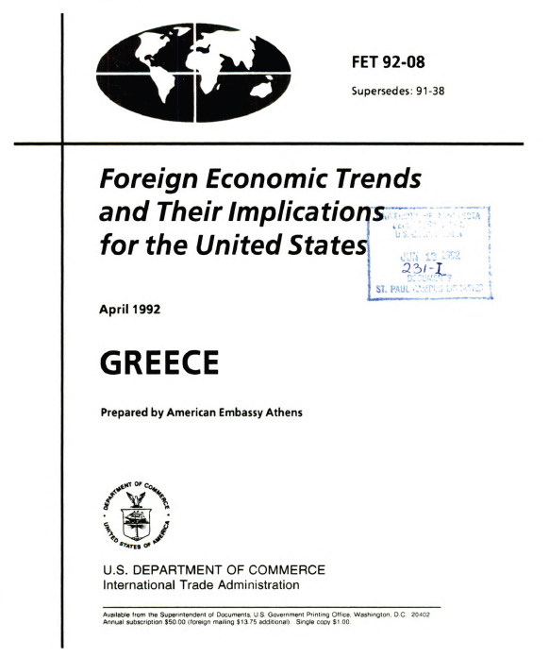
RDA authorized access point: United States. Embassy (Greece)
Notes:
May 1, 2013
ANIMATED SLIDE
An example of an embassy as creator, another type of body that is recorded subordinately:
110 1_ United States. $b Embassy (Greece)
Statement of responsibility reads: “Prepared by American Embassy Athens”
[Source: HathiTrust: http://babel.hathitrust.org/cgi/pt?id=umn.31951d002879490]

Slide 11
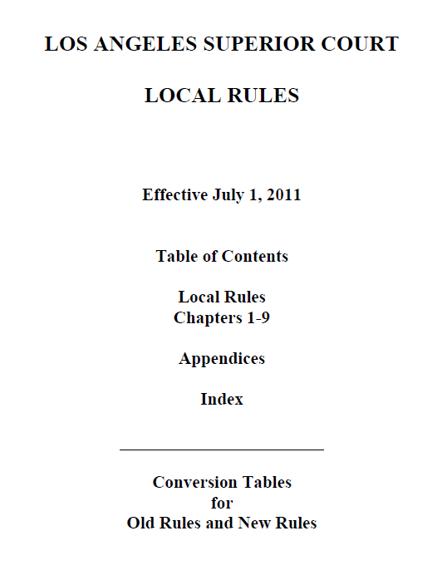
RDA authorized access point: California. Superior Court (Los Angeles County)
Notes:
May 1, 2013
ANIMATED SLIDE
An example of court rules, a form of legal work. The creator is the court, which is established as a subordinate body under the name of the California government:
110 1_ California. $b Superior Court (Los Angeles County)
[Source: Los Angeles County Bar Association website: http://www.lacba.org/Files/Main%20Folder/CourtNotices/files/LASC_Local_Rules_Effective_July_1_2011.pdf]

Slide 12
Places as contributors, etc.
Governments and governmental bodies can be contributors to an expression, or may be associated with manifestations and items as well, for example, as
  Performers (e.g., military bands)
  Publishers; broadcasters
  Printers
  Producers of unpublished resources
  Distributors
  Owners (e.g., government libraries and museums)
Notes:
May 1, 2013
In addition to these, there are many other ways places can be related to works, expressions, manifestations, or items.

Slide 13

RDA authorized access point: United States. Embassy (Tanzania)
Notes:
May 1, 2013
ANIMATED SLIDE
An example of a government body as a contributor: “based in part on information provided by the U.S. Embassy in Tanzania”
110 1_ United States. $b Embassy (Tanzania)
[Source: HathiTrust: http://babel.hathitrust.org/cgi/pt?id=umn.31951003049783y]

Slide 14
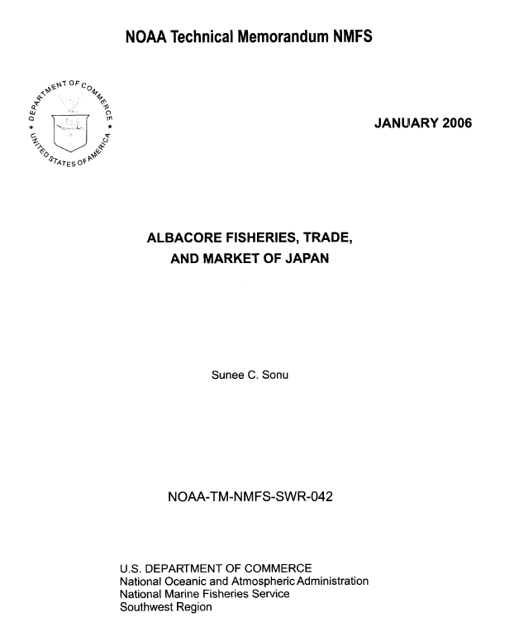
RDA authorized access point: United States. National Marine Fisheries Service. Southwest Region
Notes:
May 1, 2013
ANIMATED SLIDE
An example of a government body as a publisher (manifestation relationship): U.S. Department of Commerce, National Oceanic and Atmospheric Administration, National Marine Fisheries Service, Southwest Region.
110 1_ United States. $b National Marine Fisheries Service. $b Southwest Region
[Source: Southwest Fisheries Science Center website: http://swfsc.noaa.gov/publications/TM/SWR/NOAA-TM-NMFS-SWR-042.PDF]

Slide 15
Places as subjects
Places are commonly the subjects of works
Subject Headings Manual H 405: Name vs. Subject Authority File
DCM Z1 Appendix 1: Ambiguous Entities
Group One: entities always established according to descriptive cataloging conventions with authority records that always reside in the name authority file
  City sections Jurisdictions, Ancient (other than cities)
  Collective settlements Military installations (active; also all after 1899)
  Comarcas Planned communities
  Communes Pueblos
  Conservation districts, U.S. Indian Tribes/Canadian First Nations (as
  Forest districts, Mining governments/jurisdictions)
  districts, Park districts,
  Recreation districts, Sanitation
  districts, Utility districts, Water districts
Above examples all tagged 151 in name authority records
Notes:
November 14, 2016
ANIMATED SLIDE
The Subject Headings Manual H 405 and the DCM Z1 Appendix 1 provide guidance on whether certain entities are established as name authorities through NACO or subject authorities through SACO. Group One entities are always established as name authorities. This slide lists those ambiguous entities that are tagged as 151 geographic access points in the name authority file. For any entity falling into Group One, follow RDA and the LC-PCC PS’s to establish its authorized access point.
Note: Do not confuse “group one” and “group two” entities as described in the Subject Headings Manual and DCM Z1 with the FRBR group 1, 2, and 3 entities. The groups we are talking about here in this module are solely for the purposes of deciding whether an entity is established according to descriptive (RDA) or subject (LCSH) rules and whether it should be a name authority record in the LC/NACO Authority File or an LCSH subject authority record.

Slide 16
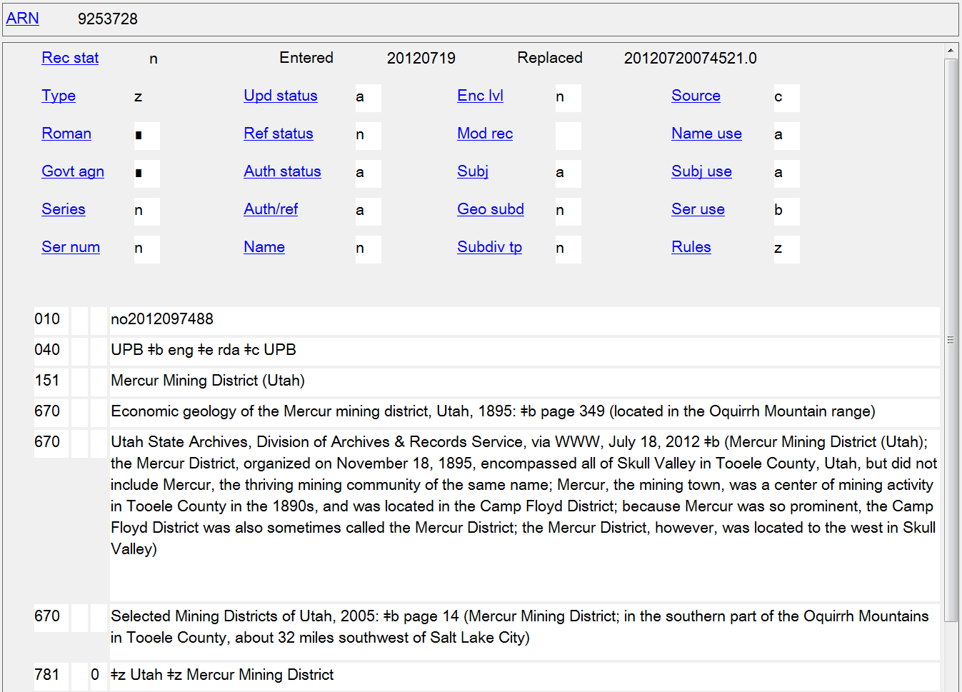
Group 1 Geographic Entity
Notes:
May 1, 2013
An example of an ambiguous entity that is included in Group 1 in The Subject Headings Manual H 405 and the DCM Z1 Appendix 1, and which is coded as a geographic place in the LC/NACO Authority File. The 010 prefix beginning with “n” indicates that this is a name heading, and the coding in the 008/10 (Rules) combined with 040 subfield $e “rda” identify it as an RDA record. Many (but by no means all) types of districts are treated as geographic entities and established in the LC/NAF. When in doubt, consult the list of ambiguous entities and inquire with the Cooperative Programs Section at LC if necessary.

Slide 17
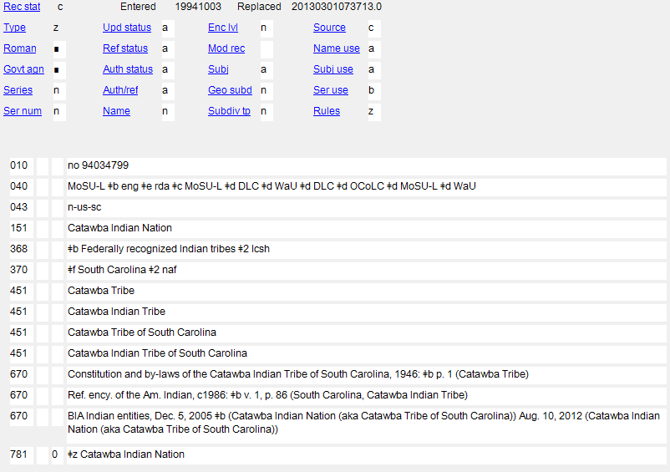
Group 1 Geographic Entity
Notes:
February 24, 2014
Another group 1 entity: U.S. Indian tribes

Slide 18
Places as subjects
Group Two: entities always established according to subject cataloging conventions with authority records that reside in either the name authority file or the subject authority file
  Amusement parks Golf courses
  Aqueducts Hazardous waste sites
  Astronomical features (asteroids, Highways
  comets, galaxies, planets, etc.) Historic sites (including historic districts
  Bridges not in cities)
  Camps Islands, Nonjurisdictional
  Canals Land grants
  Cemetery sites, Archaeological Locks (Hydraulic engineering)
  Cities, Extinct (pre-1500) Military installations
  Collective farms (inactive pre-1900 installations)
  Docks Mines
  Estates Parks (Geographic entities)
  Fairgrounds Pipelines
  Farms Playgrounds
  Forests Plazas (Open spaces, squares, etc.)
  Fortresses (Structures) Ports (Physical facilities)
  Gardens Ranches
Notes:
March 21, 2017: updated speaker notes to spell out “Hdgs.” in 667
The Subject Headings Manual H 405 and the DCM Z1 Appendix 1 provide guidance on whether certain entities are established as name authorities through NACO or subject authorities through SACO. Group two entities are established according to subject cataloging conventions in the Subject Headings Manual. Their authority records may reside either in the LC/NACO Authority File or in LCSH. The slide lists some of the ambiguous entities that are in group two and tagged as 151 geographic. Consult SHM H 405 for the complete list.
DCM Z1: Appendix 1: Ambiguous Entities
If a group two entity is needed as a descriptive access point create a name authority record according to subject cataloging rules. Add a 667 note to the NAR with the statement “Subj. Headings Manual/RDA”. If a Group 2 Heading for the same entity exists in the LCSH Authority File create an NAR (cf. DCM Z1 Appendix 1: Ambiguous Entities, Section 3.1) and send a notification to saco@loc.gov to delete the existing subject authority record.

Slide 19
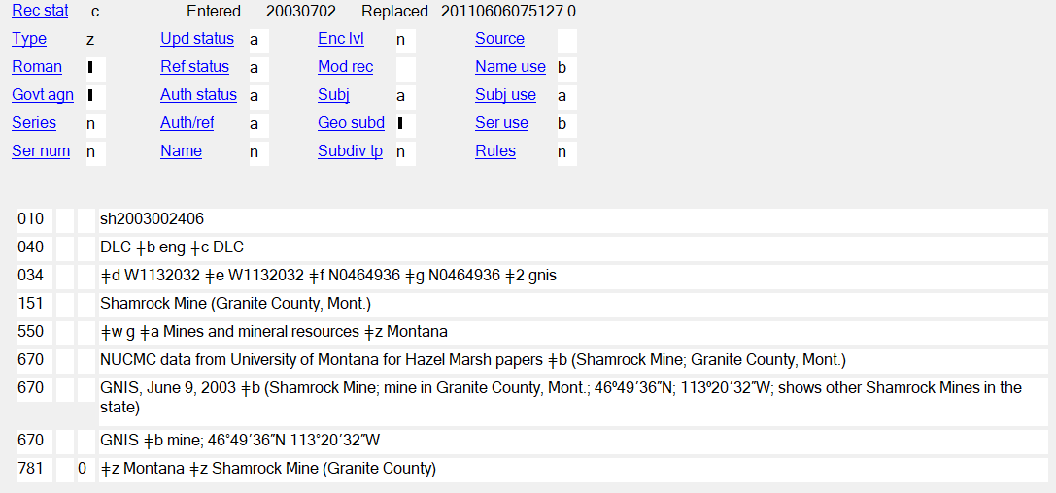
Group 2 Geographic Entity Needed as Subject
Notes:
September 17, 2018
An example of a group 2 heading that was needed as a subject, and established in the subject authority file - note the LCCN prefix of “sh” rather than one beginning with “n”. The 008/10 (Rules) is coded “n” for “not applicable” (since no descriptive cataloging rules were used to formulate this heading). Note also the presence of a broader topical subject term (550), found only in subject authority records.
In case anyone inquires further:
008/10 Descriptive cataloging rules code
Represents the cataloging rules used for establishing the name, name/title, or uniform title heading in the 1xx field.
The possible values are:
a Earlier rules
b AACR1
c AACR2
d AACR2 compatible heading
n Not applicable
z Other

Slide 20
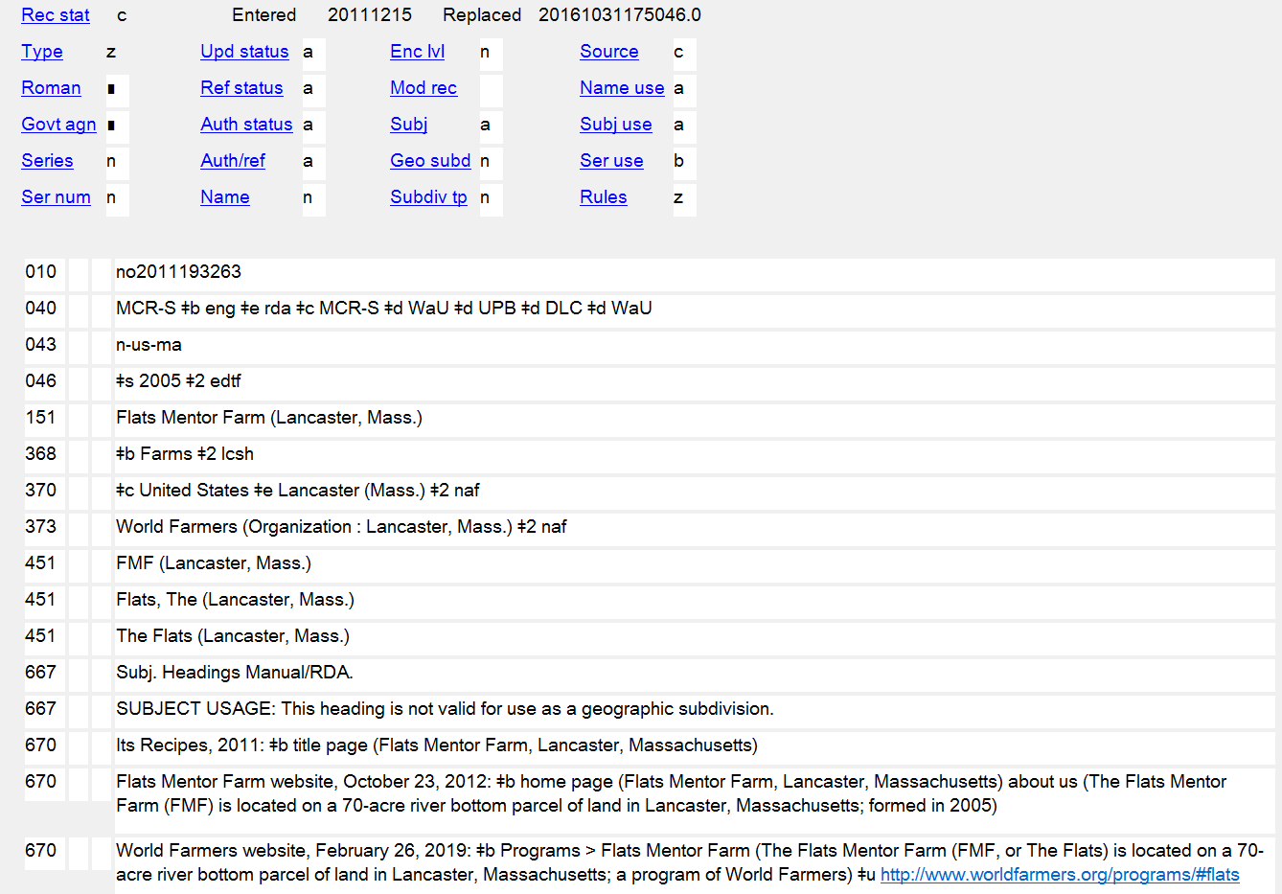
If a subject heading for the same entity already exists, create the NAR and notify saco@loc.gov to cancel the subject authority record.
Group 2 Geographic Entity Needed as a Descriptive Access Point
Notes:
February 26, 2019: updated slide to spell out “Hdgs.” in 667 per DCM Z1 Appendix 1
ANIMATED SLIDE
Example of a group two geographic entity (a farm) needed as a descriptive access point. In such a case, the access point is formulated according to the Subject Headings Manual instructions, but is added to the name authority file. A 667 note “Subj. Headings Manual/RDA” is included in the record.
DCM Z1: Appendix 1: Ambiguous Entities
If a group two entity is needed as a descriptive access point create a name authority record according to subject cataloging rules. Add a 667 note to the NAR with the statement “Subj. Headings Manual/RDA”. If a Group 2 Heading for the same entity exists in the LCSH Authority File create an NAR (cf. DCM Z1 Appendix 1: Ambiguous Entities, Section 3.1) and send a notification to saco@loc.gov to delete the existing subject authority record.

Slide 21
MARC Authority Coding Overview
Places are coded in X51 in authority records
  Except when jurisdiction is first part of access point for a subordinate body or for a work/expression: then X10 1_
  151 Manitoba
  but
  110 1_ Manitoba. $b Department of Education
  110 1_ Manitoba. $t Highway Traffic Act
Both indicators in X51s are blank
As with other authority records, RDA records for places are coded “z” in 008/10 (“Rules”) and “rda” in 040 subfield $e
Notes:
May 1, 2013
NAR for jurisdiction:
151 Manitoba
NAR for subordinate unit of Manitoba:
110 1_ Manitoba. $b Department of Education
110 1_ Manitoba. $b Legislative Assembly
NAR for work/expression created by Manitoba:
110 1_ Manitoba. $t Highway Traffic Act
110 1_ Manitoba. $t Laws, etc. (Statutes : 1871)
110 1_ Manitoba. $t Laws, etc. (Statutes : 1871). $l French

Slide 22
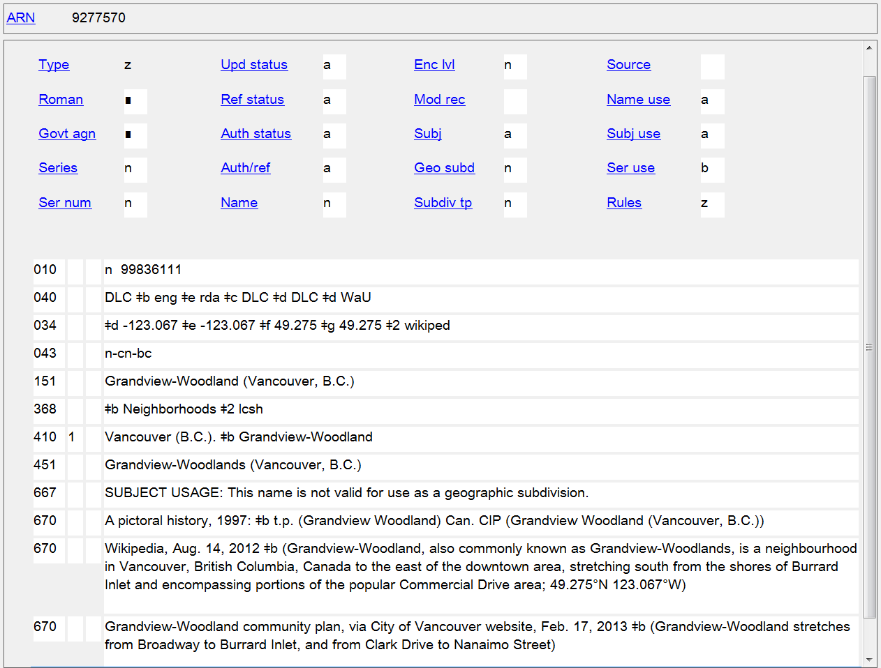
Notes:
May 1, 2013
Another example of an RDA geographic name authority, in this case for a neighborhood in Vancouver, British Columbia. Note the tagging in the authorized access point is 151. The 010 prefix beginning with “n” indicates this is a name authority record, and the combination of codes in 008/10 (Rules) and 040 subfield $e indicate that this is an RDA record.

Slide 23
MARC Bibliographic Coding Overview
In bibliographic records, 151 in authorities turns into:
110 1_ or 710 1_ for access points
651 _0 for subjects (not 610 10)
Notes:
May 1, 2013

Slide 24
RDA Authority Record
RDA Bibliographic Records
040 DLC $b eng $e rda $c DLC $d DLC $d WaU $d OCoLC $d DLC $d CSt
151 Zambia
451 Republic of Zambia
451 Sambia
451 Zambië
451 Zanbia
451 Saambiya
451 Замбія
451 Замбија
451 Ζάμπια
451 ザンビア
451 赞比亚
...
781 _0 $z Zambia
110 1_ Zambia, $e enacting jurisdiction.
240 10 Constitution (1996)
245 10 Constitution of the Republic of Zambia.
100 1_ Kaela, Laurent C. W., $d 1950- $e author.
245 10 Zambia national governance baseline survey : $b report / $c prepared for the Government of the Republic of Zambia by the Department of Political and Administrative Studies, University of Zambia ; Laurent C.W. Kaela, lead consultant.
651 _0 Zambia $x Politics and government.
710 1_ Zambia.
710 2_ University of Zambia. $b Department of Political and Administrative Studies, $e author.
Notes:
March 4, 2020: updated notes
Example showing how the 151 in the authority record becomes 110, 651, and 710 in bibliographic records.
In the second bibliographic example, the first 710 is lacking a relationship designator. This is because there is currently no appropriate relationship designator available in RDA I.2.2 (Relationship Designators for Other Persons, Families, or Corporate Bodies Associated with a Work) to describe this particular type of relationship (“prepared for the Government of the Republic of Zambia”). PCC participants may suggest new relationship designators for RDA by filling out a form on the PCC website (http://www.loc.gov/aba/pcc/scs/RD-Requests.html), which will then be reviewed by the PCC Standing Committee on Standards. If the Standing Committee approves the proposal, it will forward it to the ALA representative to the RSC for submission as a fast track proposal.

Slide 25
Exercises
MARC Coding
Notes:
May 1, 2013

Slide 26
Which, if any, of the following access points would be incorrectly coded in an authority record?
151 Missouri
110 1_ Las Vegas (Nev.). $b Office of Business Development
151 Emerald People's Utility District (Or.)
410 2_ Republic of Botswana
410 1_ Government of Belize
151 Canada. $b Embassy (France)
410 2_ N.S.W.
110 2_ Toronto Board of Education
151 Ontario International Airport (Calif.)
110 2_ Skagit Soil Conservation District (Wash.)
451 Chicago (Ill.). $b Wrigleyville
151 Anchorage School District (Alaska)
151 Algeria (Provisional government, 1958-1962)
Notes:
August 13, 2019
ANIMATED SLIDE
The incorrectly coded ones are:
410 2_ Republic of Botswana - should be 451
410 1_ Government of Belize - should be 451
151 Canada. $b Embassy (France) - should be 110 1_
410 2_ N.S.W. - should be 451
151 Ontario International Airport (Calif.) - should be 110 2_ - airports are not treated/coded as geographic places unless they are military installations (air bases)
110 2_ Skagit Soil Conservation District (Wash.) - should be 151
451 Chicago (Ill.). $b Wrigleyville - should be 410 1_
151 Anchorage School District (Alaska) - should be 110 2_ - school districts are not treated/coded as geographic places
In case anyone asks, there is also a place in Kentucky named Anchorage, so that may be the reason the Anchorage School District was qualified by (Alaska).

Slide 27
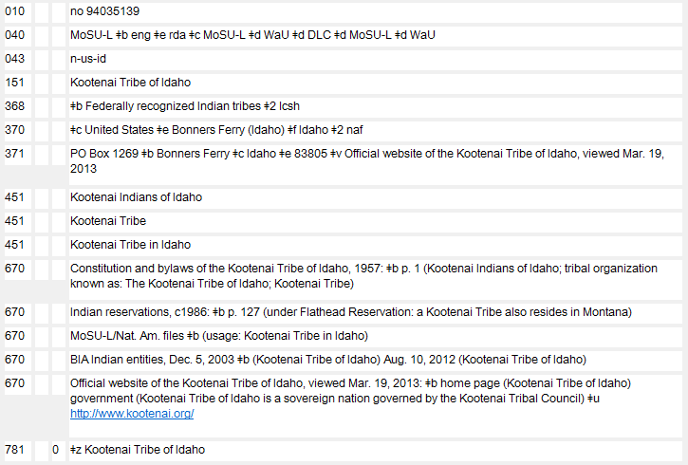
Based on this NAR ...
Notes:
February 24, 2014

Slide 28
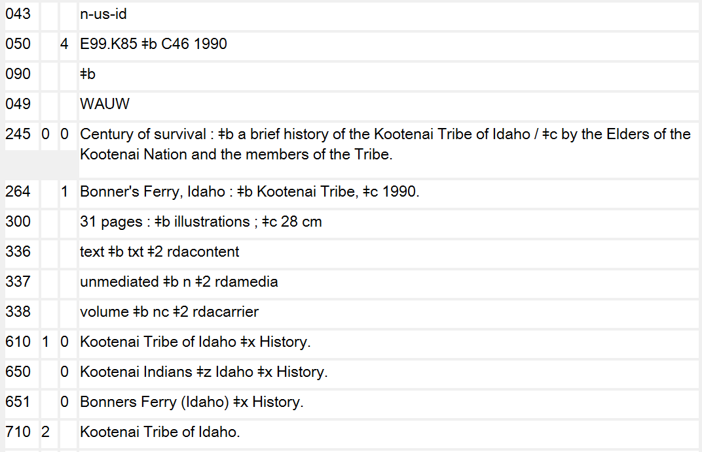
... is there anything wrong with the MARC coding in this bibliographic record?
Notes:
May 1, 2013
The NAR on the previous slide shows that this entity is a geographic place/jurisdiction, tagged 151. In the bibliographic record, the 610 10 should be 651 _0. The 710 first indicator should be a 1, for a corporate body jurisdictional access point.

Slide 29
Preferred Name for Place
RDA 16.2.2
Name or form of name chosen to identify a place.
  The preferred name is used
    as the conventional name of a government, etc.,
    as an addition to the name of a family, a corporate body, a conference, etc., or a work,
    to record a place associated with an agent or a work
Notes:
March 21, 2017: updated to reflect current RDA language
December 12, 2016: language updated to reflect current RDA language; “work” added to third bullet point, since place of origin of the work is an element of the work entity (RDA 6.5)

Slide 30
Sources for the Preferred Name
(RDA 16.2.2.2)
Sources (in order of preference)
  gazetteers and other reference sources in the language preferred by the agency creating the data
  gazetteers and other reference sources issued in the jurisdiction in which the place is located in the official language or languages of that jurisdiction
Notes:
May 1, 2013
Read RDA 16.2.2.2-16.2.2.3 together.

Slide 31
LC-PCC PS for 16.2.2.2
U.S.: base preferred name on form found in GNIS
Australia: base on form found in Geoscience Australia Place Name Search
Canada: base on form found in Canadian Geographical Names Data Base
Great Britain: base on form found in Ordnance Survey gazetteer or Geographic Names Server (GNS)
N.Z.: base on form found in New Zealand Gazetteer of Place Names
Other names: base on the form found in the resource being cataloged together with a consideration of the form found in the Geographic Names Server
Notes:
March 4, 2020: updated source for N.Z. Links in LC-PCC PS now resolve to New Zealand Gazetteer of Place Names
October 10, 2023: updated name of GNS from GEOnet Names Server to Geographic Names Server
The LC-PCC Policy Statement for 16.2.2.2 gives preferred online sources that should be used to determine the preferred form of a place name.

Slide 32
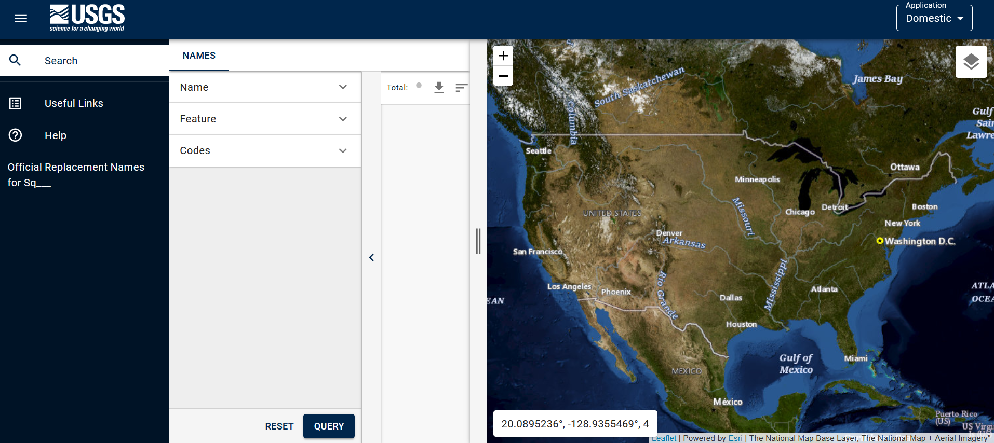
https://www.usgs.gov/tools/geographic-names-information-system-gnis
Notes:
October 10, 2023: updated screen shot and URL
Geographic Names Information System (GNIS): https://www.usgs.gov/tools/geographic-names-information-system-gnis
Base the preferred name for places in the United States on the form found in GNIS.

Slide 33
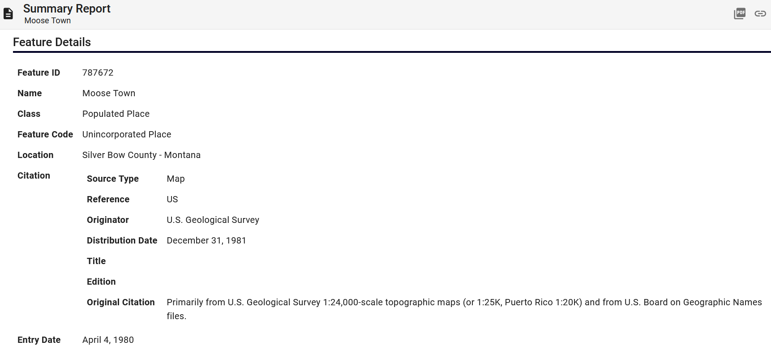
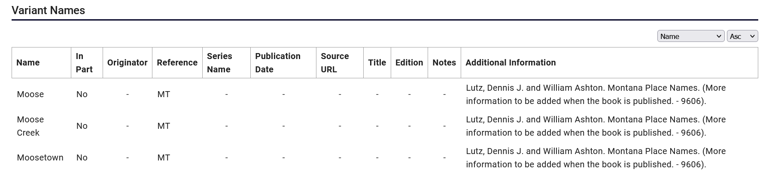
AUTHORIZED GNIS FORM
VARIANT FORMS
Notes:
October 10, 2023: Updated screen shot
GNIS record for a populated place in Montana. The record shows the authorized name (Moose Town) and several variant names (Moose, Moose Creek, and Moosetown).
If time permits and Internet access is available, have the trainees try searching a place in GNIS, to get some hands-on experience with the database. Or if access is available on the trainer’s computer, demonstrate a search.

Slide 34
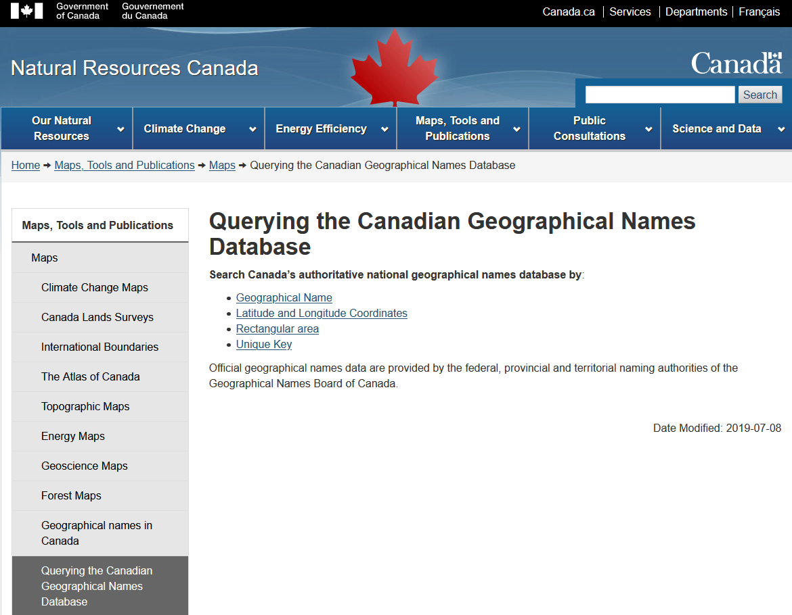
Notes:
March 4, 2020: updated screenshot
The Canadian Geographical Names Data Base is searchable at: http://www.nrcan.gc.ca/earth-sciences/geography/place-names/search/9170

Slide 35
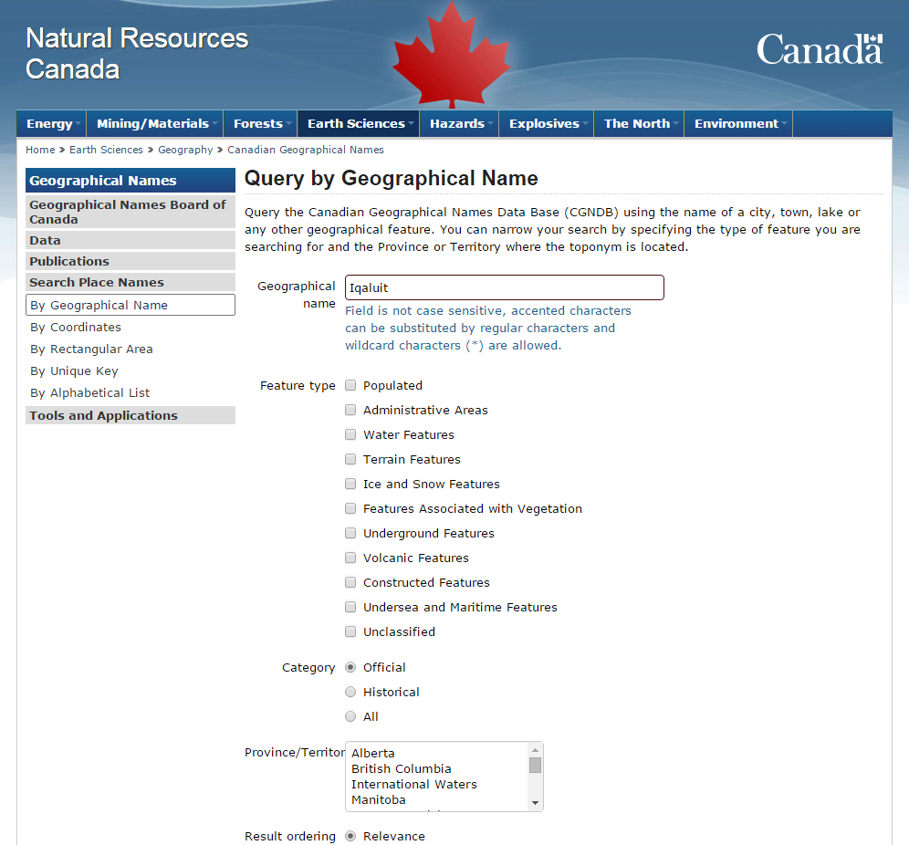
Notes:
November 25, 2015
This slide shows a search by geographical name for the name “Iqaluit.”

Slide 36
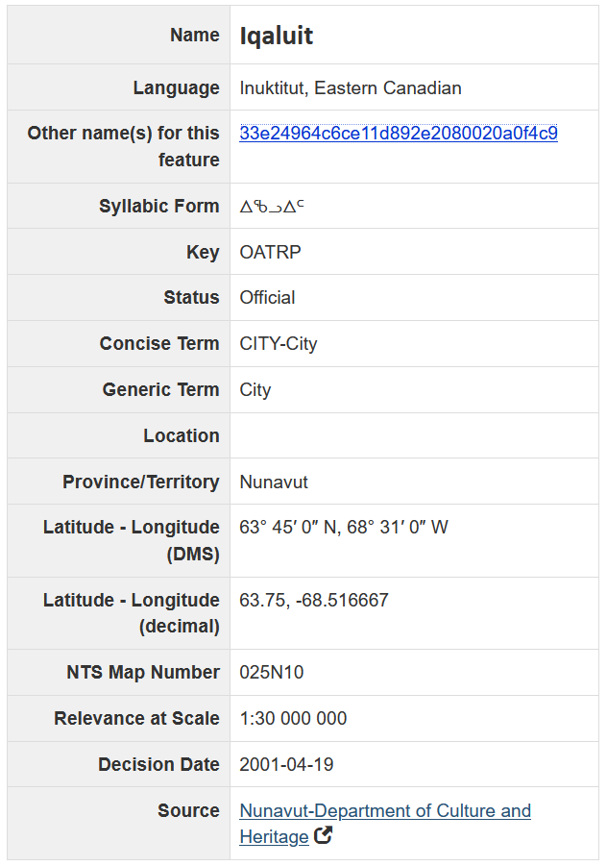
AUTHORIZED FORM
VARIANT FORM
(DIFFERENT SCRIPT)
Notes:
March 4, 2020: updated screenshot and notes
Results of searching the Canadian Geographical Names Data Base for a place in Nunavut. This record shows a different script form. These are treated as variant names in RDA (16.2.3.7). This particular script (Canadian Aboriginal syllabics) is not currently permitted in LC/NACO authority records. The only scripts currently allowed in NARs are those that represent the MARC-8 repertoire of UTF-8: Arabic, Chinese, Cyrillic, Greek, Hebrew, Japanese, and Korean. If the script form found here transliterates to a form that is different from the preferred name, it can be included as a variant access point.

Slide 37

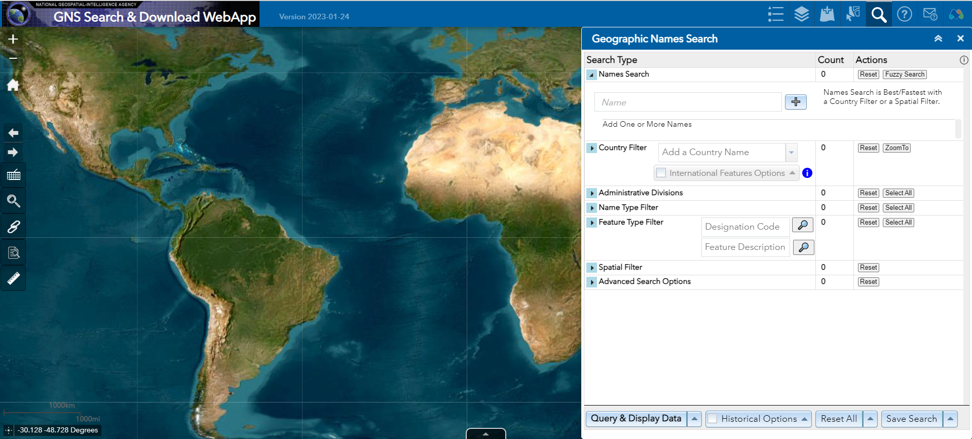
https://geonames.nga.mil/geonames/GeographicNamesSearch/
Notes:
October 10, 2023: updated screen shot and speaker notes
This resource is now known as Geographic Names Server (GNS). It was formerly referred to as the GEOnet Names Server (or just GEOnet). The Cartographic Data Source Code for it remains “geonet”.
Geographic Names Server home page: https://geonames.nga.mil/geonames/GeographicNamesSearch/. The site works best with Chrome and Edge browsers.
Cite in NARs as “GNS” or “Geographic names server”. When searching this database, the default is that all name types (conventional, approved, non-roman script, provisional, variant, et.) are selected for searching.
Priority order for selecting the preferred name is: choose a form in English if there is one in general use; choose conventional name over standard approved name; generally select the approved longer form over the short form (see later slides that cover this in more detail).

Slide 38
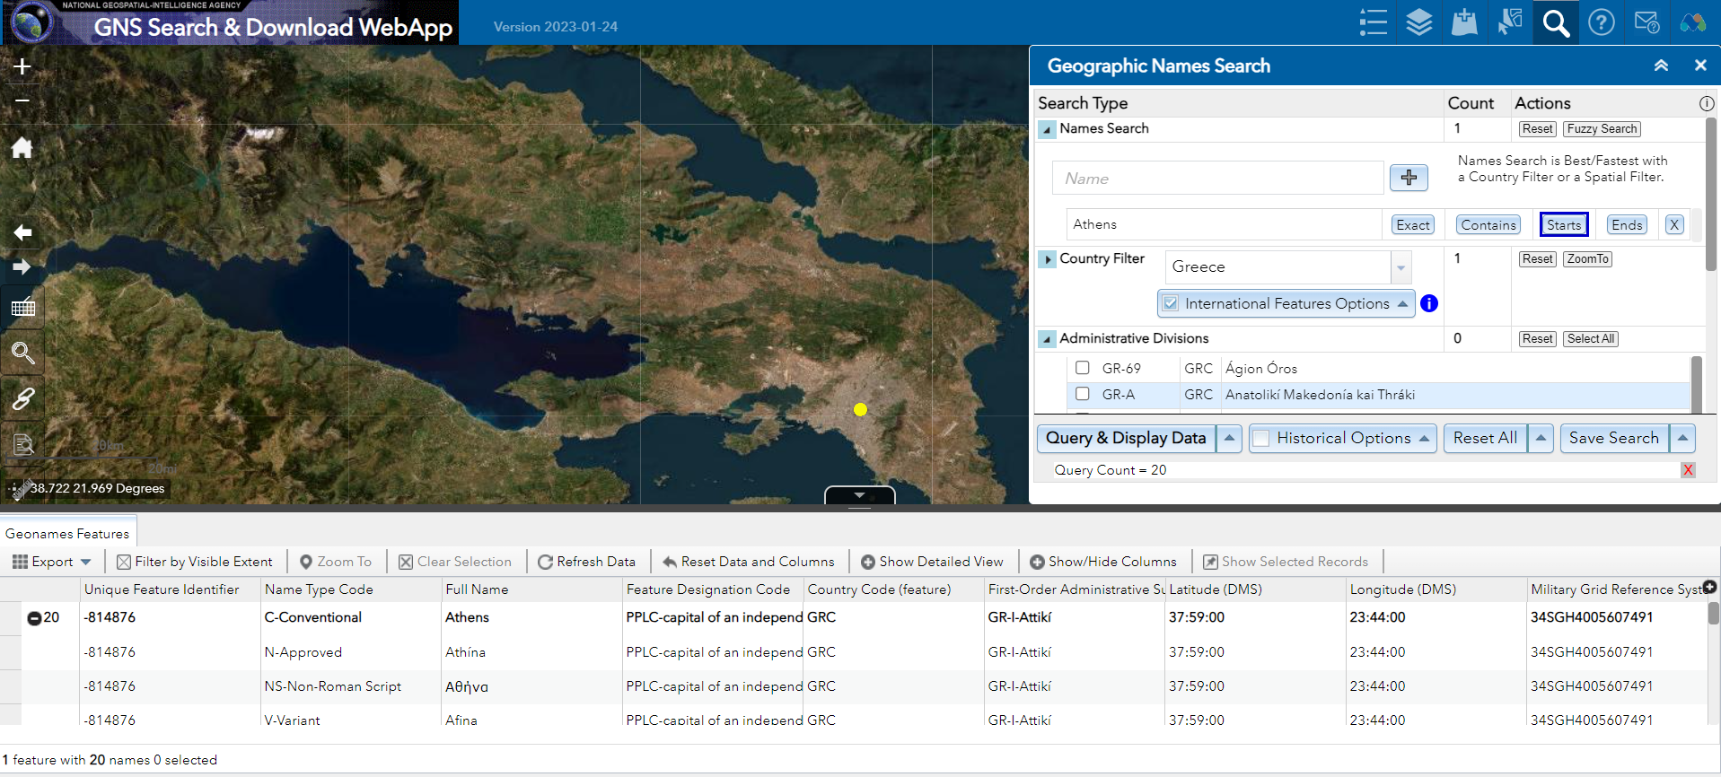
Form of name to use in preferred name of place is the conventional name: Athens
Numerous variant forms given in Latin and non-Latin scripts
Notes:
October 10, 2023: updated screen shot and speaker notes
Record for Athens, Greece in GNS. Note the many variant forms provided, including some in three non-Latin scripts (Greek, Cyrillic, and Arabic), all of which are permitted in LC/NACO authority records.
The form of name to use in the preferred name for the place is the one labeled as the “conventional” name: Athens. LC-PCC PS for 16.2.2.3 says to choose the conventional form over any other BGN-approved form of name.
If time permits and Internet access is available, have the trainees try searching a place in GNS, to get some hands-on experience with the database. Or if access is available on the trainer’s computer, demonstrate a search.

Slide 39
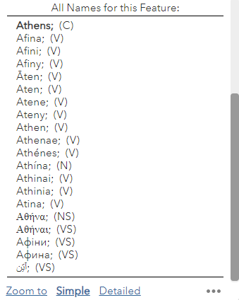
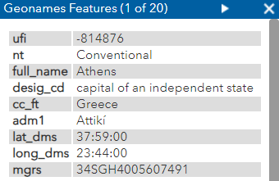
Name Type Codes:
C = Conventional
N = Approved
NS = Non-Roman Script
V = Variant
VS = Variant Non-Roman Script
Numerous variant forms given in Latin and non-Latin scripts
Notes:
October 10, 2023: updated screen shot and speaker notes
Record for Athens, Greece in GNS. Note the many variant forms provided, including some in three non-Latin scripts (Greek, Cyrillic, and Arabic), all of which are permitted in LC/NACO authority records.
The form of name to use in the preferred name for the place is the one labeled as the “conventional” name: Athens. LC-PCC PS for 16.2.2.3 says to choose the conventional form over any other BGN-approved form of name.
If time permits and Internet access is available, have the trainees try searching a place in GNS, to get some hands-on experience with the database. Or if access is available on the trainer’s computer, demonstrate a search.

Slide 40
Choosing the Preferred Name
(RDA 16.2.2.3 & 16.2.2.6)
Choose in this order:
  form of the name in the language preferred by the agency preparing the data, if there is one in general use
  form of the name in the official language of the jurisdiction in which the place is located
LC-PCC PS for 16.2.2.6: Choose a form of name in English if one is in general use, determining this from reference sources in English.
Notes:
May 1, 2013
16.2.2.6
Choose as the preferred name for a place a form in the language preferred by the agency preparing the data if there is one in general use. Determine this from gazetteers and other reference sources published in the language preferred by the agency. [For the NACO Program, the language preferred is English (LC-PCC PS 16.2.2.6).]
Austria not Österreich
Copenhagen not København
If the form of name for a place in the language preferred by the agency is the name of the government that has jurisdiction over the place, choose that form.
Soviet Union not Sovetskiĭ Soi͡uz not Russia
If there is no form in the language preferred by the agency in general use, choose the form in the official language of the jurisdiction in which the place is located.
Buenos Aires
Horlivka
Tallinn
Livorno not Leghorn (English form no longer in general use)
If the jurisdiction has more than one official language, choose the form most commonly found in sources in the language preferred by the agency.
Louvain not Leuven
Helsinki not Helsingfors
LC-PCC for 16.2.2.6 Choose a form of name in English if one is in general use, determining this from reference sources in English.

Slide 41
Choosing the Preferred Name
LC-PCC PS for 16.2.2.3:
– If the United States Board on Geographic Names (BGN) approves both a standard and a conventional form, use the conventional form
– Gives list of names for which an English form is used rather than a BGN-approved form
– If transliterating a place name, always use ALA-LC form of transliteration in the authorized access point. Warning: The BGN transliteration may not be the ALA-LC form
Notes:
May 1, 2013
October 10, 2023: moved example in speaker notes to new next slide
Third bullet: BGN doesn’t always follow ALA-LC romanization practices. Slavic place names in Cyrillic script are a very common example of this (see next slide).

Slide 42
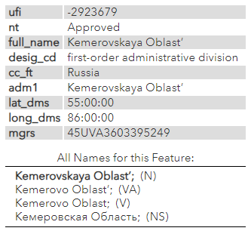
Choosing the Preferred Name
Warning: The BGN transliteration may not follow ALA-LC Romanization Tables
The ALA-LC romanization of Кемеровская Область is Kemerovskai͡a Oblastʹ. Follow ALA-LC for preferred name. A different BGN transliteration can be recorded as a variant.
Notes:
October 10, 2023: new slide
From GNS:
Kemerovskaya Oblastʹ (Approved)
Кемеровская Область (Non-Roman Script)
The ALA-LC romanization of the Cyrillic script is different from the BGN-approved form above: Kemerovskai︠a︡ Oblastʹ
In NAR:
151 Kemerovskai︠a︡ oblastʹ (Russia)
451 Kemerovskaya oblastʹ (Russia)
451 Кемеровская область (Russia)

Slide 43
Choosing the Preferred Name
LC-PCC PS for 16.2.2.3:
– If Geographic Names Server shows both a BGN approved and a BGN short form of the place name, generally select the longer form as the preferred name, unless RDA 16.2.2.8 is applicable (place names that begin with a term indicating type of jurisdiction and that are commonly listed under another part of the name)
Borno State (Approved); Borno (Short)
authorized access point: Borno State (Nigeria)
but
County Kerry (Approved); Kerry (Short)
authorized access point: Kerry (Ireland)
Notes:
March 21, 2017: updated RDA instruction number
Note to Instructor: RDA 16.2.2.8 is discussed in detail on upcoming slides.
16.2.2.8 Terms Indicating Type of Jurisdiction
If the first part of a place name is a term indicating a type of jurisdiction and the place is commonly listed under another part of its name in lists published in the language of the country in which it is located, omit the term indicating the type of jurisdiction.
Kerry (Ireland)
not County Kerry (Ireland)
Ostholstein (Germany)
not Kreis Ostholstein (Germany)
In all other cases, include the term indicating the type of jurisdiction.
Città di Castello (Italy)
Ciudad Juárez (Mexico)
District of Columbia
Distrito Federal (Brazil)

Slide 44
Choosing the Preferred Name - Initial Articles
LC-PCC PS for 16.2.2.4:
  Drop initial articles from the beginning of the first element of geographic names in Arabic and other languages employing the Arabic initial article
‘Aqabah (Jordan) not al-’Aqabah (Jordan)
  Also drop Hebrew and Yiddish initial articles
  Retain the initial article when the name is to be accessed under the initial article, regardless of language
  Y Felinheli (Wales) not Felinheli (Wales)
  Retain initial articles for non-English place names in English-speaking countries
Los Angeles (Calif.) not Angeles (Calif.)
  Drop all other initial articles
Dalles (Or.) not The Dalles (Or.)
Notes:
March 21, 2017: updated to reflect current policy statement
RDA 16.2.2.4 provides two alternatives for recording the preferred name of places that begin with articles. The basic rule says: “When recording the preferred name of a place, include an initial article if present.” The alternative says “Omit an initial article (see appendix C) unless the name is to be accessed under the article.” NACO libraries will be doing a little bit of both, by following the LC-PCC PS for 16.2.2.4:
LC-PCC PS for 16.2.2.4 Initial Articles
Drop initial articles from the beginning of the first element of geographic names in Arabic and other languages employing the Arabic initial article. Similarly, drop Hebrew and Yiddish initial articles. Retain the initial article when the name is to be accessed under the initial article, regardless of language (e.g., “Los Angeles”). Retain initial articles for non-English place names in English-speaking countries. Drop all other initial articles (e.g., drop “The” from “The Dalles”).
Note: 16.2.3.4 instructs that if the initial article was retained in the authorized access point, a variant access point may be made without the initial article. If the initial article was dropped from the authorized access point, a variant access point with the initial article may be made.

Slide 45


Choosing the Preferred Name
- Mounts and Saints
LC-PCC PS for 16.2.2.3:
  Mount/Mt.
  Always use the spelled-out form “Mount” even if “Mt.” appears on the resource being cataloged or in other sources
  Saint/St.
  Places or jurisdictions in the United Kingdom and the Republic of Ireland: prefer the abbreviation “St.”
  Places or jurisdictions in Canada: use the approved form found in Canadian Geographical Names Data Base
  Places in other countries: Always used the spelled-out form “Saint” even if “St.” appears on the resource being cataloged or in other sources
Notes:
March 7, 2019: revised note about Canada
LC-PCC PS for 16.2.2.3 gives instructions on places with the word Mount or its abbreviation and Saint or its abbreviation.
Always use “Mount” in the preferred name. If you have a usage with the abbreviated form, record that as a variant name.
For the U.K. and Ireland, prefer the abbreviation “St.” over the spelled-out form. Provide a variant access point for the spelled out.
For Canada, use the approved form found in Canadian Geographical Names Data Base (http://www4.rncan.gc.ca/search-place-names/search?lang=en). Catalogers may also wish to check Canadiana Authorities online or VIAF to see if Library and Archives Canada has established the place and use those resources as additional reference sources. However, according to the LAC website, Library and Archives Canada (LAC) will no longer be updating the Canadiana database and the site will no longer be searchable after March 2019. LAC stopped creating new authorities in AMICUS in September 2018 and will resume creating English-language authorities in the Name Authority Cooperative Program (NACO) file; French-language authorities will be created in a separate file. (Note: AACR2/LCRI practice was to use the form established by LAC and to have LAC verify the form of any newly created corporate body and jurisdiction headings that they had not yet established. This is no longer the policy. NACO libraries, including Library and Archives Canada, follow RDA and the LC-PCC Policy Statements)
For everywhere else, always use the spelled-out form “Saint” in the preferred name. If there is usage for the abbreviated form, provide a variant access point for it.
[Sources: City of Mt. Healthy logo: http://www.mthealthy.org/. City of St. Louis banner: http://stlouis-mo.gov/]

Slide 46
Recording the Preferred Name
(RDA 16.2.2.4)
Record as part of the name of a place (other than a country or a state, etc., listed in 16.2.2.9.1, 16.2.2.10, or 16.2.2.11) the name of the larger place in which it is located or the larger jurisdiction to which it belongs
  For Coles County also record Ill.
  For Budapest also record Hungary
  For Toronto also record Ont.
  For Edinburgh also record Scotland
USE ABBREVIATIONS FOR LARGER PLACE FROM APPENDIX B.11
Notes:
May 1, 2013
Note that when you are recording the name of the larger place, you must apply appendix B.11 and use the abbreviation found there for the place:
B.11
Use the abbreviations in table B.1 for the names of certain countries and of the names of states, provinces, territories, etc., of Australia, Canada, and the United States when the names are recorded:
a) as part of the name of a place located in that state, province, territory, etc. (see 16.2.2.9) or other jurisdiction (see 16.2.2.11)
b) as the name or part of the name of a place associated with a person (see 9.8-9.11) family (see 10.5), or corporate body (see 11.3).
The following four slides cover the detailed instructions (16.2.2.9-16.2.2.12) on when and when not to record the name of a larger jurisdiction associated with a place.

Slide 47
Australia, Canada, U.S., former U.S.S.R, and former Yugoslavia (16.2.2.9)
States, provinces, territories, etc. or constituent countries: Do not record the name of the larger jurisdiction
Delaware Yukon Queensland
Places in states, provinces, territories, etc. or constituent countries: Record the name of the state, province, etc. Abbreviate per B.11
Kent County (Del.) Whitehorse (Yukon)
Brisbane (Qld.) Kiev (Ukraine)
Notes:
May 1, 2013
For states, provinces, territories, etc. in Australia, Canada, and the U.S., for the constituent republics of the former Soviet Union and Yugoslavia, do not record the name of the larger jurisdiction:
Delaware not Delaware (U.S.)
Yukon not Yukon (Canada)
Queensland not Queensland (Australia)
Ukraine not Ukraine (U.S.S.R.)
Slovenia not Slovenia (Yugoslavia)
This rule also covers overseas territories of the U.S. (there is a reference from 16.2.2.11 to 16.2.2.9.1):
Puerto Rico not Puerto Rico (U.S.)
Guam not Guam (U.S.)
For places within these states, provinces, territories, etc. of Australia, Canada, and the U.S., and places within the constituent republics of the former Soviet Union and Yugoslavia, record the name of the state, province, territory, etc. or constituent republic. Use abbreviations for the larger place found in B.11.
Kent County (Del.)
Whitehorse (Yukon)
Brisbane (Qld.)
Kiev (Ukraine)
Bled (Slovenia)
San Juan (P.R.)
Andersen Air Force Base (Guam)

Slide 48
England, Northern Ireland, Scotland, and Wales (16.2.2.10)
Constituent countries of the United Kingdom: Do not record the name of the larger jurisdiction
England not England (Great Britain)
Places in constituent countries: Record the name of the constituent country
Hampshire (England)
Glasgow (Scotland)
Cardiff (Wales)
Belfast (Northern Ireland)
Notes:
May 1, 2013

Slide 49
Overseas Territories, Dependencies, Etc. (16.2.2.11)
Overseas territories, dependencies, etc.: Do not record the name of the larger jurisdiction
Greenland not Greenland (Denmark)
New Caledonia not New Caledonia (France)
Aruba not Aruba (Netherlands)
Isle of Man not Isle of Man (Great Britain)
Places in overseas territories, dependencies, etc.: Record the name of the overseas territory, dependency, etc.
Nuuk (Greenland)
Nouméa (New Caledonia)
Oranjestad (Aruba)
Papeete (French Polynesia)
Notes:
May 1, 2013
For overseas territories of the U.S. (e.g., Guam, Puerto Rico), see 16.2.2.9.1.

Slide 50
Everywhere Else (16.2.2.12)
For places in jurisdictions everywhere else (except Malaysia): Record the name of the country in which the place is located. Abbreviate country names per B.11
Buenos Aires (Argentina)
Paris (France)
Vladivostok (Russia)
Copperbelt Province (Zambia)
Wellington (N.Z.)
Seoul (Korea)
Notes:
August 13, 2019: added “(except Malaysia)” to slide
Note that terms for type of jurisdiction (e.g., Federation) and other distinguishing characteristics (e.g., South) are not included in the qualifier. Only the preferred name for the larger place is used, not the authorized access point. Vladivostok (Russia) and Seoul (Korea) illustrate this in this slide (see also slide 50).

Slide 51
Malaysia (LC-PCC PS for 16.2.2.12)
Apply the alternative in 16.2.2.12 (to record the name of a state, province, or highest-level administrative division preceding the name of the country) only to places in Malaysia.
Segamat (Johor, Malaysia)
Jasin (Malacca, Malaysia)
Port Dickson (Negeri Sembilan, Malaysia)
Ipoh (Perak, Malaysia)
George Town (Pulau Pinang, Malaysia)
Kota Kinabalu (Sabah, Malaysia)
Bintulu (Sarawak, Malaysia)
Notes:
August 13, 2019
There is an alternative in 16.2.2.12 to record the name of a state, province, or highest-level administrative division preceding the name of the country. LC/PCC policy for this alternative is to apply it only to Malaysia (LC-PCC PS for 16.2.2.12, May 2013). For example:
Segamat (Johor, Malaysia) [town of Segamat, located in the state of Johor]
Jasin (Malacca, Malaysia) [town of Jasin, located in the state of Malacca]
Port Dickson (Negeri Sembilan, Malaysia) [town of Port Dickson, located in the state of Negeri Sembilan]
Ipoh (Perak, Malaysia) [city of Ipoh, located in the state of Perak]
George Town (Pulau Pinang, Malaysia) [city of George Town, the capital of the state of Pulau Pinang]
Kota Kinabalu (Sabah, Malaysia) [city of Kota Kinabalu, located in state of Sabah]
Bintulu (Sarawak, Malaysia) [city of Bintulu, located in the state of Sarawak]
There are 13 states in Malaysia: Johor, Kedah, Kelantan, Melaka, Negeri Sembilan, Pahang, Perak, Perlis, Pulau Pinang, Sabah, Sarawak, Selangor, Terengganu; and 1 federal territory (Wilayah Persekutuan) with 3 components, Kuala Lumpur, Labuan, and Putrajaya.

Slide 52
Form of Larger Place
LC-PCC PS 16.2.2.4
Do not include a term for type of jurisdiction or other designation when larger place is added to the smaller place
Albany (N.Y.) not Albany (N.Y. (State))
Moscow (Russia) not Moscow (Russia (Federation))
T’bilisi (Georgia) not T’bilisi (Georgia (Republic))
Seoul (Korea) not Seoul (Korea (South))
Kinkala (Congo) not Kinkala (Congo (Brazzaville))
Kinshasa (Congo) not Kinshasa (Congo (Democratic Republic))
Notes:
May 1, 2013
LC practice/PCC practice: If the heading for the larger place being added to the smaller place is created according to the provisions of RDA 11.13.1.6 (type of jurisdiction) or RDA 11.13.1.7 (other designation associated with the body), do not include the term for type of jurisdiction or the other designation associated with the body.

Slide 53
Recording Preferred Name
(RDA 16.2.2.4)
If the place name is being used as the conventional name for a government (see 11.2.2.5.4), enclose the name of the larger place in parentheses
  Budapest (Hungary)
  Toronto (Ont.)
  Edinburgh (Scotland)
RDA: If the place name is being used to record the location of a conference, etc., (see 11.3.2), the location of the headquarters of a corporate body (see 11.3.3), the place of origin of a work (see 6.5), or a place associated with a person (see 9.8-9.11), family (see 10.5), or corporate body (see 11.3), precede the name of the larger place by a comma
  Budapest, Hungary
  Toronto, Ont.
  Edinburgh, Scotland
BUT, PCC policy is to record this element using the authorized form of the name
370 $e Budapest (Hungary) $2 naf
Notes:
February 24, 2014
Note that when you are recording the name of the larger place, you must apply appendix B.11 and use the abbreviation found there for the place:
B.11
Use the abbreviations in table B.1 for the names of certain countries and of the names of states, provinces, territories, etc., of Australia, Canada, and the United States when the names are recorded:
a) as part of the name of a place located in that state, province, territory, etc. (see 16.2.2.9) or other jurisdiction (see 16.2.2.11)
b) as the name or part of the name of a place associated with a person (see 9.8-9.11) family (see 10.5), or corporate body (see 11.3).

Slide 54
Places Recorded in NARs
110 2_ Beth Tikvah Synagogue (Toronto, Ont.)
370 $e Toronto (Ont.) $2 naf
111 2_ RSKT (Conference) $n (2nd : $d 2007 : $c Toronto, Ont.)
370 $e Toronto (Ont.) $2 naf
130 _0 Signature series (Toronto, Ont.)
370 $g Toronto (Ont.) $2 naf
NAR for the jurisdiction:
151 Toronto (Ont.)
and
100 1_ Gould, Glenn
370 Toronto (Ont.) $b Toronto (Ont.) $2 naf
Notes:
May 15, 2014
In the geographic place (jurisdiction) name authority record, the name of the larger place will be recorded in parentheses.
In the 370 field attribute for the associated place, use the authorized access point form found in the authority record in the LC/NAF.
If no authorized access point exists in the LC/NACO Authority File for the place, it is not necessary to create a NAR in order to code the 370 field. Use the RDA preferred name for the place, but note that when there is no authorized source, a subfield $2 cannot be added.
370 subfields used in the examples in this slide:
$a Place of birth
$b Place of death
$e Place of residence/Location of headquarters [includes location of conference]
$g Place of origin of work

Slide 55
Places Recorded in NARs
NAR for the jurisdiction:
151 Russia (Federation)
Form of name in 370:
370 $c Russia (Federation) $2 naf
As an addition in an access point: Russia
110 2_ Pervyĭ kadetskīĭ korpus (Russia)
As part of preferred name of a local place: Russia
151 Moscow (Russia)
NAR for the jurisdiction:
151 Korea (South)
Form of name in 370:
370 $c Korea (South) $2 naf
As an addition in an access point: Korea
110 2_ Hyŏ̆ndae Ilbon Yŏn’guhoe (Korea)
As part of preferred name of a local place: Korea
151 Ich’ŏ̆n-si (Korea)
Notes:
November 25, 2015: no change in content; change in formatting of slide only
Note: The form of place name in 370 may differ from the form of place name added to a preferred name of place or an access point per RDA and LC-PCC PS instruction (updated in Nov. 2013)

Slide 56
Recording Preferred Name - Place Names for Jurisdictions
(RDA 16.2.2.8)
If the first part of a place name is a term indicating a type of jurisdiction and the place is commonly listed under another part of its name in lists published in the language of the country in which it is located, omit the term indicating the type of jurisdiction
Kerry (Ireland) not County Kerry (Ireland)
Ostholstein (Germany) not Kreis Ostholstein (Germany)
  but
Città di Castello (Italy)
Ciudad Juárez (Mexico)
District of Columbia
Distrito Federal (Brazil)
Notes:
December 13, 2016: RDA instruction number corrected

Slide 57
Recording Preferred Name - Place Names for Jurisdictions
(RDA 16.2.2.8)
If a place name other than the name for a city or town does not include a term indicating a type of jurisdiction, and the place name is being used as the conventional name for a government, apply the instructions given under 11.13.1.6.
11.13.1.6: Add a term designating the type of jurisdiction to the name of a government other than a city or a town (see 11.7.1.5), if necessary, to distinguish between access points for two or more governments that have the same name, or names so similar that they may be confused.
Notes:
December 13, 2016: RDA instruction number corrected in header, speaker notes modified to account for the deletion from RDA of 16.2.2.8.2
11.13.1.6 tells us that we do not add a term for type of jurisdiction for cities and towns. Terms for type of jurisdiction are only added to jurisdictions at higher political/administrative levels than cities and towns (e.g., counties, districts, states, provinces, regions) or places within a city or town (e.g., neighborhoods, parishes, historic districts, special zones, etc.). If two or more places have the same name in the same larger jurisdiction, 16.2.2.13 applies, and the conflict is usually broken by adding the name of an appropriate smaller place before the name of the larger place.
11.7.1.5, to which 11.13.1.6 refers, gives instructions for recording the type of jurisdiction as an element. This element can be recorded for any jurisdiction, including cities and towns (MARC 368 $b).
If needed in the authorized access point under 11.13.1.6, record the type of jurisdiction for a government other than a city or a town in the language preferred by the agency creating the data. If there is no equivalent term for the type of jurisdiction in the language preferred by the agency, or in case of doubt, record it in the official language of the jurisdiction.
LC-PCC PS for 11.7.1.5: Record the type of jurisdiction in English. If there is no equivalent term for the type of jurisdiction in the language preferred by the agency, or in case of doubt, record it in the official language of the jurisdiction. Descriptive Cataloging Manual Z1, 368 says to prefer controlled vocabulary for terms describing type of jurisdiction. Controlled vocabulary is not used when type of jurisdiction is recorded under 11.13.1.6 as part of the authorized access point. This means the term recorded as an 11.7.1.5 element (in MARC 368 $b) might not be the same as the term recorded in the authorized access point.
Common types of jurisdictions recorded in the preferred name as a qualifier: District; County; State; Province; Republic; Kingdom; Duchy; Town*; Township*
* See LC-PCC PS for 16.4, covered in an upcoming slide. In this case “town” and “township” refer to jurisdictions below the county level in many U.S. states made up of multiple local places.

Slide 58
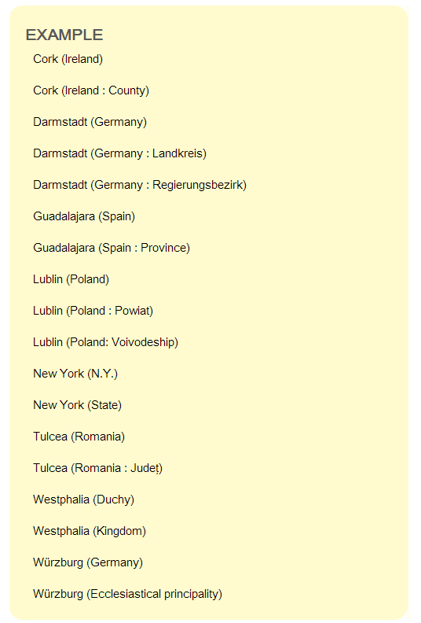
RDA 11.13.1.6 Type of Jurisdiction
151 Cork (Ireland : County)
368 $b Counties $2 lcsh
151 Guadalajara (Spain : Province)
368 $b Provinces $2 aat
151 Lublin (Poland : Powiat)
368 $b Powiat
151 Lublin (Poland : Voivodeship)
368 $b Polish voivodeships $2 lcsh
151 Westphalia (Duchy)
368 $b Duchies $2 lcsh
151 Westphalia (Kingdom)
368 $b Kingdoms (political administrative bodies) $2 aat
Notes:
December 14, 2016
This slide shows authorized access points for places for which a term for type of jurisdiction is added to differentiate the place from another with the same name. When recorded as a separate element, the type of jurisdiction is put in MARC field 368, subfield $b. Note: DCM Z1 says to “Prefer controlled vocabulary for terms, recording the source in subfield $2.” See next two slides for more examples showing this. If there is no controlled term, the term should be recorded in the singular (see the Powiat example)
11.7.1.5, to which 11.13.1.6 refers, gives instructions for recording the type of jurisdiction as an element. This element can be recorded for any jurisdiction, including cities and towns (MARC 368 $b).
If needed in the authorized access point under 11.13.1.6, record the type of jurisdiction for a government other than a city or a town in the language preferred by the agency creating the data. If there is no equivalent term for the type of jurisdiction in the language preferred by the agency, or in case of doubt, record it in the official language of the jurisdiction.
LC-PCC PS for 11.7.1.5: Record the type of jurisdiction in English. If there is no equivalent term for the type of jurisdiction in the language preferred by the agency, or in case of doubt, record it in the official language of the jurisdiction. Descriptive Cataloging Manual Z1, 368 says to prefer controlled vocabulary for terms describing type of jurisdiction. Controlled vocabulary is not used when type of jurisdiction is recorded under 11.13.1.6 as part of the authorized access point. This means the term recorded as an 11.7.1.5 element (in MARC 368 $b) might not be the same as the term recorded in the authorized access point.
The slide illustrates instances where there is no good English term for the type of jurisdiction, so the term in the official language of the jurisdiction is used instead: Landkreis; Regierungsbezirk; Powiat; Judet. Other common ones in use are Amphoe [Thailand jurisdiction]; Arrondissement [French jurisdiction]; Oblast [jurisdiction in many East European countries].
Common types of English-language jurisdictions recorded in the preferred name as a qualifier: Town*; Township*; District; County; Parish; State; Province; Canton; Region; Republic; Kingdom; Duchy; Principality
* See LC-PCC PS for 16.4, covered in an upcoming slide. In this case “Town” and “Township” as a qualifier refer to jurisdictions below the county level in many U.S. states made up of multiple local places.
Even if a term for type of jurisdiction is not needed in an access point, one or more can be recorded in the 368 field. The cataloger has the choice of recording it in singular form if the term does not come from any controlled vocabulary, or in plural if the term is found in a controlled vocabulary that uses plural forms.
Examples: City [uncontrolled] vs. Cities and towns [LCSH form]; Duchy [uncontrolled] vs. Duchies [LCSH form]; Village [uncontrolled] vs. Villages [LCSH form]; Country or Nation [both uncontrolled - no equivalent in LCSH];
Tribe or Indian tribe or First Nation or Indian band [all uncontrolled - no exact equivalent in LCSH or Canadian Subject Headings, although LCSH does have “Federally recognized Indian tribes”]

Slide 59
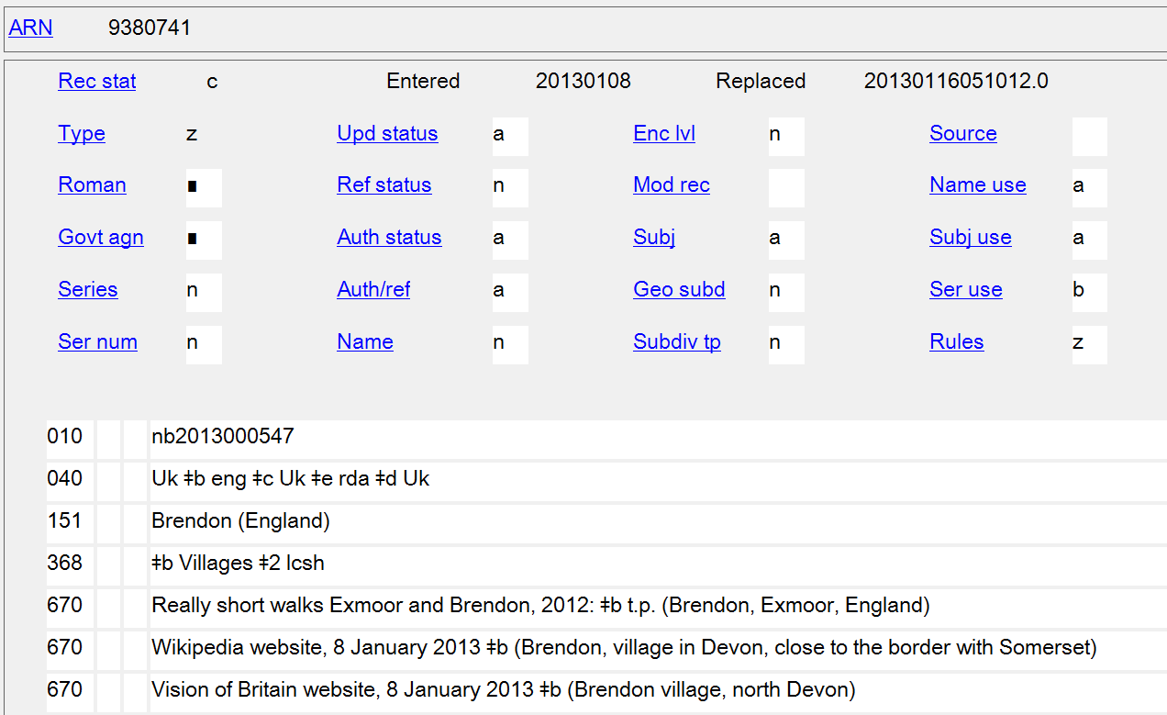
11.7.1.5 Type of Jurisdiction
Notes:
May 1, 2013
Type of jurisdiction may be recorded as a separate element even if it is not needed in the authorized access point. The following examples follow the DCM Z1 instruction for field 368 to “Prefer controlled vocabulary for terms, recording the source in subfield $2.”

Slide 60
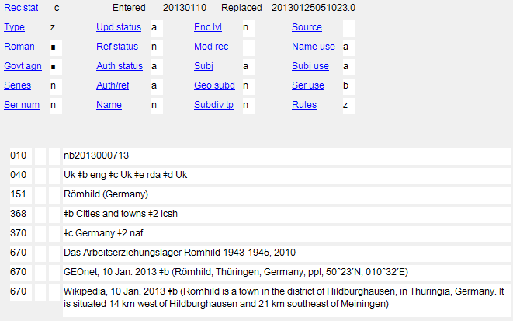
11.7.1.5 Type of Jurisdiction
Notes:
February 24, 2014

Slide 61
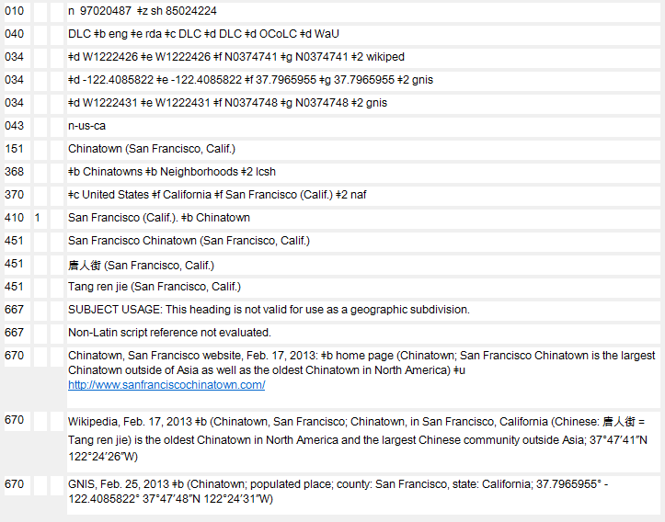
11.7.1.5 Type of Jurisdiction
Notes:
November 25, 2015: highlight box moved to show field 368
Multiple types of jurisdiction may be recorded as attributes if applicable and appropriate.

Slide 62
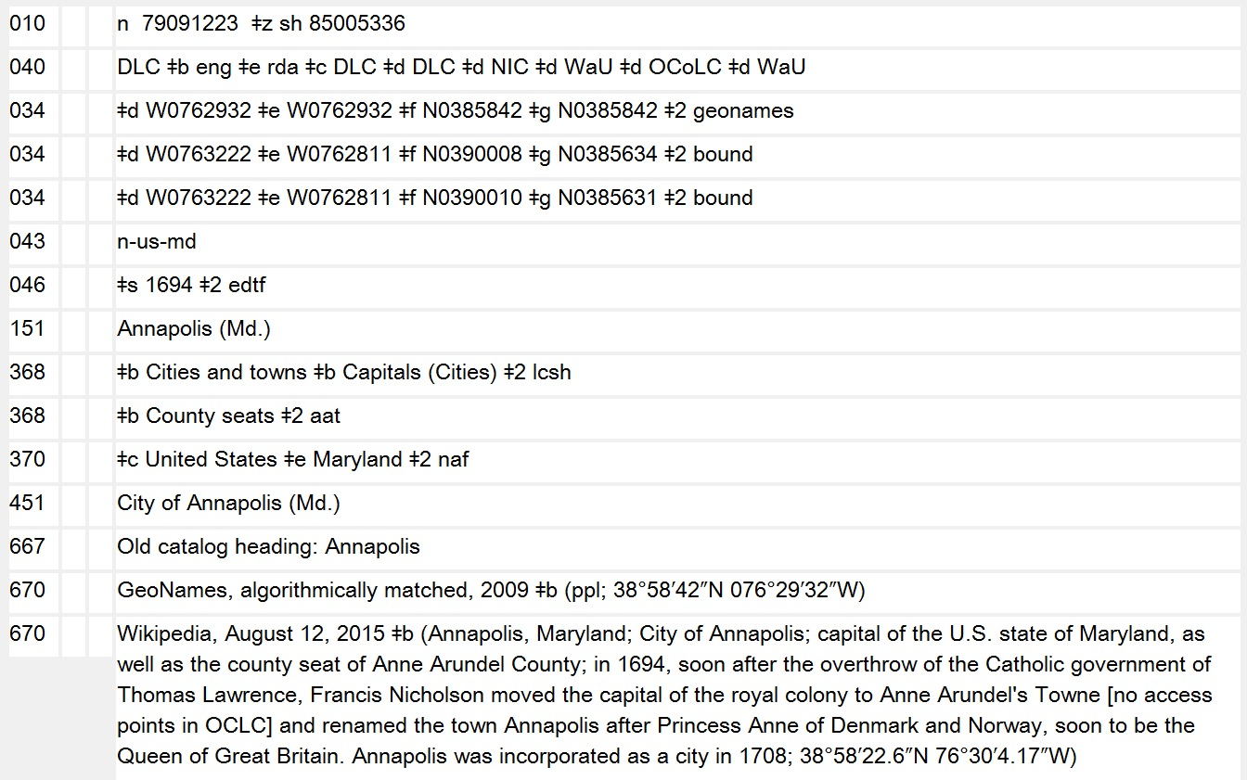
11.7.1.5 Type of Jurisdiction
Notes:
August 13, 2019
If the terms for types of jurisdiction come from different thesauri/controlled vocabularies, the field must be repeated.

Slide 63
LC-PCC PS for 16.4
Townships and towns in U.S. (entities that encompass one or more local communities and surrounding territory)
  Generally, do not include the term “township” or “town” as part of the name. Instead, add the term after the name of the state.
  Apply LC-PCC PS for 16.2.2.13 if more than one township with same name in same state
Notes:
March 21, 2017: updated to reflect current LC-PCC PS, revised speaker notes
LC-PCC PS for 16.4
U.S. Townships
For U.S. townships (called “towns” in some states) that encompass one or more local communities and the surrounding territory, apply RDA 16.2.2.8 to determine whether the term “township” or “town” should be included as part of the name. If such a term is not included in the name, add the term after the name of the state, etc. in the authorized access point. Generally consider U.S. townships listed in GNIS in the form “Township of” or “Town of” to fall under the first condition in RDA 16.2.2.8 and establish them without the first part of the name indicating a type of jurisdiction.
If the jurisdictional term is not part of the preferred name, add it as an addition to the authorized access point.
EXAMPLE
BGN GNIS: Township of Kintire
151 ## $a Kintire (Minn. : Township)
BGN GNIS: Town of Milo
151 ## $a Milo (Me. : Town)
[No longer included in LC-PCC PS 16.4.] These non-local jurisdictions are called “townships” in Arkansas, California, Illinois, Indiana, Iowa, Kansas, Michigan, Minnesota, Missouri, Nebraska, New Jersey, North Carolina North Dakota, Ohio, Pennsylvania, and South Dakota; they are called “towns” in Connecticut, Maine, Massachusetts, New Hampshire, New York, Rhode Island, Vermont, and Wisconsin.

Slide 64
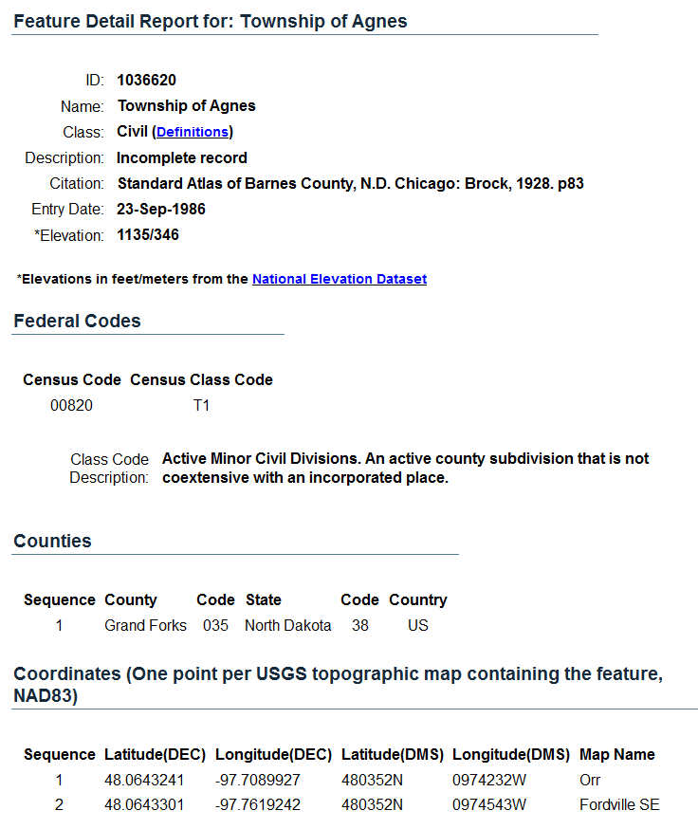
GNIS Record for a Township
Notes:
May 1, 2013
Screen shot of a record for the Township of Agnes in North Dakota. Note that the class code description indicates that this is a county subdivision that is not coextensive with an incorporated place.

Slide 65
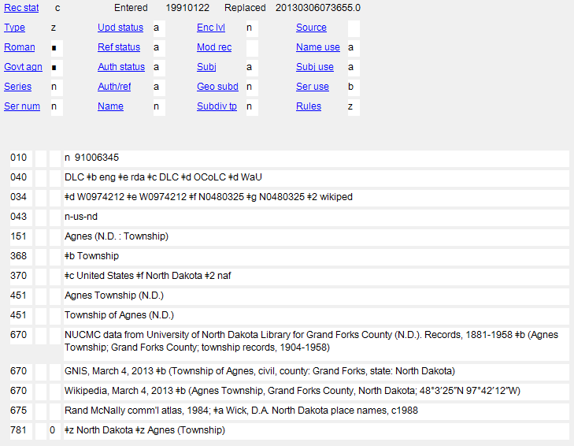
Notes:
February 24, 2014

Slide 66
Exercises
Choosing and Recording the Preferred Name
Notes:
May 1, 2013

Slide 67
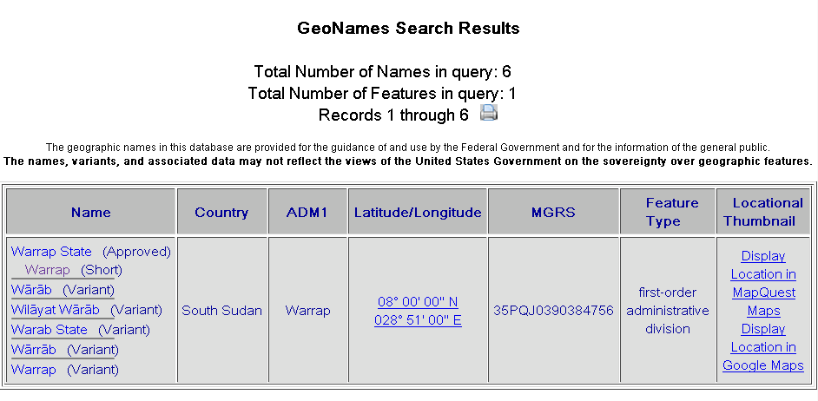
Choosing the Preferred Name
What form of this place name will be recorded in the preferred name?
Preferred name: Warrap State (South Sudan)
Notes:
March 21, 2017: corrected RDA instruction number in speaker notes
ANIMATED SLIDE
Answer:
Form of place name recorded in the preferred name: Warrap State
Preferred name: Warrap State (South Sudan)
Why?: LC-PCC PS for 16.2.2.3 says that if Geographic Names Server shows both a BGN approved and a BGN short form of the place name, generally select the longer form as the preferred name (unless RDA 16.2.2.8 is applicable, which in this case it isn’t). Reminder: According to 16.2.2.4, the preferred name for the place (other than a country, state, etc. listed in 16.2.2.9.1, 16.2.2.10, or 16.2.2.11) includes the name of the larger place in which it is located or the larger jurisdiction to which it belongs. If the place name is being used as the conventional name for a government, the name of the larger place is enclosed in parentheses. The authorized access point for the larger place (country) in question is South Sudan.
Access point for the place (assuming no conflict): Warrap State (South Sudan)

Slide 68
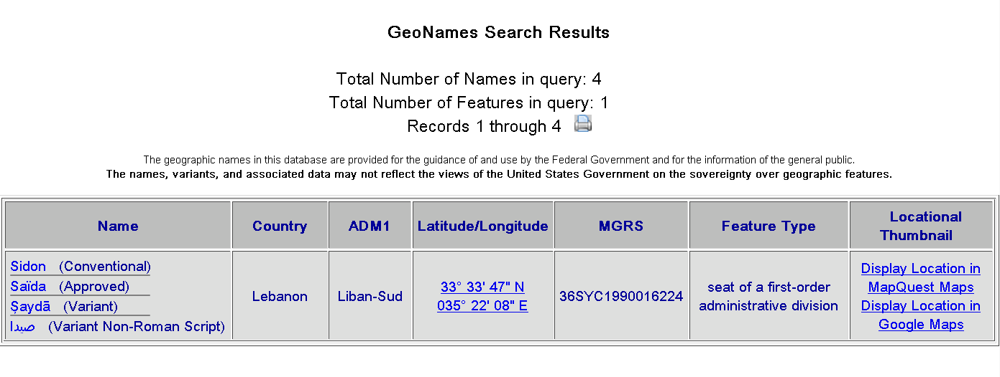
Choosing the Preferred Name
What form of this place name will be recorded in the preferred name?
Preferred name: Sidon (Lebanon)
Notes:
March 12, 2014
ANIMATED SLIDE
Answer:
Form of place name recorded in the preferred name: Sidon
Preferred name: Sidon (Lebanon)
Why?: LC-PCC PS for 16.2.2.3 says if the United States Board on Geographic Names (BGN) approves both an approved and a conventional form, use the conventional form. Reminder: According to 16.2.2.4, the preferred name for the place (other than a country, state, etc. listed in 16.2.2.9.1, 16.2.2.10, or 16.2.2.11) includes the name of the larger place in which it is located or the larger jurisdiction to which it belongs. If the place name is being used as the conventional name for a government, the name of the larger place is enclosed in parentheses. The authorized access point for the larger place (country) in question is Lebanon.
Access point for the place (assuming no conflict): Sidon (Lebanon)

Slide 69
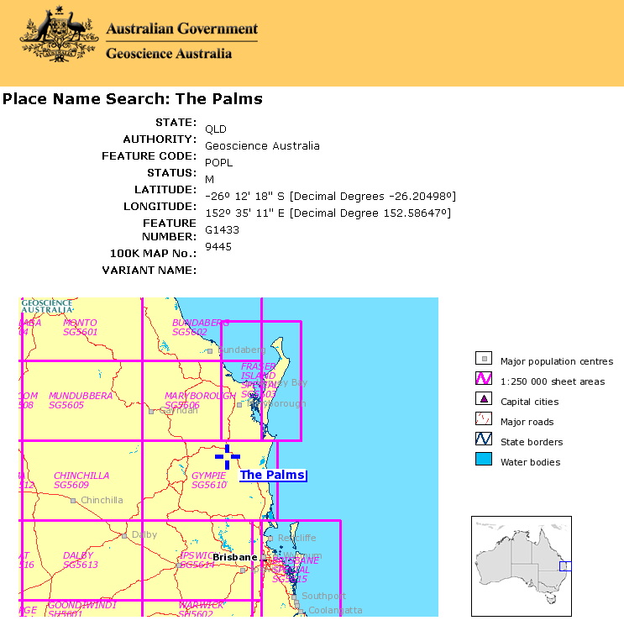
Choosing the Preferred Name
What is the preferred name for this place based on the reference source shown?
Preferred name: Palms (Qld.)
Notes:
March 21, 2017: corrected LC-PCC PS number in speaker notes
ANIMATED SLIDE
Answer:
Preferred name: Palms (Qld.)
Why?: LC-PCC PS for 16.2.2.4 says to drop the initial article in a name like this. Reminder: According to 16.2.2.4, the preferred name for the place (other than a country, state, etc. listed in 16.2.2.9.1, 16.2.2.10, or 16.2.2.11) includes the name of the larger place in which it is located or the larger jurisdiction to which it belongs. If the place name is being used as the conventional name for a government, the name of the larger place is enclosed in parentheses. 16.2.2.9.2 says to abbreviate the name of the larger place as instructed in Appendix B (B.2) and B.2 refers catalogers to B.11 (Names of Certain Countries, States, Provinces, Territories, Etc.). The abbreviation found in B.11 for Queensland is Qld.
Access point for the place (assuming no conflict): Palms (Qld.)

Slide 70
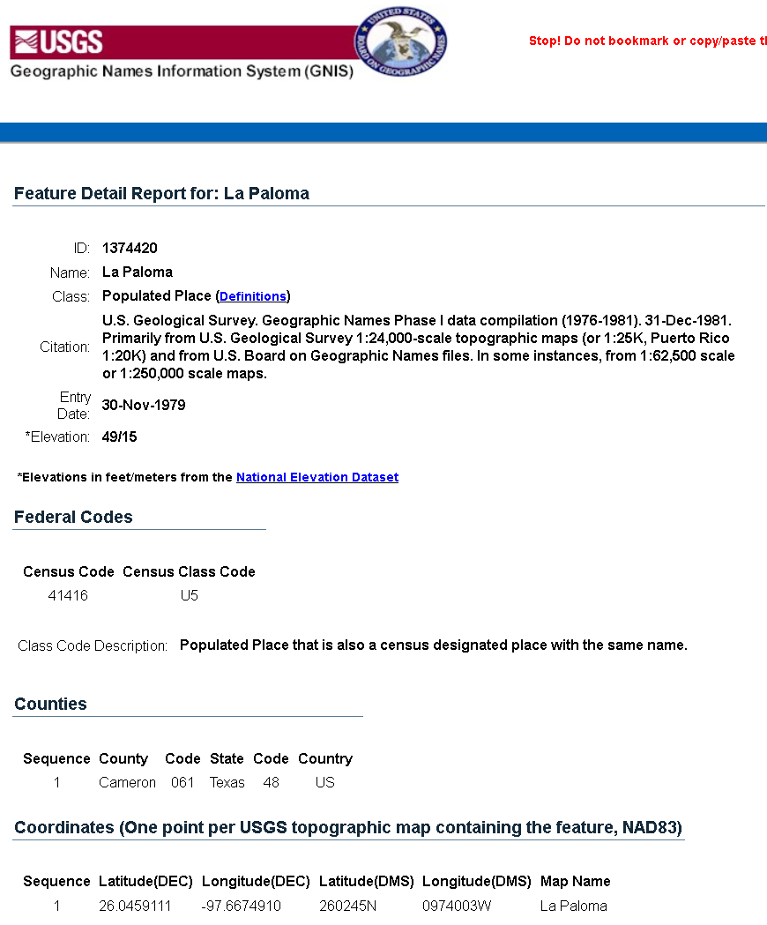
Choosing the Preferred Name
What is the preferred name for this place based on the reference source shown?
Preferred name: La Paloma (Tex.)
Notes:
March 21, 2017: corrected LC-PCC PS 16.2.2.4 number and text in speaker notes
ANIMATED SLIDE
Answer:
Preferred name: La Paloma (Tex.) Note: La Paloma means “The Dove” in English.
Why?: LC-PCC PS for 16.2.2.4 says to retain the initial article when the name is to be accessed under the initial article, regardless of language (e.g., “Los Angeles”). Retain initial articles for non-English place names in English-speaking countries.
Reminder: According to 16.2.2.4, the preferred name for the place (other than a country, state, etc. listed in 16.2.2.9.1, 16.2.2.10, or 16.2.2.11) includes the name of the larger place in which it is located or the larger jurisdiction to which it belongs. If the place name is being used as the conventional name for a government, the name of the larger place is enclosed in parentheses. 16.2.2.9.2 says to abbreviate the name of the larger place as instructed in Appendix B (B.2) and B.2 refers catalogers to B.11 (Names of Certain Countries, States, Provinces, Territories, Etc.). The abbreviation found in B.11 for Texas is Tex.
Access point for the place (assuming no conflict): La Paloma (Tex.)

Slide 71
Recording the Place
Differentiate these works by adding the country of origin:
a. The X Factor - from United States
b. The X Factor - from Great Britain
c. The X Factor - from New Zealand
d. Ik’s-faktor - from Armenia
variant name: X-Factor
B.11 Table B.1:
New Zealand: N.Z.
United Kingdom: U.K.
United States: U.S.
a, b, and c:
130 _0 X factor (Television program : _________)
370 $g _____________
d:
130 _0 Ik’s-faktor
430 _0 X-factor (Television program : _________)
370 $g ______________
NARs:
151 United States
151 Great Britain
451 United Kingdom
151 New Zealand
151 Armenia (Republic)
Notes:
May 1, 2013
Answers on next slide

Slide 72
X Factor Answers
a) 130 _0 X factor (Television program : U.S.)
370 $g United States $2 naf
b) 130 _0 X factor (Television program : Great Britain)
370 $g Great Britain $2 naf
c) 130 _0 X factor (Television program : N.Z.)
370 $g New Zealand $2 naf
d) 130 _0 Ik’s-faktor
430 _0 X-factor (Television program : Armenia)
370 $g Armenia (Republic) $2 naf
Notes:
March 21, 2017: updated answers and reference to DCM Z1 in speaker notes
ANSWERS - ANIMATED SLIDE. Click to bring in each answer
You must apply Appendix B.11 and use abbreviations for places listed there, so N.Z. for New Zealand, and U.S. for United States.
a) 130 _0 $a X factor (Television program : U.S.)
370 $g United States $2 naf
b) 130 _0 $a X factor (Television program : Great Britain)
370 $g Great Britain $2 naf
Note: LC-PCC PS for 16.4 says “Follow the British Library’s practice of using ‘Great Britain’ as the conventional name for the government of the United Kingdom.” Therefore, the abbreviation U.K. will never be used when recording a place. Always use “Great Britain” for the name of that country.
c) 130 _0 $a X factor (Television program : N.Z.)
370 $g New Zealand $2 naf
d) 130 _0 $a Ikʻs-faktor
430 _0 $a X-factor (Television program : Armenia)
370 $g Armenia (Republic) $2 naf
Note from the last example that any qualifying term for type of jurisdiction that may be included in the authorized access point is not included in the qualifier. DCM Z1 for field 370:
For jurisdictions or other place names with authority records in the LC/NAF, use the authorized access point form as found, recording the source in subfield $2. The form of place name in 370 may
differ from the form of place name added to a preferred name of place or an access point per RDA and LC-PCC PS instructions.

Slide 73
Determine the preferred name and authorized access point for this place
Preferred name for the place: ______________
151
670 Evaluation of district credit plan, 1979: $b t.p. (Ujjain District, Madhya Pradesh)
670 GNS, Feb. 16, 2013 $b (Ujjain (approved); Ujjain District (variant); second-order administrative division; India; ADM1: Madhya Pradesh; 23°25’00”N 075°30’00”E; also lists a populated place in Madhya Pradesh with same approved name)
Notes:
October 10, 2023: changed GEOnet to GNS in 670
Answer on next slide.
Preferred name for the place: Ujjain (India)
Access points:
151 __ $a Ujjain (India : District)
451 __ $a Ujjain District (India)
Explanation: BGN approved form is selected as the basis for the preferred name, but it conflicts with a city/town. Therefore type of jurisdiction (11.7.1.5) becomes a core element, since it is needed to differentiate the two jurisdictions with the same name. 11.13.1.6 requires the type of jurisdiction to be added to distinguish one access point from another, but it is only added to the access point for the district in this case. According to 11.13.1.6, a term for type of jurisdiction is only ever added to the name of a government other than a city or a town.

Slide 74
Determine the preferred name and authorized access point for this place - ANSWER
Ujjain (India)
Preferred name for the place:
151
670 Evaluation of district credit plan, 1979: $b t.p. (Ujjain District, Madhya Pradesh)
670 GNS, Feb. 16, 2013 $b (Ujjain (approved); Ujjain District (variant); second-order administrative division; India; ADM1: Madhya Pradesh; 23°25’00”N 075°30’00”E; also lists a populated place in Madhya Pradesh with same approved name)
Ujjain (India : District)
Notes:
May 1, 2013
October 10, 2023: changed GEOnet to GNS in 670
ANSWER. ANIMATED SLIDE. Click to bring in each answer.
Preferred name for the place: Ujjain (India)
Access points:
151 __ $a Ujjain (India : District)
451 __ $a Ujjain District (India)
Explanation: BGN approved form is selected as the basis for the preferred name, but it conflicts with a city/town. Therefore type of jurisdiction (11.7.1.5) becomes a core element, since it is needed to differentiate the two jurisdictions with the same name. 11.13.1.6 requires the type of jurisdiction to be added to distinguish one access point from another, but it is only added to the access point for the district in this case. According to 11.13.1.6, a term for type of jurisdiction is only ever added to the name of a government other than a city or a town.

Slide 75
More on Recording Preferred Name
Places with same name
Places within cities
Special cases
Notes:
May 1, 2013

Slide 76
Recording Preferred Name - Places with the Same Name
(RDA 16.2.2.13)
LC-PCC PS
  Research always required to determine if there is a conflict
  Conflicts must be broken, even if other place is not in the NAF
“Conflict in place names is not restricted to those already represented in the file against which the searching and cataloging is being done. Instead, if there is no existing conflict in that file, search gazetteers, etc., to determine if two or more places within the same jurisdiction have the same name or if two or more places with the same name would bear the same qualifier for the larger place.”
Notes:
March 21, 2017: corrected RDA instruction number.
Before we look at the instructions for recording the preferred name for places with the same name, it’s important to remember what the LC-PCC Policy Statement for 16.2.2.13 tells us: research must always be done for place names to determine if there is more than one place with the same name in a particular jurisdiction. Conflicts must be broken even in cases where the other place is not yet established in the name authority file.
Conflicts
LC practice/PCC practice: Apply either RDA 16.2.2.13 or RDA 11.13.1.6 (type of jurisdiction) to resolve conflicts in preferred names for geographic names and names of governments not already resolved by the additions called for by RDA 16.2.2.9-16.2.2.13. Conflict in place names is not restricted to those already represented in the file against which the searching and cataloging is being done. Instead, if there is no existing conflict in that file, search gazetteers, etc., to determine if two or more places within the same jurisdiction have the same name or if two or more places with the same name would bear the same qualifier for the larger place.

Slide 77
Recording Preferred Name - Places with the Same Name
(RDA 16.2.2.13)
Include as part of the preferred name of the place a word or phrase commonly used to distinguish them
Alhama de Almería (Spain)
Short form of name: Alhama
Alhama de Granada (Spain)
Short form of name: Alhama
Frankfurt am Main (Germany)
Short form of name: Frankfurt
Frankfurt an der Oder (Germany)
Short form of name: Frankfurt
Notes:
March 21, 2017: updated to reflect current RDA language
If two or more places have the same name in the same larger jurisdiction, 16.2.2.13 applies. There are two cases addressed by this instruction:
1) If the inclusion of the name of the larger place or jurisdiction (see 16.2.2.9–16.2.2.12) is insufficient to distinguish between two or more places with the same name, include as part of the preferred name a word or phrase commonly used to distinguish them.
2) If there is no commonly used word or phrase to distinguish between places in the same larger place or jurisdiction, record the name of an intermediate place between the name of a place being identified and the larger place or jurisdiction. [next slide]

Slide 78
Recording Preferred Name - Places with the Same Name
(RDA 16.2.2.13)
If there is no commonly used word or phrase to distinguish them, record the name of an intermediate place between the name of a place being identified and the larger place or jurisdiction
Friedberg (Bavaria, Germany)
Friedberg (Hesse, Germany)
Northfield (Atlantic County, N.J.)
Northfield (Essex County, N.J.)
Li Xian (Hunan Sheng, China)
Li Xian (Sichuan Sheng, China)
Notes:
March 21, 2017: updated to reflect current RDA language
If two or more places have the same name in the same larger jurisdiction, 16.2.2.13 applies. There are two cases addressed by this instruction:
1) If the inclusion of the name of the larger place or jurisdiction (see 16.2.2.9–16.2.2.12) is insufficient to distinguish between two or more places with the same name, include as part of the preferred name a word or phrase commonly used to distinguish them.
2) If there is no commonly used word or phrase to distinguish between places in the same larger place or jurisdiction, record the name of an intermediate place between the name of a place being identified and the larger place or jurisdiction.

Slide 79
Recording Preferred Name - Places with the Same Name
LC-PCC PS for 16.2.2.13
  Conflict between townships in the same state: add the preferred name for the county to each name before type of jurisdiction
  Amity (Berks County, Pa. : Township)
  Amity (Erie County, Pa. : Township)
  Amity (Washington County, Pa. : Township)
  Hawaii: if conflict, add preferred name for the island on which the place is located rather than the county
    Waialua (Oahu, Hawaii) not Waialua (Honolulu, Hawaii)
    Waihee (Maui, Hawaii) not Waihee (Maui County, Hawaii)
    Waimea (Kauai, Hawaii) not Waimea (Kauai County, Hawaii)
Notes:
March 21, 2017: updated to use preferred name as the qualifier not authorized access point; LC-PCC PS for Hawaii needs to be updated
If two or more places have the same name in the same larger jurisdiction, 16.2.2.13 applies. There are two cases addressed by this instruction:
1) If the inclusion of the name of the larger place or jurisdiction (see 16.2.2.9–16.2.2.12) is insufficient to distinguish between two or more places with the same name, include as part of the preferred name a word or phrase commonly used to distinguish them.
2) If there is no commonly used word or phrase to distinguish between places in the same larger place or jurisdiction, record the name of an intermediate place between the name of a place being identified and the larger place or jurisdiction.
LC-PCC PS for 16.2.2.13
U.S. Townships
LC practice/PCC practice: If a name of a U.S. township (called “towns” in some states) conflicts with the name of another township within the same state, add the preferred name for the county to each name. Consult GNIS to determine if there is more than one township with the same name in the same state: http://geonames.usgs.gov/pls/gnispublic.
EXAMPLE
151 Spring (Berks County, Pa. : Township)
151 Spring (Centre County, Pa. : Township)
Before May 2007 as the result of differing instructions, some towns or townships that were coextensive with the populated place were subsumed under the authorized access point for the populated place. As these civil jurisdictions are encountered, establish them separately.
Hawaii
If local places in Hawaii conflict, add to each name the authorized access point preferred name for the island on which the place is located rather than the authorized access point for the county.
In each of the examples in the slide, there is another place with the same name on a different island/different county.
[In case anyone wonders, Honolulu is both a city and county (the same as San Francisco, California and Denver, Colorado) and has jurisdiction over the entire island of Oahu and a few small outlying islands:
Honolulu (Hawaii)
City and County of Honolulu (Hawaii)
451 Honolulu County (Hawaii)]

Slide 80




Recording Preferred Name - Places within Cities, Etc.
(RDA 16.2.2.14)
City sections, neighborhoods, quarters, districts, etc.
Record the name of the city, etc., and the larger place within which the city, etc., is located
  Andersonville (Chicago, Ill.)
  Little Italy (Philadelphia, Pa.)
  Rose Quarter (Portland, Or.)
  Garment District (New York, N.Y.)
  Old Montréal (Montréal, Québec)
  Kings Cross (Sydney, N.S.W.)
  Art Deco Historic District (Miami Beach, Fla.)
  11e Arrondissement (Paris, France)
  Ninth Ward (New Orleans, La.)
  Circoscrizione XVI (Rome, Italy)
Notes:
May 1, 2013
[Little Italy image from http://www.web-books.com/eLibrary/Books/B0/B52/MAIN/images/C8S2a.jpg]
[Rose Quarter image from http://rosequarterblog.com/about/p1000016/]
[Kings Cross image from http://chanshirley04.blogspot.com/2011/08/kings-cross.html]
[Art Deco Historic District image from http://ollie.neglerio.com/wp-content/uploads/2011/07/miami-beach-art-deco-district-ocean-blvd-12.jpg]

Slide 81
Recording Preferred Name - Places within Cities, Etc.
(RDA 16.2.2.14)
Places with same name in the same city: apply principles in 16.2.2.13 and include as part of the preferred name a word or phrase commonly used to distinguish them, or if there is no such word or phrase, record the name of an appropriate smaller place before the name of the city
Chelsea (Manhattan, New York, N.Y.)
Chelsea (Staten Island, New York, N.Y.)
Little Italy (Bronx, New York, N.Y.)
Little Italy (Manhattan, New York, N.Y.)
Hayes (Bromley, London, England)
Hayes (Hillingdon, London, England)
Notes:
May 1, 2013

Slide 82
Places within Cities, Etc. - Subject Policies
Subject Headings Manual H 720: City Sections
Headings for city sections that currently exist in the subject authority file should be transferred to the name authority file as they are needed for use as subject headings in current cataloging.
H 830: Geographic Subdivision
Do not divide topics geographically to a level lower than that of a city, town, etc. Instead, assign additional headings to bring out entities and features in cities, including archaeological sites, parks and gardens, streets and roads, city sections, etc.
Notes:
May 1, 2013

Slide 83
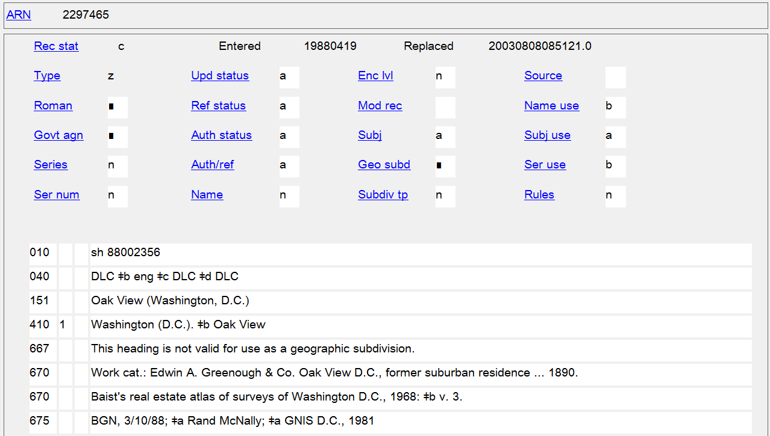
City Section Subject Authority
Notes:
May 1, 2013
This is an example of a city section that is currently found in the LC Subject Authority File that should be transferred to the LC/NACO Authority File when needed as a subject in current cataloging (by creating a new NAR for the place and then requesting/proposing the cancellation of the subject authority record).
The fact that this record is a subject authority is seen by the prefix “sh” in the LCCN in the 010 field, as well as by the coding in 008/14 (Heading use code—main or added entry) of “b” (Heading not appropriate for main or added entry) and in 008/10 (Descriptive cataloging rules code) of “n” (Not applicable). The NAR created for this place would have a prefix beginning with “n”, “nb”, “no”, or “ns”; 008/14 “a” (Heading appropriate for main or added entry); and 008/10 “z” (Other) with subfield $e rda in the 040 field.

Slide 84
Places within Cities, Etc. - Subject Policies
Example:
Authorized access point: Chinatown (San Francisco, Calif.)
For a work about tourism in San Francisco’s Chinatown, assign two subject headings:
650 _0 Tourism $z California $z San Francisco.
651 _0 Chinatown (San Francisco, Calif.)
not
650 _0 Tourism $z California $z Chinatown (San Francisco)
nor
650 _0 Tourism $z California $z San Francisco $z Chinatown.
Notes:
May 1, 2013
LCSH policy is that subject headings may not be subdivided below the level of a city or town. In order to bring out a topic in conjunction with a particular city section, the topic can be subdivided down to a particular city and then an additional subject heading for the specific city section is added.

Slide 85
Places within Cities, Etc. - Subject Policies
Subject Headings Manual H 835: Geographic Subdivision Information in Name Authority Records
667 field is used to record the fact that a geographic name heading is not appropriate for use as a geographic subdivision. Headings for geographic entities within cities that are qualified by the name of the city, such as city sections, districts, neighborhoods, etc., may not be used as geographic subdivisions.
DCM Z1 667 - NARs and subject usage
Optionally add for geographic access points that are not appropriate for use as geographic subdivisions:
667 SUBJECT USAGE: This name is not valid for use as a geographic subdivision.
Notes:
May 1, 2013
DCM Z1 667 - NARs and subject usage
PCC optional practice:
Add a 667 note to name authority records for geographic names that are not appropriate for use as geographic subdivisions in subject cataloging usage (per SHM H 835) when the name represents an entity within a city and is qualified by the city name. Such notes will most frequently be needed for names of city sections, districts, neighborhoods, etc. Make no changes to values in bytes of the 008.
667 SUBJECT USAGE: This name is not valid for use as a geographic subdivision.
Example:
151 Hollywood (Los Angeles, Calif.)
667 SUBJECT USAGE: This name is not valid for use as a geographic subdivision.
Follow these guidelines for newly-created authority records. Add the note to an existing record when making any other change to the record.
See DCM Z1 781 for guidelines on adding 781 fields to name authority records for geographic names that may also be used as geographic subdivisions.

Slide 86
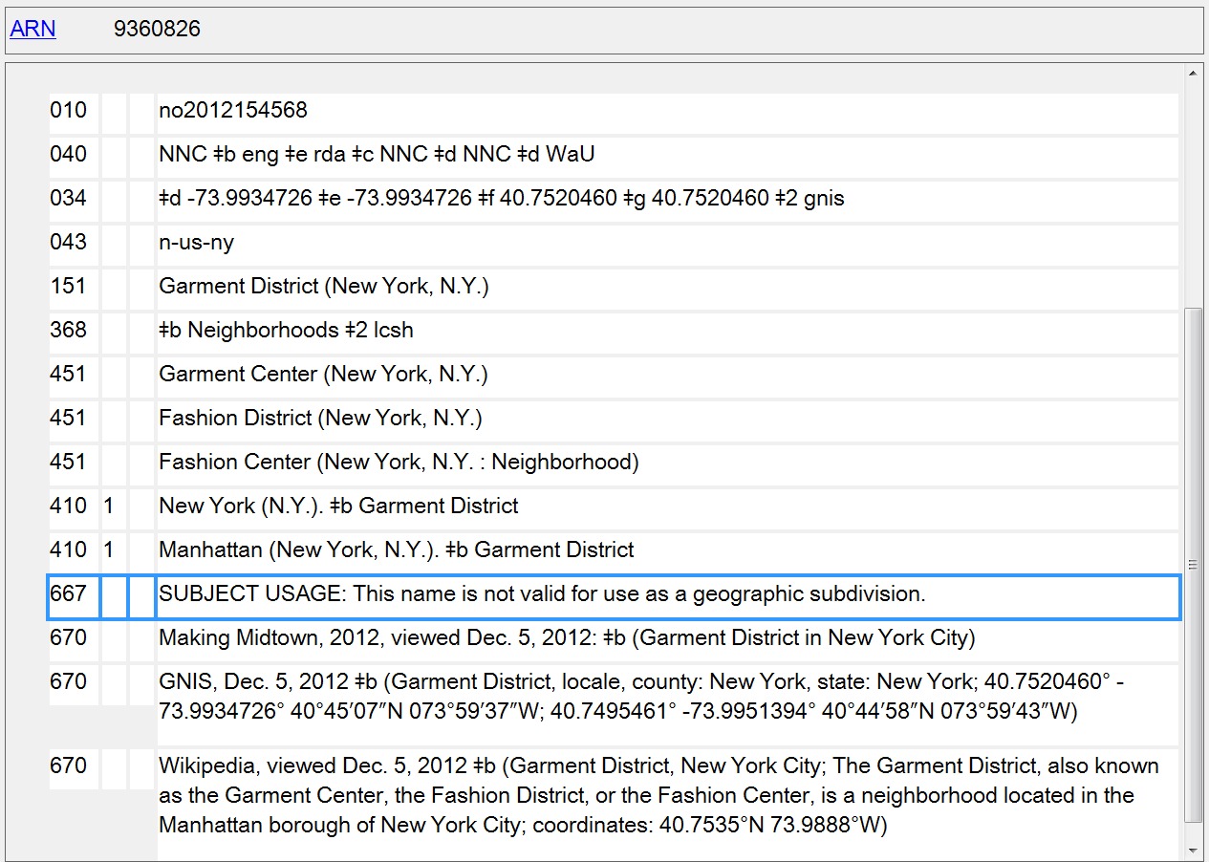
667 SUBJECT USAGE Note for City Sections
Notes:
May 1, 2013
Example of a name authority record for a city section, showing the inclusion of the 667 field alerting catalogers that the access point is not valid for use as a geographic subdivision.

Slide 87
Special Cases - LC-PCC PS for 16.4.1
Military installations
  Treat military installations (forts, bases, camps, airfields, and Coast Guard stations but not shipyards) as local places
  Add as a qualifier the country, state, province, etc., that would have been added to a city or town in the same place, even if the installation is located outside the country that controls it
  151 Fort Knox (Ky.)
  151 Camp Pendleton (Calif.)
  151 Guantánamo Bay Naval Base (Cuba)
  151 Yokota Air Force Base (Japan)
Notes:
May 1, 2013
Note that even though the last two examples are U.S. military installations, since they are located in another country that other country is used as the qualifier.

Slide 88
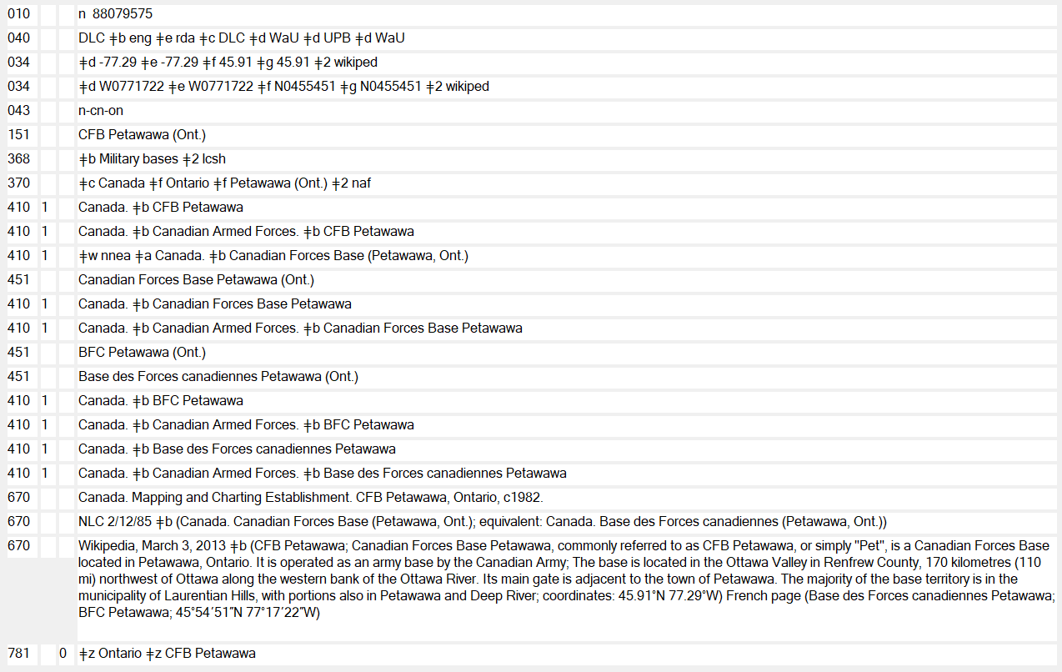
Notes:
September 17, 2018
An example of a Canadian military base. The name used in AACR2 (which by agreement with Library and Archives Canada would have followed the LAC-established form) did not necessarily follow the NACO policy of establishing military bases as geographic places. LAC coded bases as corporate bodies (110) and established them as subordinate units of Canada. When upgraded to RDA, the authorized access point for a Canadian military installation will need to be reevaluated to see if it follows the policy statement for 16.4.1. The earlier established AACR2 form can be seen in the slide in the 410 field that has $w nnea. When this record was upgraded to RDA, since the access point is now coded as a geographic place that is eligible for use as a geographic subdivision, a 781 was also added to the record, as were coded geographic coordinates (034). An 043 geographic area code could also have been added.

Slide 89
Special Cases - LC-PCC PS for 16.4.1
American Indian Tribes
  Tribes recognized by the U.S. government are independent, autonomous political entities with inherent powers of self-government; they possess sovereignty and are equal to national governments
  Establish as jurisdictions tagged 151
  For approved name, consult official list published in the Federal Register, “Indian Entities Recognized and Eligible To Receive Services From the Bureau of Indian Affairs” (can cite as “BIA Indian entities”).
Notes:
September 17, 2018: removed URL to http://www.bia.gov/DocumentLibrary/index.htm, added hyperlink to slide and instructions in speaker notes to find most recent list in the Federal Register
October 10, 2023: updated link in speaker notes to latest version of list available
LC-PCC PS for 16.4
American Indian Tribes
Tribes recognized by the U.S. government are independent, autonomous political entities with inherent powers of self-government; they possess sovereignty and are equal to national governments. There are over 500 recognized tribes within the continental United States. Nearly all federally recognized tribes have jurisdiction over some delimited area of land, a geographic place, although land and area vary with each tribe.
Consult the official list created and maintained by the Department of the Interior, Bureau of Indian Affairs, published and updated in the Federal Register. The list of federally recognized tribes, published bi-annually since 1979, entitled: Indian Entities Recognized and Eligible to Receive Services from the United States Bureau of Indian Affairs is accessed through the Federal Register website. This source may be cited as “BIA Indian Entities.” If a name for a tribal entity is not found in the BIA list, conduct additional research and/or construct the authorized access point from information on the resource being cataloged.
To find the most recent list:
Go to https://www.gpo.gov/fdsys/search/home.action
In the search box, enter: title:(Indian Entities Recognized and Eligible To Receive Services From the Bureau of Indian Affairs) AND collection:FR
Click Search.
Sort by: Date (New to Old).
Click Go.
Official list as of August 11, 2023: https://www.govinfo.gov/content/pkg/FR-2023-08-11/pdf/2023-17195.pdf
PSD website has a link to version from January 14, 2015: http://www.loc.gov/catdir/cpso/biaind.pdf
EXAMPLE
151 San Carlos Apache Tribe of the San Carlos Reservation, Arizona
670 BIA Indian entities, 2005, Dec. 14, 2005 $b (San Carlos Apache tribe of the San Carlos Reservation, Arizona)
Some tribes have federally-approved names that sound as if the name were for a populated place rather than a tribe. Confusion may result when there actually is a populated place of that name. In such cases, the tribe and the populated place are separate entities.
EXAMPLE
151 Native Village of Nunapitchuk
Tribe
151 Nunapitchuk (Alaska)
Populated place

Slide 90
Notes:
February 24, 2014
Example of an authority for an Indian tribe as a geographic place/sovereign nation. For the preferred name for the tribe, use the form found in BIA Indian Entities. No qualifier is added to the authorized access point.
Note also the geographic subdivision practice: as sovereign nations, geographic subdivision is direct through the name of the tribe.

Slide 91
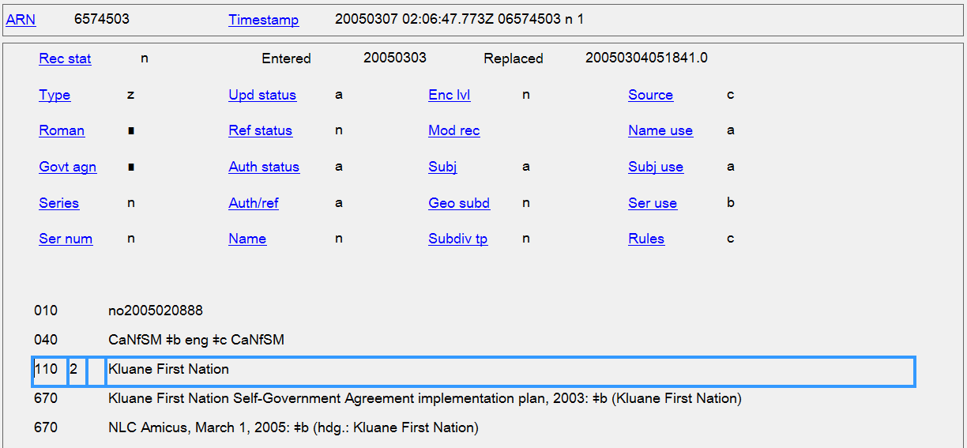
Canadian First Nations under RDA
Treat Canadian First Nations as geographic places/jurisdictions; convert corporate body coding in AACR2 records to geographic place coding
Notes:
May 1, 2013
In AACR2, NACO policy was to use the form for Canadian places and corporate bodies approved by Library and Archives Canada. LAC establishes Canadian First Nations as corporate bodies tagged 110, so this is how you will find them if established under AACR2 (see slide). Under RDA, they may be treated the same as American Indian tribes. Establish new records for First Nations as geographic places. When upgrading a record for a Canadian First Nation to RDA, evaluate the access points and retag them as geographic places (X51). As with American Indian tribes, geographic subdivision is direct through the name of the First Nation. BFM may need to be reported when upgrading these records.

Slide 92
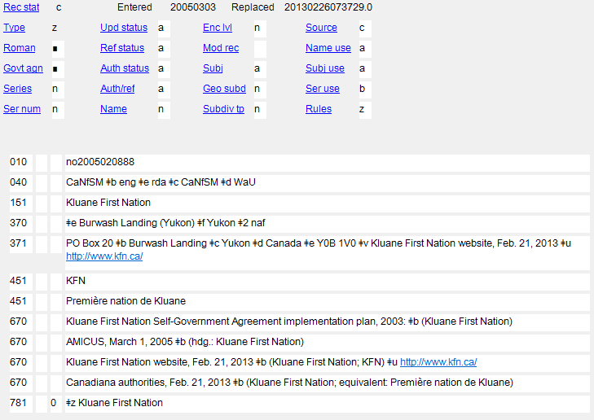
Notes:
February 24, 2014
Slide shows the NAR for the Kluane First Nation after it has been upgraded to RDA. X10s have been changed to X51s and a 781 was added to show that the place may be used as a geographic subdivision, directly entered under its name.

Slide 93
Variant Names (16.2.3)
Not CORE
Take from any source
Several specific cases given
  Initial Articles
  Expanded Name
  Initialism / Abbreviated Form
  Alternative Linguistic Form of Name
  Other Variant Name
Notes:
May 1, 2013

Slide 94
Variant Names - Initial Articles (16.2.3.4)
If article kept in the preferred name, record the name without the article as a variant
151 Los Angeles (Calif.)
451 Angeles (Calif.)
If article omitted from the preferred name, record the name with the article as a variant
151 Dalles (Or.)
451 The Dalles (Or.)
Notes:
March 5, 2019: made grammatical correction to slide

Slide 95
Variant Names - Expanded Name (16.2.3.5)
If preferred name is or contains an initialism or an abbreviated or shortened form of name, record the expanded form as a variant
151 St. John's (N.L.)
451 Saint John's (N.L.)
151 Tribeca (New York, N.Y.)
451 Triangle Below Canal (New York, N.Y.)
Notes:
May 1, 2013
N.L. is the abbreviation used for the province Newfoundland and Labrador. The province’s name changed officially from Newfoundland to Newfoundland and Labrador on December 6, 2001. The former abbreviation was Nfld., which would still be used for any places that existed only during the time when the province was known by the earlier name.

Slide 96
Variant Names - Initialism/
Abbreviated Form (16.2.3.6)
If the name chosen as the preferred name of the place is a full form of the name, record an initialism or abbreviated form of the name as a variant name
151 Prince Edward Island
451 P.E.I.
451 PEI
151 South of Market (San Francisco, Calif.)
451 SOMA (San Francisco, Calif.)
Notes:
May 1, 2013
Examples of initialisms recorded as variant names

Slide 97
Variant Names - Initialism/ Abbreviated Form (16.2.3.6)
If the name chosen as the preferred name of the place is a full form of the name, record an initialism or abbreviated form of the name as a variant name
151 Saint Louis (Mo.)
451 St. Louis (Mo.)
151 Mount Airy (Philadelphia, Pa.)
451 Mt. Airy (Philadelphia, Pa.)
151 South Daytona (Fla.)
451 So. Daytona (Fla.)
Notes:
May 1, 2013
Examples of abbreviated forms recorded as variant names

Slide 98
Variant Names - Initialism/Abbreviated Form (16.2.3.6)
If the name chosen as the preferred name consists of an initialism, record form with/without full stops as a variant
151 R.A.F. Kenley (England)
451 RAF Kenley (England)
If the full name is chosen as the preferred name, record initials without full stops, as well as with full stops as variant names
  151 Northwest Territories
  451 N.W.T.
  451 NWT
Notes:
May 1, 2013

Slide 99
Variant Names - Alternate Linguistic Form (16.2.3.7)
Different Language Suomi / Finland
Different Script Србија / Srbija
Different Spelling Rumania / Romania
Different Transliteration Aqaba / Akaba / ʿAqabah
Different Representation of Numbers (Words vs. Numerals) 9th Ward / Ninth Ward
Zweiter Bezirk / 2. Bezirk
日本 اليابان Япония Ιαπωνία 일본 יפן
Японія ژاپن 日本國 Јапонија
جاپان Јапан יאפאן ياپونىيە Япунмастор
Notes:
May 1, 2013
16.2.3.7 deals with alternative linguistic forms of the name for a place, and the examples are categorized as seen in the bullets in this slide.
Different Language: Suomi vs. Finland
Different Script: Србија vs. Srbija
Different Spelling: Rumania vs. Romania
Different Transliteration: Aqaba or Akaba vs. ʿAqabah
Different Representation of Numbers: Zweiter Bezirk vs. 2. Bezirk; Tredicesima Circoscrizione vs. XIII Circoscrizione; East Seventh Avenue Historic District vs. East 7th Avenue Historic District; 9th Ward vs. Ninth Ward
FYI: All the names shown at the bottom of this slide are for Japan, in various languages and in scripts that are eligible for inclusion in name authority records (Arabic, Chinese, Cyrillic, Greek, Hebrew, Japanese, and Korean scripts). If you have a name in any other script (examples include: Armenian, Burmese, Cherokee, Devanagari, Georgian, Inuktitut, Mongolian, Sinhalese, Tamil, Thai, Tibetan) you must transliterate it according to the ALA-LC Romanization Tables (online at http://www.loc.gov/catdir/cpso/roman.html). At the present time, only the romanized forms of names in such scripts may be included in NARs.

Slide 100
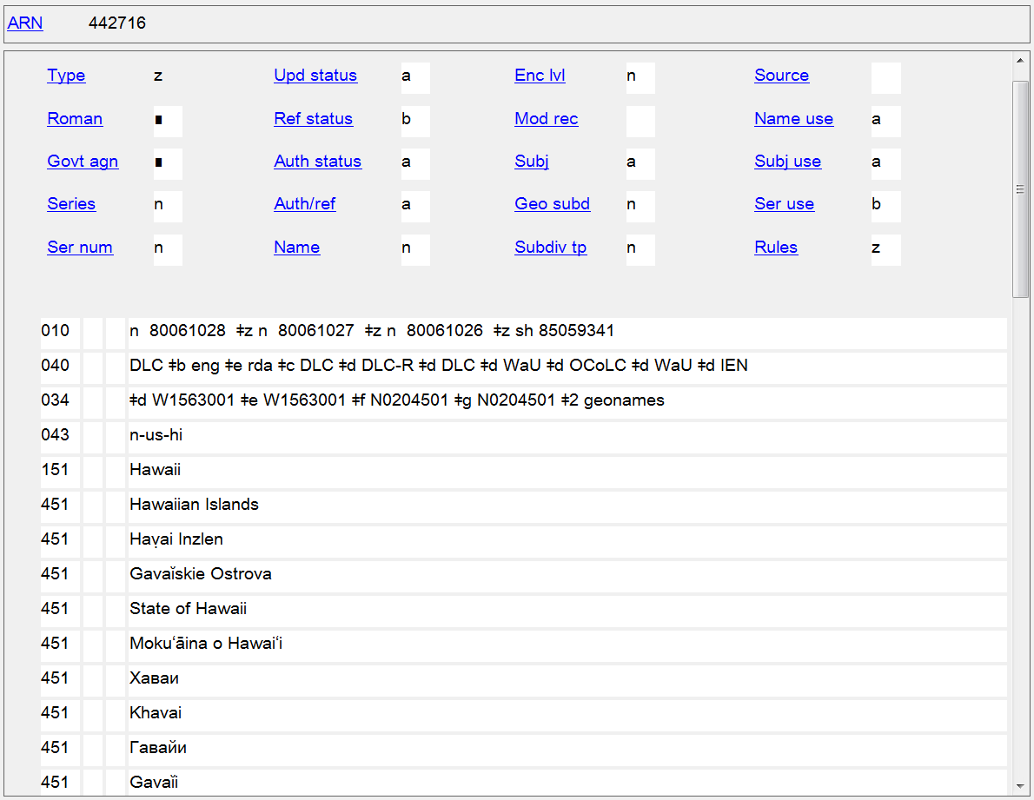
LC Guidelines Supplement to MARC 21 Authority Format: 008/29: use code “b” in all NARs with non-Latin script references. Also assure that 667 note “Non-Latin script reference(s) not evaluated” is also present.
Notes:
October 7, 2024: Updated speaker notes
May 1, 2013
The slide shows a number of variant names for Hawaii, including some variant English names, names in other languages, and names in other scripts. Remember that if you add non-Latin script references (and you are encouraged to!), that the 008/29 (Ref status in OCLC) must be coded with value “b” and a 667 note “Non-Latin script reference(s) not evaluated” must also be added (next slide).
LC Guidelines 008/29: Code b will also occur in all name/series records with non-Latin script references until guidelines for evaluating non-Latin script references are developed. When code b is used in this latter case assure that a 667 note with the statement: "Non-Latin script reference not evaluated" is also present in the NAR.
Note: In September 2024 the PCC SCS Task Group on Evaluation Guidelines for Non-Latin Script References in Name Authority Records (https://wiki.lyrasis.org/display/PFCCP/SCS+Task+Group+on+Evaluation+Guidelines+for+Non-Latin+Script+References+in+NARs) issued its final report and recommendations for ceasing the coding currently done in records with non-Latin script variant access points. If the recommendations are approved, all non-Latin script references in new authority records will be evaluated by catalogers and some variant access points will be marked as preferred non-Latin script variants. References in existing authorities will be evaluated according to the same principles. Implementation date for the new policy is currently undetermined.

Slide 101
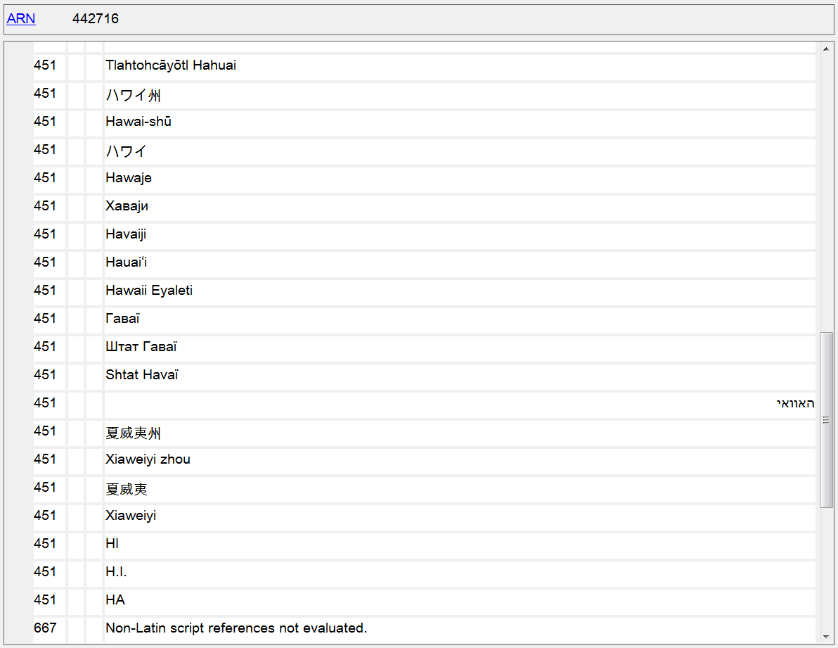
LC Guidelines Supplement to MARC 21 Authority Format: 008/29: use code “b” in all NARs with non-Latin script references. Also assure that 667 note “Non-Latin script reference(s) not evaluated” is also present.
Notes:
May 1, 2013
Remember: Justify any non-Latin references you add with 670s. Only romanized forms of names in non-Latin scripts are required in NARs; addition of the non-Latin script form is optional.
Note: In September 2024 the PCC SCS Task Group on Evaluation Guidelines for Non-Latin Script References in Name Authority Records (https://wiki.lyrasis.org/display/PFCCP/SCS+Task+Group+on+Evaluation+Guidelines+for+Non-Latin+Script+References+in+NARs) issued its final report and recommendations for ceasing the coding currently done in records with non-Latin script variant access points. If the recommendations are approved, all non-Latin script references in new authority records will be evaluated by catalogers and some variant access points will be marked as preferred non-Latin script variants. References in existing authorities will be evaluated according to the same principles. Implementation date for the new policy is currently undetermined.

Slide 102
Variant Names - Other Forms (16.2.3.8)
Different Names
Place within City as Subdivision of Authorized Access Point for the City
151 Garment District (New York, N.Y.)
451 Fashion District (New York, N.Y.)
451 Garment Center (New York, N.Y.)
410 1_ New York (N.Y.). $b Garment District
Notes:
March 21, 2017: updated speaker notes to reflect current RDA language
16.2.3.8 tells us to record other variant names and variant forms of the name not covered by 16.2.3.4–16.2.3.7, if considered important for identification or access. It lists two situations covered in this instruction: different names, and name of place within a city as subdivision of authorized access point for the city. But the instruction does not limit catalogers to these two situations. Anything not covered under 16.2.3.4-16.2.3.7 is eligible for recording as a variant name under 16.2.3.8.
Here’s an example not covered by any of the rules: a neighborhood or other kind of city section within some larger neighborhood or city section. For example, the Garment District of New York City is located within the borough of Manhattan. In addition to the variant access point shown in the slide, the cataloger might decide it was useful to record a variant access point for the neighborhood as a subdivision of the borough in which it is located:
410 1_ Manhattan (New York, N.Y.). $b Garment District

Slide 103
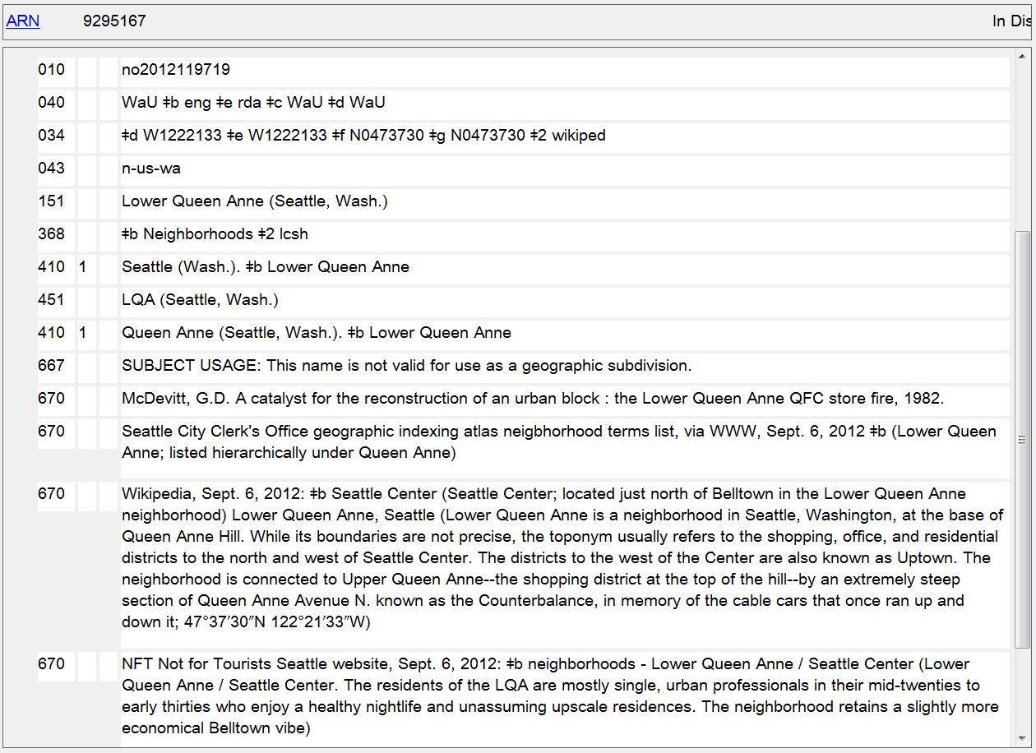
Other variant name: place within city as a subdivision of a larger place within city
Notes:
May 1, 2013
A situation not explicitly covered in RDA, but permitted under instruction 16.2.3.8: a neighborhood that is part of a larger neighborhood. Lower Queen Anne in Seattle is a separately named part of the Queen Anne neighborhood. In addition to a variant access point made for the neighborhood as a subdivision of the city (first 410 in the record), an additional variant access point has been made for the neighborhood as a subdivision of the larger neighborhood.

Slide 104
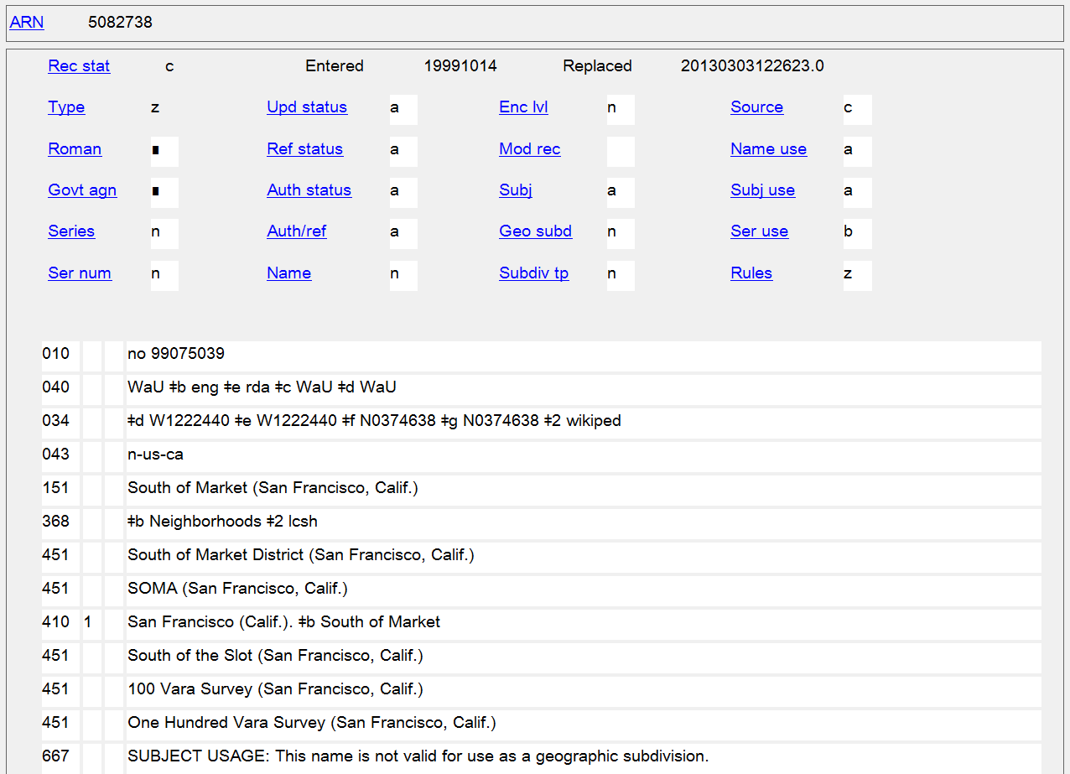
Different Names
Initialism
Name as Subdivision of City
Different Representation of Numbers
Notes:
May 1, 2013
Summary example: This slide illustrates a number of different kinds of variant names that have been recorded in the authority record for the neighborhood South of Market in San Francisco.
Reminder: Places within cities cannot be used as geographic subdivisions, so including a 667 SUBJECT USAGE note would be helpful to other catalogers.

Slide 105
Variant Names - LC-PCC PS for 16.4.2
Choice of larger place when smaller name stays same, but larger place name changes
  In 151, use the current name of the larger place in qualifier
  If name in resource pertains to earlier period, consider recording a variant access point from form with qualifier for the earlier name of larger place
151 Minsk (Belarus) 151 Charles Town (W. Va.)
451 Minsk (Byelorussian S.S.R.) 451 Charles Town (Va.)
Notes:
November 14, 2016
LC-PCC PS for 16.4.2
Choice of Larger Place
LC practice/PCC practice: When adding the name of a larger place as a qualifier, use the current name of the larger place (see RDA 16.2.2.9-RDA 16.2.2.12), and apply Appendix B.11, as applicable. If the smaller place existed when the larger place had an earlier name, and the name in the resource pertains to the earlier period, consider recording a variant access point from the form that shows the earlier name of the larger place if the qualifier is appropriate for the smaller place.
EXAMPLE
151 ## $a Minsk (Belarus)
451 ## $w nne $a Minsk (Byelorussian S.S.R.)
Variant access point that was previously used as authorized form. Byelorussian S.S.R. became Belarus
151 ## $a Torit (South Sudan)
451 ## $w nne $a Torit (Sudan)
Variant access point that was previously used as authorized form. Torit became part of the new country South Sudan
151 ## $a Charles Town (W. Va.)
451 ## $a Charles Town (Va.)
Variant access point that was not previously used as authorized form
151 ## $a Ballard (Seattle, Wash.)
451 ## $a Ballard (Wash.)
Variant access point that was not previously used as authorized form. The city Ballard became a city section of Seattle

Slide 106
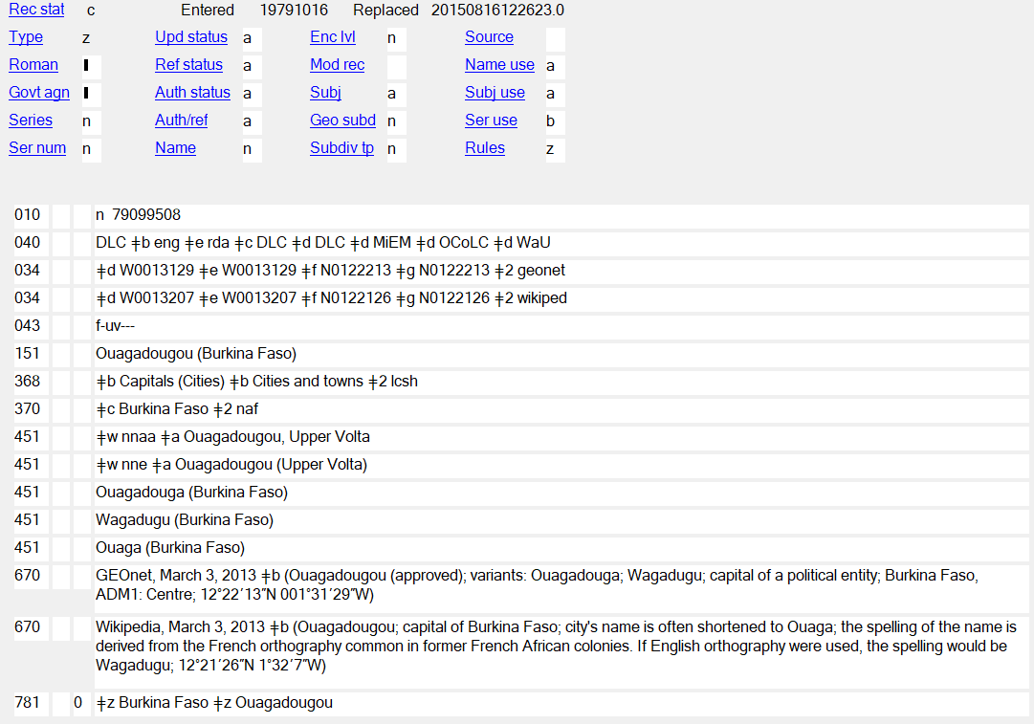
Name of larger place changed. Variant access point made from name with earlier qualifier
Notes:
September 17, 2018
Slide illustrates the situation where there is already an established access point for a place, and the name of the larger place in which the smaller place is located changes. This can happen with mergers and splits (e.g., Prague, Czechoslovakia becomes Prague, Czech Republic) or simply when a larger jurisdiction changes its name (example in this slide; another example is Kinshasa, Zaire becomes Kinshasa, Congo). In this case, the qualifier in the 151 and 451s is changed to the current name for the larger place, and a 451 is made for the previously authorized access point for the place. Don’t forget also to change the 781 field if it is in the record!

Slide 107
Variant Names - LC-PCC PS for 16.4.2
Choice of larger place when place within a city had a previous independent existence, provided its name remains constant (see also LC-PCC PS for 16.2.2.14)
  In 151, use the name of the city as the larger place
  Consider making a variant access point with a qualifier appropriate to body’s earlier independent existence
  151 Ballard (Seattle, Wash.)
  451 Ballard (Wash.)
    A single authorized access point is used for Ballard, both as a city section of Seattle and as an earlier independent city.
Notes:
November 14, 2016
Ballard example from LC-PCC PS for 16.4.2.
Note: Rule for qualifier is in LC-PCC PS for 16.2.2.14:
LC practice/PCC practice: For places within cities, add the city in parentheses. Use the access point reflecting its current status for the entire period of the place within the city’s existence, including any earlier independent existence it may have had, provided the name remains constant. Consider making a variant access point from the name of the place within the city as a subheading of the name of the city.
Based on this policy statement, Ballard (Seattle, Wash.) is used as the access point for both the current section/neighborhood of Seattle as well as for the place when it was a separate city prior to annexation by Seattle (1890-1907).
However, if the place within the city once had an independent existence but changed its name when it was absorbed into the larger place, create an authorized access point for each name.
EXAMPLE
For resources issued before 1975:
151 Endersbach (Germany)
For resources issued after 1974:
151 Weinstadt-Endersbach (Weinstadt, Germany)
410 1_ Weinstadt (Germany). $b Weinstadt-Endersbach

Slide 108
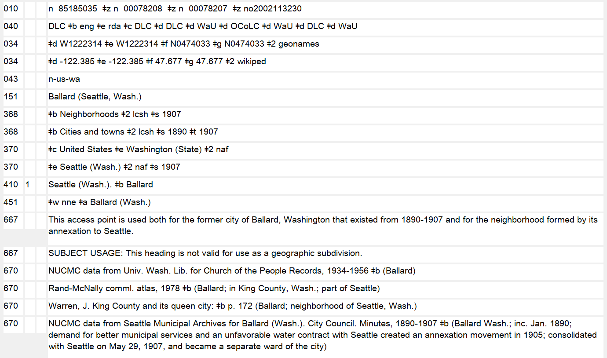
Use access point for the current place even for subordinate bodies of the formerly separate jurisdiction:
110 1_ Ballard (Seattle, Wash.). $b City Council
110 1_ Ballard (Seattle, Wash.). $b Fire Department
Notes:
September 17, 2018
This practice means that you could have a somewhat unusual situation where a subordinate body for the period where the place had an independent existence, would be entered under the access point for the current city section:
110 1_ Ballard (Seattle, Wash.). $b City Council
110 1_ Ballard (Seattle, Wash.). $b Fire Department

Slide 109
Variant Names - LC-PCC PS for 16.4.2
Military installations
  Make variant access points from the name as subheading of country that controls it and as subheading of military branch to which it belongs
151 Fort Knox (Ky.)
410 1_ United States. $b Fort Knox
410 1_ United States. $b Army. $b Fort Knox
151 Guantánamo Bay Naval Base (Cuba)
410 1_ United States. $b Guantánamo Bay Naval Base
410 1_ United States. $b Navy. $b Guantánamo Bay Naval Base
Notes:
May 1, 2013
LC-PCC PS for 16.4.2
Military Installations
LC practice/PCC practice: Construct variant access points from the name as a subheading of the country that controls it and as a subheading of the military branch to which it belongs.
EXAMPLE
151 Fort Hood (Tex.)
410 1_ United States. $b Fort Hood
410 1_ United States. $b Army. $b Fort Hood
151 March Air Force Base (Calif.)
410 1_ United States. $b March Air Force Base
410 1_ United States. $b Air Force. $b March Air Force Base
151 Yokosuka Naval Base (Japan)
410 1_ United States. $b Yokosuka Naval Base
410 1_ United States. $b Navy. $b Yokosuka Naval Base

Slide 110
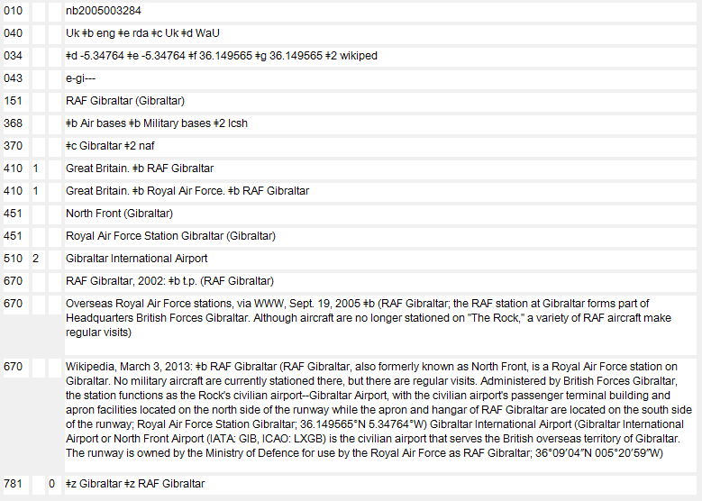
Notes:
February 24, 2014
An example of a non-U.S. military installation authority record.

Slide 111
Exercises
Variant Names
Notes:
May 1, 2013

Slide 112
Fill out these fields:
151
451
Notes:
May 1, 2013
NOTE: ANSWER SLIDES TO VARIANT NAMES EXERCISES ARE AFTER ALL THE VARIANT NAME EXERCISES
ANSWER:
151 Palms (Qld.)
451 The Palms (Qld.)
Remember: You must also check for conflicts for any variant forms of names that you are recording, and if there is a conflict with other places in the same larger place, you must break that conflict if possible. Assume no conflicts in this example.

Slide 113
Fill out these fields:
151
451
Notes:
May 1, 2013
ANSWER
151 La Paloma (Tex.)
451 Paloma (Tex.)
Remember: You must also check for conflicts for any variant forms of names that you are recording, and if there is a conflict with other places in the same larger place, you must break that conflict if possible. Assume no conflicts in this example.

Slide 114
151
451
451
451
Note: place is in Ohio
151
451
451
451
Notes:
Updated: November 25, 2015
ANSWERS
151 Mount Healthy (Ohio)
451 Mt. Healthy (Ohio)
451 City of Mt. Healthy (Ohio)
451 City of Mount Healthy (Ohio) is also a possible variant
151 Saint Louis (Mo.)
451 St. Louis (Mo.)
451 City of St. Louis (Mo.)
451 City of Saint Louis (Mo.) is also a possible variant

Slide 115
Determine the preferred name and authorized and variant access points for this place
Preferred name for the place: ______________
151
451
670 Evaluation of district credit plan, 1979: $b t.p. (Ujjain District, Madhya Pradesh)
670 GNS, Feb. 16, 2013 $b (Ujjain (approved); Ujjain District (variant); second-order administrative division; India; ADM1: Madhya Pradesh; 23°25’00”N 075°30’00”E; also lists a populated place in Madhya Pradesh with same approved name)
Notes:
May 1, 2013
October 10, 2023: changed GEOnet to GNS in 670
Preferred name for the place: Ujjain (India)
151 Ujjain (India : District)
451 Ujjain District (India)
Explanation: BGN approved form is selected as the basis for the preferred name, but it conflicts with a city/town. Therefore type of jurisdiction (11.7.1.5) becomes a core element, since it is needed to differentiate the two jurisdictions with the same name. 11.13.1.6 requires the type of jurisdiction to be added to distinguish one access point from another, but it is only added to the access point for the district in this case. According to 11.13.1.6, a term for type of jurisdiction is only ever added to the name of a government other than a city or a town.

Slide 116

151
4__
670 The Leslieville’r daily news, via WWW, April 25, 2013: $b home page (the Leslieville neighbourhood of Toronto) $u http://paper.li/leslieviller/1291175230
Notes:
May 1, 2013
ANSWER
151 Leslieville (Toronto, Ont.)
410 1_ Toronto (Ont.). $b Leslieville

Slide 117

Notes:
May 1, 2013

Slide 118

Notes:
May 1, 2013

Slide 119
151
4__
4__
4__
670 NODO : creating destination at the pedestrian scale, 2007: $b page
ii (North Downtown; evolving into one of Omaha’s most exciting
and active neighborhoods) page 1 (North Downtown Omaha (NODO))
670 North Downtown : Omaha’s new urban neighborhood, 2006?
670 Wikipedia, April 25, 2013 $b (under Downtown Omaha: North
Downtown extends 80 blocks, from the campus of Creighton
University to the CenturyLink Center and new developments along the
Missouri River; area comprising NoDo is central to the history of
Omaha)
675 GNIS, April 25, 2013
Notes:
May 1, 2013
POSSIBLE ANSWERS
151 NODO (Omaha, Neb.) or NoDo (Omaha, Neb.)
410 1_ Omaha (Neb.). $b NODO
451 North Downtown (Omaha, Neb.)
451 North Downtown Omaha (Omaha, Neb.)
or
151 North Downtown (Omaha, Neb.)
410 1_ Omaha (Neb.). $b North Downtown
451 NODO (Omaha, Neb.) or NoDo (Omaha, Neb.)
451 North Downtown Omaha (Omaha, Neb.)
The example illustrates that the choice of preferred and variant names is not always straightforward. Based on the information available, a cataloger might select one form or the other, especially when no BGN-approved form of name is found.

Slide 120
Fill out these fields:
151
451
Palms (Qld.)
The Palms (Qld.)
Notes:
May 1, 2013
ANIMATED SLIDE
ANSWER:
151 Palms (Qld.)
451 The Palms (Qld.)
Remember: You must also check for conflicts for any variant forms of names that you are recording, and if there is a conflict with other places in the same larger place, you must break that conflict if possible. Assume no conflicts in this example.

Slide 121
Fill out these fields:
151
451
La Paloma (Tex.)
Paloma (Tex.)
Notes:
May 1, 2013
ANIMATED SLIDE
ANSWER
151 La Paloma (Tex.)
451 Paloma (Tex.)
Remember: You must also check for conflicts for any variant forms of names that you are recording, and if there is a conflict with other places in the same larger place, you must break that conflict if possible. Assume no conflicts in this example.

Slide 122
151
451
451
451
Note: place is in Ohio
Mount Healthy (Ohio)
151
451
451
451
Saint Louis (Mo.)
Mt. Healthy (Ohio)
St. Louis (Mo.)
City of Mt. Healthy (Ohio)
City of St. Louis (Mo.)
City of Saint Louis (Mo.)
City of Mount Healthy (Ohio)
Notes:
Updated: November 25, 2015
ANIMATED SLIDE
ANSWERS
151 Mount Healthy (Ohio)
451 Mt. Healthy (Ohio)
451 City of Mt. Healthy (Ohio)
451 City of Mount Health (Ohio) is also a possible variant
151 Saint Louis (Mo.)
451 St. Louis (Mo.)
451 City of St. Louis (Mo.)
451 City of Saint Louis (Mo.) is also a possible variant

Slide 123
Determine the preferred name and authorized access point for this place - ANSWER
Ujjain (India)
Preferred name for the place:
151
451
670 Evaluation of district credit plan, 1979: $b t.p. (Ujjain District, Madhya Pradesh)
670 GNS, Feb. 16, 2013 $b (Ujjain (approved); Ujjain District (variant); second-order administrative division; India; ADM1: Madhya Pradesh; 23°25’00”N 075°30’00”E; also lists a populated place in Madhya Pradesh with same approved name)
Ujjain (India : District)
Ujjain District (India)
Notes:
May 1, 2013
October 10, 2023: changed GEOnet to GNS in 670
ANIMATED SLIDE. Click to bring in each answer.
ANSWER
Preferred name for the place: Ujjain (India)
Access points:
151 Ujjain (India : District)
451 Ujjain District (India)
Explanation: BGN approved form is selected as the basis for the preferred name, but it conflicts with a city/town. Therefore type of jurisdiction (11.7.1.5) becomes a core element, since it is needed to differentiate the two jurisdictions with the same name. 11.13.1.6 requires the type of jurisdiction to be added to distinguish one access point from another, but it is only added to the access point for the district in this case. According to 11.13.1.6, a term for type of jurisdiction is only ever added to the name of a government other than a city or a town.

Slide 124
151
4__
670 The Leslieville’r daily news, via WWW, April 25, 2013: $b home page (the Leslieville neighbourhood of Toronto) $u http://paper.li/leslieviller/1291175230
Leslieville (Toronto, Ont.)
10 1_ Toronto (Ont.). $b Leslieville
Notes:
November 25, 2015
ANIMATED SLIDE
ANSWER
151 Leslieville (Toronto, Ont.)
410 1_ Toronto (Ont.). $b Leslieville

Slide 125
151
4__
4__
4__
670 NODO : creating destination at
the pedestrian scale, 2007: $b page ii
(North Downtown; evolving into one
of Omaha’s most exciting and active
neighborhoods) page 1 (North
Downtown Omaha (NODO))
670 North Downtown : Omaha’s
new urban neighborhood, 2006?
670 Wikipedia, April 25, 2013 $b
(under Downtown Omaha: North
Downtown extends 80 blocks, from
the campus of Creighton University
to the CenturyLink Center and new
developments along the Missouri
River; area comprising NoDo is
central to the history of Omaha)
675 GNIS, April 25, 2013
NODO (Omaha, Neb.)
10 1_ Omaha (Neb.). $b NODO
51 North Downtown (Omaha, Neb.)
51 North Downtown Omaha (Omaha,
Neb.)
151
4__
4__
4__
670 NODO : creating destination at
the pedestrian scale, 2007: $b page ii
(North Downtown; evolving into one
of Omaha’s most exciting and active
neighborhoods) page 1 (North
Downtown Omaha (NODO))
670 North Downtown : Omaha’s
new urban neighborhood, 2006?
670 Wikipedia, April 25, 2013 $b
(under Downtown Omaha: North
Downtown extends 80 blocks, from
the campus of Creighton University
to the CenturyLink Center and new
developments along the Missouri
River; area comprising NoDo is
central to the history of Omaha)
675 GNIS, April 25, 2013
North Downtown (Omaha, Neb.)
10 1_ Omaha (Neb.). $b North Downtown
51 NODO (Omaha, Neb.)
51 North Downtown Omaha (Omaha,
Neb.)
OR
125
Notes:
May 1, 2013
ANIMATED SLIDE
POSSIBLE ANSWERS
151 NODO (Omaha, Neb.) or NoDo (Omaha, Neb.)
410 1_ Omaha (Neb.). $b NODO
451 North Downtown (Omaha, Neb.)
451 North Downtown Omaha (Omaha, Neb.)
or
151 North Downtown (Omaha, Neb.)
410 1_ Omaha (Neb.). $b North Downtown
451 NODO (Omaha, Neb.) or NoDo (Omaha, Neb.)
451 North Downtown Omaha (Omaha, Neb.)
The example illustrates that the choice of preferred and variant names is not always straightforward. Based on the information available, a cataloger might select one form or the other, especially when no BGN-approved form of name is found.
125

Slide 126
Change of Name (16.2.2.7)
Generally, when name of a place changes, make separate NARs, linking earlier/later names
151 Kristiania (Norway)
451 Christiania (Norway)
551 $w r $i Successor: $a Oslo (Norway)
and
151 Oslo (Norway)
551 $w r $i Predecessor: $a Kristiania (Norway)
Notes:
March 5, 2020: updated speaker notes
May 30, 2024 updated to include relationship designators per announcement on the PCC list May 30, 2024
The city currently called Oslo, was known as Christiania from 1624-1877, and as Kristiania (due to orthographic reform) from 1877-1925.
Note: As of March 2020, the DCM Z1 for field 551 says: “Do not use subfield $i with subfield $w coded “r” until relationship designators for places are developed. (Currently RDA has a placeholder for Appendix L).” Therefore, $w a and $w b have been used in the examples in this and other slides. Also as of March 2020, OCLC Connexion will not validate records that have subfield $i in 551. Practically, this means that the earlier/later $w codes “a” and “b” must be used in 551 fields until OCLC changes its validation parameters.

Slide 127
Change of Name - Subject Policy
SHM H 708/DCM Z1 667 NARs and subject usage: Only the latest name of a political jurisdiction that has had one or more earlier names may be used as a subject or subject subdivision, as long as the territorial identity remains essentially unchanged. Add 667 note to the record for earlier name to state this. Also code the 008/11 “n” and the 008/15 “b”.
151 Kristiania (Norway)
451 Christiania (Norway)
551 $w r $i Successor: $a Oslo (Norway)
667 SUBJECT USAGE: This name is not valid for use as a subject. Works about this place are entered under Oslo (Norway).
Notes:
September 17, 2018: moved $w to beginning of 551 field
May 30, 2024 revised relationship designator (see previous slide)
The same information can be found in the Subject Headings Manual H 708 Linear Jurisdictional Name Changes in Name Authority Records and in the DCM Z1 667 in the section “NARs and subject usage”. For linear changes where the territory of a jurisdiction stays essentially unchanged, only the latest name may be used as a subject heading. The earlier name(s) for the jurisdiction must be coded as follow:
008/11 Subject heading system (OCLC: Subj) - “n” = Not applicable
008/15 Heading use code--subject added entry (OCLC: Subj use) - “b” = Heading not appropriate as subject added entry
667 SUBJECT USAGE: This name is not valid for use as a subject. Works about this place are entered under [access point for latest name].

Slide 128
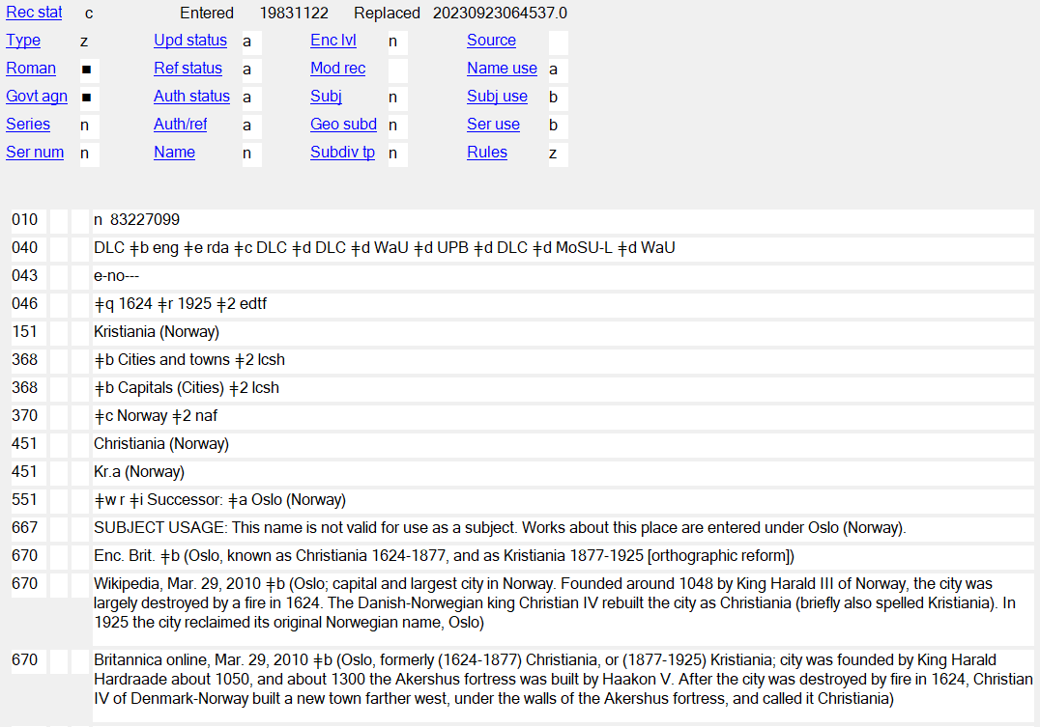
Notes:
September 17, 2018
May 30, 2024 replaced image of record to show new relationship designator (see previous slides)

Slide 129
Change of Name - Subject Policy
SHM H 710 Jurisdictional Mergers and Splits
For mergers and splits, where the territorial identity has changed, all names are valid for use as subjects and geographic subdivisions
Subj: a Subj use: a Subj: a Subj use: a
151 Czechoslovakia 151 Germany (East)
551 Czech Republic 551 Germany
551 Slovakia 781 _0 $z Germany (East)
781 _0 $z Czechoslovakia
Notes:
May 1, 2013
SHM 710 Jurisdictional Mergers and Splits
1. General principles. For situations where jurisdictions have merged or split, various headings may be appropriate depending on the area and the time period being discussed. In general, assign subject headings that correspond to the physical extent of the area being discussed.
2. Mergers.
a. Pre-merger coverage. For the area corresponding to the post-merger jurisdiction, assign the heading for the post-merger jurisdiction. Assign this heading even though the jurisdiction did not exist for the pre-merger time period. For an area corresponding to one of the pre-merger jurisdictions, assign the heading for the pre-merger jurisdiction.
b. Post-merger coverage. For the area corresponding to the post-merger jurisdiction, assign the heading for the post-merger jurisdiction. For an area corresponding to one of the pre-merger jurisdictions, assign the heading for the pre-merger jurisdiction. Assign the heading for the pre-merger jurisdiction even if the jurisdiction no longer exists or the heading is not valid for descriptive access for that time period.
3. Splits.
a. Name of earlier jurisdiction not reused by later jurisdiction.
(1) Pre-split coverage. For the area corresponding to the pre-split jurisdiction, assign the heading for the pre-split jurisdiction even if that jurisdiction no longer exists. For an area corresponding to one of the post-split jurisdictions, assign the heading for the post-split jurisdiction.
(2) Post-split coverage. For the area corresponding to the pre-split jurisdiction, assign the heading for the pre-split jurisdiction if the name is still in use for the region. If the former jurisdictional name is no longer in common use as a name for the region, assign an equivalent subject heading, or assign the headings for the post-split jurisdictions. For an area corresponding to one of the post-split jurisdictions, assign the heading for the post-split jurisdiction.
b. Name of earlier jurisdiction retained by one of the later jurisdictions.
(1) Pre-split coverage. For the area corresponding to the pre-split jurisdiction, assign the heading for the pre-split jurisdiction. For an area corresponding to one of the post-split jurisdictions, assign the heading for the post-split jurisdiction.
(2) Post-split coverage. For the area corresponding to the pre-split jurisdiction, assign headings for all post-split jurisdictions. For an area corresponding to one of the post-split jurisdictions, assign the heading for the post-split jurisdiction.
4. Geographic subdivision usage. Subject headings for merged or split jurisdictions follow the normal procedures for use as geographic subdivisions. For place names using the practice of indirect subdivision, assign the name as a subdivision following the name of the country where currently located, regardless of the time period covered. For detailed instructions see H 830.
5. Special or complex situations. Because there are a variety of ways in which jurisdictions may be merged, split, or otherwise reorganized, the above instructions may not apply in every case. In exceptional or complex situations, subject usage notes may be added to name authority records according to the procedures in H 432, or scope notes may be added to subject authority records. For instructions on Germany, see H 945; for Soviet Union, see H 1023; for Yugoslavia, see H 1055.

Slide 130
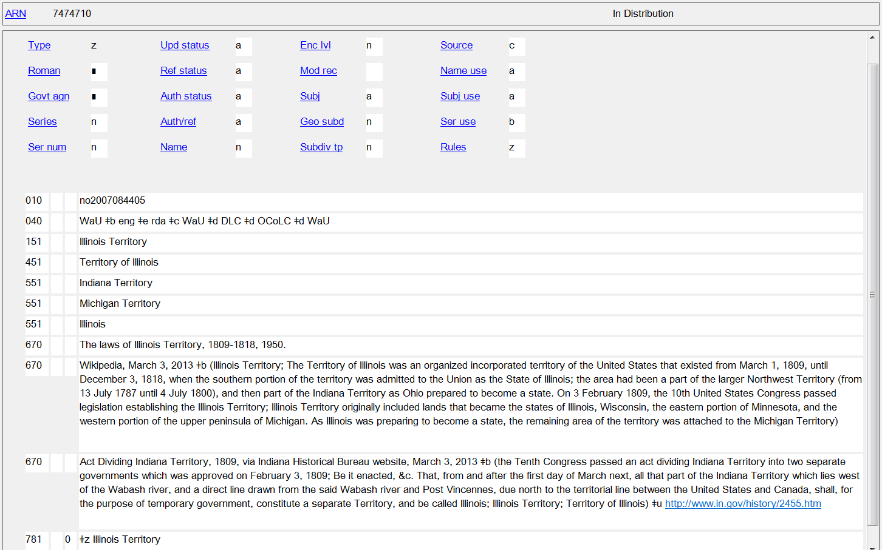
Notes:
May 1, 2013
NAR for Illinois Territory, a jurisdiction that was split off from the Indiana Territory and that then split into Michigan Territory and the state of Illinois. Since the territory of the jurisdictions changed substantially in size, all the access points are valid for use as subjects and geographic subdivisions.

Slide 131
Optional Fields
Used only with geographic places:
  034 (coded geographic coordinates)
  043 (geographic area code)
  781 (form of geographic subdivision)
Also available:
  024 (other standard identifiers)
  046 (start and termination dates)
  3XXs (type of jurisdiction; other designation; associated country; other associated place; address; associated language; etc.)
  678 (historical note)
Notes:
August 16, 2023: updated notes to indicate that URIs may be added.
Dec. 23, 2020: Edited speaker note to remove references to 024 moratorium and deleted asterisk from slide.
March 5, 2020
For the 024 field, see NACO 024 Best Practices Guidelines

Slide 132
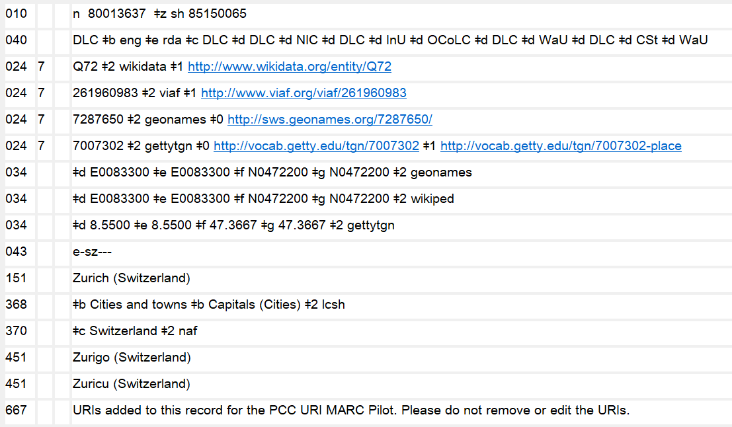
024 *
Optional Fields
Notes:
August 16, 2023: updates notes to indicate new policy on adding URIs to the 024 field.
Dec. 23, 2020: Edited speaker note to remove references to 024 moratorium; added Feb. 2021 text of DCM Z1 024.
March 5, 2020: updated slide and notes
NACO catalogers may add URIs to the 024 field following the guidance in NACO 024 Best Practices Guidelines.
DCM Z1 (February 2021):
General
Follow the guidelines in NACO Best Practices for the 024 Field posted at: https://www.loc.gov/aba/pcc/naco/documents/NACO-024-Best-Practices.pdf. As a general rule, limit the number of 024 fields in a NACO authority record to five. Do not routinely delete or change existing 024 fields when adding new ones.
Maintenance:
LC/PCC catalogers are not required to maintain identifiers coded in the 024 field of NACO authority records. When an 024 field is present in an authority record that is being reported for deletion (for example, in the case of a duplicate), LC/PCC catalogers should transfer the field to the record that is to be retained. When two authority records are being collapsed into one, and each record has a different 024 field, LC/PCC catalogers should include both 024 fields in the updated record.
DCM Z1 024 (August 2019):
Maintenance:
LC/PCC catalogers are not required to maintain identifiers coded in the 024 field of NACO authority records. When an 024 field is present in a personal name record that is being reported for deletion (for example, in the case of a duplicate), LC/PCC catalogers should transfer the field to the record that is to be retained. When two personal name authority records are being collapsed into one, and each record has a different 024 field, LC/PCC catalogers should include both 024 fields in the updated record.

Slide 133

034, 043
Optional Fields
Notes:
November 25, 2015
October 10, 2023: changed GEOnet to GNS in speaker notes
ANIMATED SLIDE for each of these fields (boxes will come in on mouse click):
Use field 034 to record coded geographic coordinates for the place. The DCM Z1 034 provides detailed guidance on how to encode the field. NACO institutions are encouraged to provide both degrees/minutes/seconds and decimal degrees when available (see second and third 034 fields in the slide). Tip: GNIS, GNS, and several other online gazetteers provide coordinates in both degrees/minutes/seconds and decimal degrees.
In 670s, when giving coordinates, do not use the apostrophe and quotation mark for minutes and seconds. LC-PCC PS for 1.4 instructs catalogers to use the soft sign, or prime sign (in OCLC diacritics called miagkiĭ znak) (ʹ) for minutes and the hard sign, or double prime (in OCLC, tvërdyĭ znak) (ʺ) for seconds. For degrees, use the degree symbol, not superscript 0. Many websites don’t use the ALA diacritics for these characters, so you may need to fix them when cutting and pasting from a web page.
Field 043 may be included in an NAR to record the geographic area code that is used for the place. Consult the MARC Code List for Geographic Areas online at http://www.loc.gov/marc/geoareas/ or available through Cataloger’s Desktop.

Slide 134


034
Notes:
October 10, 2023: updated screen shot and slight revision to speaker notes
GNIS provides coordinates in both decimal degrees and in degrees/minutes/seconds. Both sets of coordinates shown in GNIS are what are called point coordinates, as they point to a single point on a map (usually, the center of the geographic place). Both sets of coordinates found here can be recorded in coded form in separate 034 fields.

Slide 135

034
$d Coordinates - westernmost longitude
$e Coordinates - easternmost longitude
$f Coordinates - northernmost latitude
$g Coordinates - southernmost latitude
Abbreviations for the hemispheres: N = North, S = South, E = East, W = West
Coordinates may be recorded various forms:
hdddmmss (hemisphere-degrees-minutes-seconds)
hddd.dddddd (hemisphere-degrees.decimal degrees)
+/-ddd.dddddd (decimal degrees, preceded by + for N and E and by - for S and W; the + is optional however)
also other forms (see DCM Z1 034)
$2 - Source of data code
gnis, geonet, geonames, wikiped, and many others are defined. See the Cartographic Data Source Codes web page
41°18′52″N 122°18′41″W is usually coded as:
034 $d W1221841 $e W1221841 $f N0411852 $g N0411852
41.314444, -122.311389 is usually coded as:
034 $d -122.311389 $e -122.311389 $f 41.314444 $g 41.314444
Notes:
November 25, 2015
October 10, 2023: updated notes about GNS
Trainers may choose to skip over the details on this slide, but it is here for reference and to help trainees complete the exercises.
Use field 034 to record coded geographic coordinates for the place. The DCM Z1 034 provides detailed guidance on how to encode the field. NACO institutions are encouraged to provide both degrees/minutes/seconds and decimal degrees when available (see second and third 034 fields in the slide). Tip: GNIS and several other online gazetteers provide coordinates in both degrees/minutes/seconds and decimal degrees. In GNS, the default display has coordinates in degrees/minutes/seconds, but if you click on the detailed view you can also see decimal degrees.
In 670s, when giving coordinates, do not use the apostrophe and quotation mark for minutes and seconds. LC-PCC PS for 1.4 instructs catalogers to use the soft sign, or prime sign (in OCLC diacritics called miagkiĭ znak) (ʹ) for minutes and the hard sign, or double prime (in OCLC, tvërdyĭ znak) (ʺ) for seconds. For degrees, use the degree symbol, not superscript 0. Many websites don’t use the ALA diacritics for these characters, so you may need to fix them when cutting and pasting from a web page.
Cartographic Data Source Codes webpage: http://www.loc.gov/standards/sourcelist/cartographic-data.html

Slide 136
034/043 Exercise
Earlier, you determined the preferred name for this place. Now add fields 034 and 043 to the NAR being created for it.
Cartographic source code for this resource is gnis
Notes:
May 1, 2013

Slide 137
034 $d $e $f $g $2
034 $d $e $f $g $2
043
151 La Paloma (Tex.)
451 Paloma (Tex.)
670 GNIS, April 26, 2013 $b (La Paloma, populated place,
Cameron County, Texas, 26.0459111° -97.6674910°,
26°02ʹ45ʺN 097°40ʹ03ʺW)
Record fields 034 and 043
Notes:
May 1, 2013

Slide 138
034 $d $e $f $g $2
034 $d $e $f $g $2
043
151 La Paloma (Tex.)
451 Paloma (Tex.)
670 GNIS, April 26, 2013 $b (La Paloma, populated place,
Cameron County, Texas, 26.0459111° -97.6674910°,
26°02ʹ45ʺN 097°40ʹ03ʺW)
-97.6674910 -97.6674910 26.0459111 26.045911 gnis
W0974003 W0974003 N0260245 N0260245 gnis
n-us-tx
Notes:
May 1, 2013
ANIMATED SLIDE
ANSWER
034 $d -97.6674910 $e -97.6674910 $f 26.0459111 $g 26.0459111 $2 gnis
034 $d W0974003 $e W0974003 $f N0260245 $g N0260245 $2 gnis
043 n-us-tx

Slide 139
Bounding Box Coordinates
Bounding Box Tool can be used to obtain coordinates in the form of a square or rectangle that encompasses the place
https://boundingbox.klokantech.com/
034 $d W0875624 $e W0873126 $f N0420122 $g N0413838 $2 bound
034 $d -087.940101 $e -087.523984 $f 042.023022 $g 041.643919 $2 bound
Notes:
March 5, 2020: new slide
Instead of point coordinates, there is an online tool available for catalogers to obtain coordinates in the form of a square or rectangle that encompasses a place. It is called the Bounding Box Tool.
You can see in the example in this slide that the coordinates in each subfield are different. These coordinates are for the city of Chicago. The source code for the Bounding Box Tool is “bound.”

Slide 140

Notes:
March 5, 2020: new slide
You can get bounding box coordinates for a place from the Bounding Box Tool. It will give coordinates in a variety of formats, including MARC OCLC, and it will give them in both degrees, minutes, and seconds (as shown in the slide) and in decimal degrees. You can copy and paste them from the tool directly into an authority record.

Slide 141
781
Geographic subdivision form
DCM Z1 781
Follow SHM H 830 to determine the form
See also SHM H 835 Geographic Subdivision
Information in Name Authority Records
Be aware which kinds of places are appropriate for
use as geographic subdivisions and which are not
Be aware of unusual situations (e.g., ancient or
obsolete jurisdictions such as historic kingdoms,
duchies, etc.; Australian places; complicated qualifiers;
Indian tribes)
Remember the “division of the world” and which
places are established as name authorities and which
as subjects
Optional Fields
Notes:
May 1, 2013
Catalogers may optionally add a 781 field (Subdivision Linking Entry-Geographic Subdivision) to records for places that can be used as a geographic subdivision. Consult DCM Z1 781, which refers catalogers to Subject Headings Manual instruction sheet H 830.
DCM Z1 781: PCC optional practice:
For a geographic name heading that may also be used as a geographic subdivision, determine the form in which the heading is to be used as a geographic subdivision following the guidelines in instruction sheet H 830 of the Subject Headings Manual. Enter the text of the geographic subdivision form in a 781 field with second indicator 0. For a geographic heading that is used directly, such as a country, enter the data in a single $z subfield. For a geographic heading that is used indirectly through a larger geographic entity, such as a city, enter the data in two successive $z subfields. Use no other subfields. Make no changes to values in bytes of the 008. Examples:
151 France 151 Paris (France)
781 _0 $z France 781 _0 $z France $z Paris
151 Lycia
781 _0 $z Turkey $z Lycia [This is an ancient jurisdiction. As a geographic subdivision, it is subdivided through the modern place in which it is located]
151 Sydney (N.S.W.) 151 Valencia (Spain : Region)
781 _0 $z Australia $z Sydney (N.S.W.) 781 _0 $z Spain $z Valencia (Region)
Do not add a 781 field to a record for a geographic name heading that is not appropriate for use as a subject added entry (008/15 value "b"), such as the earlier name of a jurisdiction that has undergone a linear name change, for example, Ceylon. See also DCM Z1 667 for guidelines on adding 667 fields with notes indicating subject cataloging usage to name authority records for geographic headings that may not be used as geographic subdivisions, such as entities within cities that are qualified by the city name. Follow these guidelines for newly-created authority records. Add a 781 field to an existing record when making any other change to it. If revising an existing record that contains a 667 field subject cataloging usage note indicating the proper geographic subdivision form, delete the 667 field and replace it with a 781 field.

Slide 142

Optional Fields
Notes:
February 24, 2014
Example of a 781 field in a record for a French village.

Slide 143

Optional Fields
Notes:
May 1, 2013
An obsolete jurisdiction. SHM H 830 says “Divide historic kingdoms, former jurisdictions, extinct cities, etc., that lie wholly within a currently existing jurisdiction through that jurisdiction.”

Slide 144

Optional Fields
Notes:
November 1, 2016
Australia is an unusual situation. The larger place added to the preferred name is the name of the state or territory, not the country, but as a geographic subdivision, places are subdivided through Australia, and the state or territory qualifier is retained in the second $z.

Slide 145
781 Exercise: Record the 781 Field
034 $d -97.6674910 $e -97.6674910 $f 26.0459111 $g
26.0459111 $2 gnis
034 $d W0974003 $e W0974003 $f N0260245 $g N0260245
$2 gnis
043 n-us-tx
151 La Paloma (Tex.)
451 Paloma (Tex.)
670 GNIS, April 26, 2013 $b (La Paloma, populated place,
Cameron County, Texas, 26.0459111° -97.6674910°,
26°02ʹ45ʺN 097°40ʹ03ʺW)
781 _0 $z $z
Texas
La Paloma
Notes:
May 1, 2013
ANIMATED SLIDE
ANSWER
781 _0 $z Texas $z La Paloma

Slide 146
046, 3XX, 678
Consider recording these fields as appropriate:
046: dates of establishment/termination
368: type of jurisdiction/other designation
370: associated places
371: address
373: associated institution
377: language code for resources issued by the place
678: historical note
Optional Fields
Notes:
May 1, 2013
Since these fields are not unique to geographic places and have already been covered previously in other modules, we will not dwell on them here or go into great detail on their definitions and how to record data in them.

Slide 147

Optional Fields
Notes:
September 17, 2018
Record showing the optional recording of start and termination dates (046), type of jurisdiction (368 $b), and associated country (370 $c).
046 $q = Date of establishment *
046 $r = Date of termination *
046 $s = Start period
046 $t= End period
* NOTE: PCC has not yet implemented $q and $r. DO NOT USE until implementation. Until then, $s and $t stand for date of establishment and date of termination.
368 $b = Type of jurisdiction
370 $c = Associated country
370 $e = Place of headquarters
370 $f = Other associated place

Slide 148

Optional Fields
Notes:
August 13, 2019
Record showing type of jurisdiction (368 $b), other designation (368 $c), and other associated place (370 $f).

Slide 149

371
Optional Fields
Notes:
February 24, 2014
Example of 371 field to record address of the government.
371 $a = Address
371 $b = City
371 $c = Intermediate jurisdiction
371 $d = Country
371 $e = Postal code
371 $m = Electronic mail address
371 $u = Uniform Resource Identifier
371 $v = Source of information

Slide 150

Notes:
May 1, 2013
It might not be first very obvious whether a place can have an associated institution, but as you can see from this slide, it can. Seven First Nations in Saskatchewan are members of a body called the Saskatoon Tribal Council.

Slide 151

373
Optional Fields
Notes:
September 17, 2018
Example of an associated institution or affiliation. The council has been established in the LC/NACO Authority File, so the cataloger records the authorized access point for the corporate body and adds a subfield $2 for naf.

Slide 152


373
Notes:
February 24, 2014
Another example of an associated institution. The Village of Barrington Hills, Illinois is a member of the Barrington Area Council of Governments.

Slide 153

678
Optional Fields
Notes:
September 17, 2018
Optional administrative history note.

Slide 154

URIs in 3XX and 5XX
Notes:
July 30, 2025: replaced example in slide and updated speaker notes
October 7, 2024: new slide
URIs may be added to 3XX and 5XX fields in accordance with PCC guidelines and best practices. Tools such as the Authority Toolkit (https://files.library.northwestern.edu/public/oclc/documentation/) may be used to automatically add URI subfields. Record authority record URIs in subfield $0, real world object URIs in $1, and relationship designator URIs in $4. The recommended order of subfields is $2 $4 $0 $1. When using RDA relationship URIs in $4, use unconstrained property URIs from the RDA Registry (https://www.rdaregistry.info/Elements/u/). Consult the URIs in MARC Pilot Resource Documents & Tools website (https://wiki.lyrasis.org/pages/viewpage.action?pageId=178881300), but note that PCC documentation on URIs is currently in the process of being revised and updated.
URIs were originally added as part of the PCC’s URIs in MARC Pilot project. The 667 note “URIs added to this record for the PCC URI MARC Pilot. Please do not remove or edit the URIs” is no longer required and may be deleted when a record is being revised for any reason.
Reminder: Any authorized access point given in a 5XX field must be established in its own authority record.
$0 - authority URI
$1 - real world object URI
$4 - relationship URI

Slide 155
Exercises
Creating Full NARs for Places
Notes:
May 1, 2013
Using all that you’ve learned and practiced, create complete NARs for the places in the following exercises. Don’t worry if you don’t know the correct Cartographic Data Source Code(s) to use in field 034, or the correct Geographic Area Code to use in field 043. They can easily be looked up online when you need to use them in NARs that you’re creating. The answers to these exercises will have them. Concentrate on the authorized access point, variant access points, and the 046 and 3XX fields.

Slide 156
034
034
043
151
368
370
451
451
670 Mt. Nebo phone directory, 1979.
670 GNIS, March 6, 2013 $b (Mount Nebo; populated place; variant name: Elberta; Utah County, Utah; 39.9527303° -111.9563298°; 39°57’10”N 111°57’23”W)
781 _0
Notes:
January 16, 2015
Based on information provided in the 670 citations, create an NAR for the place. Optionally record attributes of the place in 034, 043, 3XX, and form of geographic subdivision in 781.
034 $d -111.9563298 $e -111.9563298 $f 39.9527303 $g 39.9527303 $2 gnis
034 $d W1115723 $e W1115723 $f N0395710 $g N0395710 $2 gnis
043 n-us-ut
151 Mount Nebo (Utah)
368 $b Cities and towns $2 lcsh
370 $c United States $e Utah and/or perhaps: $e Utah County (Utah) $2 naf
451 Mt. Nebo (Utah)
451 Elberta (Utah)
781 _0 $z Utah $z Mount Nebo
Note: always choose “Mount” over “Mt.” for the preferred name, even if sources consulted only use “Mt.” Conflicts in NARs only have to be broken between jurisdictions, not with non-jurisdictional geographic features like mountains, rivers, lakes, etc. If a subject heading for a place with the same name is needed, the conflict will be broken in the subject heading: Nebo, Mount (Utah : Mountain)

Slide 157
034
034
043
046
151
368
370
451
451
451
451
551
670 Santa Elena Province, 2009?: $b map recto (Gobierno Provincial de Santa Elena)
670 Wikipedia, March 7, 2013 $b (Santa Elena Province; The Province of Santa
Elena is a province of Ecuador in the coastal region. Created in 2007 from
territory that belonged to the Guayas Province; its capital city is Santa Elena,
from which the province derives its name; province is divided into three
cantons: La Libertad, Salinas, Santa Elena) Spanish version of page (Provincia de
Santa Elena; Santa Elena)
670 GNS, March 7, 2013 $b (Santa Elena (approved); Provincia de Santa Elena
(approved); Santa Elena (short); first-order administrative division; Ecuador;
02°05’00”S 080°35’00”W; -2.083333° -80.583333°)
781 _0
Already established:
151 Guayas (Ecuador : Province)
See next slide
Notes:
March 21, 2017: added controlled vocabulary to 368
October 10, 2023: changed GEOnet to GNS in 670 and in speaker notes
Based on information provided in the 670 citations, create an NAR for the place. Optionally record attributes of the place in 034, 043, 046, 3XX, and form of geographic subdivision in 781.
034 $d W0803500 $e W0803500 $f S0020500 $g S0020500 $2 geonet
034 $d -80.583333 $e -80.583333 $f -2.083333 $g -2.083333 $2 geonet
043 s-ec---
046 $s 2007 $2 edtf
151 Santa Elena (Ecuador : Province)
368 $b Province or $b Provinces $2 aat
370 $c Ecuador $2 naf
451 Santa Elena Province (Ecuador)
451 Gobierno Provincial de Santa Elena (Ecuador)
451 Province of Santa Elena (Ecuador)
451 Provincia de Santa Elena (Ecuador)
551 Guayas (Ecuador : Province)
781 _0 $z Ecuador $z Santa Elena (Province)
Note: Here we have a case of a split of territory. In such a case, both the resulting entities are valid for use as a subject, as is the earlier entity. In this situation, Guayas province didn’t split into two new provinces, it just gave up some territory to a new province, Santa Elena. RDA does not currently contain a relationship designator appropriate for use here, so the relationship between the two entities is coded as a simple see also relationship.
LC-PCC PS for 16.2.2.3: If the Geographic Names Server (GNS) shows both a BGN standard and a BGN short form of the place name, generally select the longer form as the preferred name, unless RDA 16.2.2.8 (place names that include a term indicating type of jurisdiction) is applicable. So the short form is selected, but it conflicts with a city and a canton with the same name, so there is a conflict, and the type of jurisdiction must be added to the preferred name.
In addition to the new NAR, the NAR already existing for Guayas province will also need to be revised to show the reciprocal relationship between it and Santa Elena province (next slide).

Slide 158
034 $d W0800000 $e W0800000 $f S0020000 $g S0020000 $2 other
034
043 s-ec---
151 Guayas (Ecuador : Province)
368
370
451
451
451
551 $w a $a Guayaquil (Ecuador : Province)
551
670 BGN 5/28/82 $b (Provincia del Guayas [Guayas=brief], ADM1, 2°00’S 80°00’W)
670 Historia social y económica de la antigua provincia de Guayaquil, 1763- 1842, 1973.
670 GNS, March 7, 2013 $b (Guayas (approved); Provincia del Guayas (approved); first-order administrative division; Ecuador; 02°00’00”S 079°50’00”W; -2° -79.833333°)
670 Wikipedia, March 7, 2013 $b (Guayas Province; Guayas is a coastal province in Ecuador; Province of Guayas; Guayaquil Province was later renamed Guayas) Spanish version (Guayas, officially Provincia del Guayas; recently the territory of the province Santa Elena was split off from Guayas)
781 _0 $z Ecuador $z Guayas (Province)
Revise this NAR after adding the last two 670s shown below
Notes:
September 17, 2018: moved $w to beginning of 551 field
March 21, 2017: added controlled vocabulary to 368
October 10, 2023: changed GEOnet to GNS in 670
Based on information provided in the new 670 citations, revise this NAR.
034 $d W0800000 $e W0800000 $f S0020000 $g S0020000 $2 other [one might also decide to delete this, since the GNS data are more current than the coordinates from 1982]
034 $d W0795000 $e W0795000 $f S0020000 $g S0020000 $2 geonet
034 $d -79.833333 $e -79.833333 $f -2 $g -2 $2 geonet
043 s-ec---
151 Guayas (Ecuador : Province)
368 $b Province or $b Provinces $2 aat
370 $c Ecuador $2 naf
451 Provincia del Guayas (Ecuador)
451 Guayas Province (Ecuador)
451 Province of Guayas (Ecuador)
551 $w a $a Guayaquil (Ecuador : Province)
551 Santa Elena (Ecuador : Province)
781 _0 $z Ecuador $z Guayas (Province)
Note: Here we have a case of a split of territory. In such a case, both the resulting entities are valid for use as a subject, as is the earlier entity. In this situation, Guayas province didn’t split into two new provinces, it just gave up some territory to a new province, Santa Elena. RDA has a relationship designator that could be used to describe this: product of a split. However, at the present time, OCLC does not validate the use of subfield $i in 551 fields, so a simple see also reference must be used for now.

Slide 159

Notes:
May 1, 2013
You are cataloging this document and will need an access point for the creator and a subject heading for the place.

Slide 160
043
151
368
370
451
451
670 Deerfield Township comprehensive plan, 2008: $b p. 4 (Deerfield Township, located in Warren County, Ohio; second most populous jurisdiction within Warren County)
670 GNIS, March 6, 2013 $b (Township of Deerfield, civil, county: Warren County, state: Ohio; also lists three other civil jurisdictions with same name in other counties)
781 _0
Notes:
March 21, 2017: added controlled vocabulary to 368
Based on information provided in the 670 citations, create an NAR for the place. Optionally record attributes of the place in 043, 3XX, and form of geographic subdivision in 781.
LC-PCC PS for 16.4 tells us that for U.S. townships (called “towns” in some states) that encompass one or more local communities and the surrounding territory, do not include the term “township” or “town” as part of the name. Instead, add the term after the name of the state. In this particular case, since there is more than one township in Ohio with the same name, the county name must also be included in the access point, followed by the term for type of jurisdiction.
043 n-us-oh
151 Deerfield (Warren County, Ohio : Township)
368 $b Township or $b Townships $2 aat
370 $c United States $e Warren County (Ohio) $2 naf
451 Deerfield Township (Warren County, Ohio)
451 Township of Deerfield (Warren County, Ohio)
781 _0 $z Ohio $z Deerfield (Warren County : Township)
The PDF for the work being cataloged can be viewed at http://virtuallibrary.cincinnatilibrary.org/lib/25/1612/deerfld-twnshp-compreh-plan.pdf

Slide 161

CREATE NAR FOR THE PLACE CITED IN THE 1ST 670
034
034
043
046
151
368
370
451
451
451
551
667
670 Great Britain. Admiralty. Pôrto Alexandre : from the Portuguese government chart of 1941, 1952.
670 Wikipedia, March 7, 2013 $b (Tômbua (also known as Tombwa, Tombwe or Porto Alexandre); city in
Namibe Province, Angola; 15°48’S 11°51’E)
670 Wikipédia [Portuguese Wikipedia], March 7, 2013 $b (Tômbua or Tombwa; founded 1895; was named
Porto Alexandre until 1975)
670 GNS, March 7, 2013 $b (Tombua (approved); variants: Port Alexander, Porto Alexandre; populated
place; Angola, ADM1: Namibe; 15°48’00”S 011°51’00”E; -15.8° 11.85°)
670 Angola : on old boot tracks in Angola, via Drive out website, March 7, 2013 $b (Tombua (formerly
Porto Alexandré))
781 _0
Notes:
March 5, 2020: update box on slide
October 10, 2023: changed GEOnet to GNS in 670
You are cataloging a map. Based on information provided in the 670 citations, create an NAR for the place depicted in the map. Optionally record attributes of the place in 034, 043, 046, 3XX, and 667 or 781.
This is an example of a name change. LCSH policy is that only the latest/current name of the place is valid for use as a subject. The fixed fields Subj and Subj use must be coded to indicate that the earlier name is not valid for use as a subject. A subject usage note may also be added in field 667. Even though the map being cataloged is from the time when the place was named Porto Alexandre, the subject that would be assigned to it is Tombua (Angola) $v Maps. Therefore, in addition to the NAR for the former name of the place, another NAR is needed for its current name (see next slide).
Ref status: a
Subj: n Subj use: b
034 $d E0115100 $e E0115100 $f S0154800 $g S0154800 $2 geonet
034 $d 11.85 $e 11.85 $f -15.8 $g -15.8 $2 geonet
043 f-ao---
046 $s 1895 $t 1975 $2 edtf
151 Porto Alexandre (Angola)
368 $b City or if using LCSH: $b Cities and towns $2 lcsh
370 $c Angola $2 naf
451 Port Alexander (Angola)
551 $w b $a Tombua (Angola)
667 SUBJECT USAGE: This name is not valid for use as a subject. Works about this place are entered under Tombua (Angola).
Note: Because OCLC does not currently validate relationship designators in subfield $i of field 551, the previous practice of using codes in subfield $w for earlier/later must still be followed.
Note: Because the earlier name is not valid for use as a subject, it is also not valid as a geographic subdivision, so no 781 field is recorded.

Slide 162
CREATE NAR FOR THE CURRENT NAME OF THE PLACE
034
034
043
046
151
368
370
451
451
451
551
667
670 Great Britain. Admiralty. Pôrto Alexandre : from the Portuguese government chart of 1941, 1952.
670 Wikipedia, March 7, 2013 $b (Tômbua (also known as Tombwa, Tombwe or Porto Alexandre); city in
Namibe Province, Angola; 15°48’S 11°51’E)
670 Wikipédia [Portuguese Wikipedia], March 7, 2013 $b (Tômbua or Tombwa; founded 1895; was named
Porto Alexandre until 1975)
670 GNS, March 7, 2013 $b (Tombua (approved); variants: Port Alexander, Porto Alexandre; populated
place; Angola, ADM1: Namibe; 15°48’00”S 011°51’00”E; -15.8° 11.85°)
670 Angola : on old boot tracks in Angola, via Drive out website, March 7, 2013 $b (Tombua (formerly
Porto Alexandré))
781 _0
Notes:
March 5, 2020: updated box on slide
October 10, 2023: changed GEOnet to GNS in 670
Based on information provided in the 670 citations, create an NAR for the current name of the place. Optionally record attributes of the place in 034, 043, 046, 3XX, 781.
This is an example of a name change. LCSH policy is that only the latest/current name of the place is valid for use as a subject. Even though the map being cataloged is from the time when the place was named Porto Alexandre, the subject that would be assigned to it is Tombua (Angola) $v Maps. Therefore, an NAR for Tombua is needed.
Ref status: a
Subj: a Subj use: a
034 $d E0115100 $e E0115100 $f S0154800 $g S0154800 $2 geonet
034 $d 11.85 $e 11.85 $f -15.8 $g -15.8 $2 geonet
043 f-ao---
046 $s 1975 $2 edtf
151 Tombua (Angola)
368 $b City or if using LCSH: $b Cities and towns $2 lcsh
370 $c Angola and perhaps $e Namibe (Angola) $2 naf
451 Tombwa (Angola)
451 Tombwe (Angola)
551 $w a $a Porto Alexandre (Angola)
781 _0 $z Angola $z Tombua
Note: Because OCLC does not currently validate relationship designators in subfield $i of field 551, the previous practice of using codes in subfield $w for earlier/later must still be followed.

Slide 163

Notes:
May 1, 2013
You are cataloging this website and you will need a subject heading for the neighborhood.
[Source: http://miamiroads.org/]

Slide 164

Notes:
May 1, 2013
Wikipedia article for the place

Slide 165

Notes:
May 1, 2013
City of Miami neighborhoods maps (from Wikipedia article on the place): http://en.wikipedia.org/wiki/File:Miami_neighborhoodsmap.png

Slide 166
034
034
043
151
368
370
4__
4__
4__
667
670 Miami Roads Neighborhood Civic Association website, March 7, 2013: $b About us
(“The Roads”; “The Roads” neighborhood) $u http://miamiroads.org/about_us.htm
670 GNIS, March 7, 2013 $b (The Roads; populated place; county: Miami-Dade; state:
Florida; 25.7555556° -80.2050000° 25°45’20”N 080°12’18”W)
670 Wikipedia, March 7, 2013 $b (The Roads; a neighborhood of Miami in Miami-Dade
County, Florida; 25.756°N 80.205°W)
781 _0
Notes:
February 24, 2014
Based on information provided in the 670 citations, create an NAR for the place. Optionally record attributes of the place in 034, 043, 046, 3XX, and 667 or 781.
The place’s name begins with an initial article. LC-PCC PS for 16.2.2.4 instructs you to drop the initial article in this case (English-language name in an English-speaking country). RDA 16.2.3.4 says that if an initial article present in the name of the place has been omitted from the preferred name of the place, record the name with the initial article as a variant name. Another variant name can be made in the form of the name of the neighborhood as a subdivision of the city.
This is an example of a neighborhood. It may be used as a subject, but is not valid for use as a geographic subdivision. A 667 could be included to specify this. 781 is not appropriate.
Ref status: a
Subj: a Subj use: a
034 $d W0801218 $e W0801218 $f N0254520 $g N0254520 $2 gnis
034 $d -80.2050000 $e -80.2050000 $f 25.7555556 $g 25.7555556 $2 gnis
043 n-us-fl
151 Roads (Miami, Fla.)
368 $b Neighborhood or if using LCSH: $b Neighborhoods $2 lcsh
370 $c United States $e Miami (Fla.) and perhaps $e Florida $2 naf
451 The Roads (Miami, Fla.)
410 1_ Miami (Fla.). $b Roads
667 SUBJECT USAGE: This name is not valid for use as a geographic subdivision.
Note: Because the name is not valid for use as a geographic subdivision, no 781 field is recorded.
Of course, if there were no NAR for the city that a neighborhood is in, it would also need to be created.

Slide 167

Notes:
May 1, 2013
You are cataloging this entity’s website. You will need a corporate body access point for the jurisdiction as well as a subject heading for it.

Slide 168
CREATE NAR FOR THE CURRENT NAME
034
034
043
151
368
370
551
667
670 Greenville Rancheria home page, March 7, 2013 $b (Greenville Rancheria; currently
located in the Indian Valley in the Sierra Nevada Mountains of Northern California; tribal
government offices have historically been located in Redding, Red Bluff and Greenville, and are
currently in Greenville) $u http://www.greenvillerancheria.com/
670 BIA Indian entities, August 10, 2012 $b (Greenville Rancheria (previously listed as the
Greenville Rancheria of Maidu Indians of California))
670 Wikipedia, March 7, 2013 $b (Greenville Rancheria of Maidu Indians; The Greenville Rancheria
of Maidu Indians of California is a federally recognized tribe in Plumas and Tehama Counties;
Greenville Rancheria is headquartered in Greenville, California)
670 GNIS, March 7, 2013 $b (Greenville Rancheria, civil, Plumas County, California, 40.1487839°
-120.8933990° 40°08’56”N 120°53’36”W; designation: Administered Tribal)
781 _0
Notes:
September 17, 2018: moved $w to beginning of 551 field
Based on information provided in the 670 citations, create an NAR for the place. Optionally record attributes of the place in 034, 043, 3XX, and 667 or 781.
This is a federally recognized Indian tribe, which is considered a jurisdiction. BIA Indian entities gives the current and former names, so two NARs are needed. This record is for the current name.
Ref status: a
Subj: a Subj use: a
034 $d -120.8933990 $e -120.8933990 $f 40.1487839 $g 40.1487839 $2 gnis
034 $d W1205336 $e W1205336 $f N0400856 $g N0400856 $2 gnis
043 n-us-ca
151 Greenville Rancheria
368 $b Federally recognized Indian tribes $2 lcsh
370 $c United States $e Greenville (Calif.) and perhaps $f California $2 naf
551 $w a $a Greenville Rancheria of Maidu Indians of California
781 _0 $z Greenville Rancheria
Note: Until OCLC validates the use of relationship designators in subfield $i of 551 fields, the previous practice of using subfield $w codes for earlier/later names will continue to be followed.
The second NAR would be for the earlier name (next slide).

Slide 169
CREATE NAR FOR THE FORMER NAME
043
151
368
370
451
551
667
670 BIA Indian entities, August 10, 2012 $b (Greenville Rancheria (previously listed
as the Greenville Rancheria of Maidu Indians of California))
670 Greenville Rancheria home page, March 7, 2013 $b (Greenville Rancheria; currently
located in the Indian Valley in the Sierra Nevada Mountains of Northern California; tribal
government offices have historically been located in Redding, Red Bluff and Greenville,
and are currently in Greenville.) $u http://www.greenvillerancheria.com/
670 Wikipedia, March 7, 2013 $b (Greenville Rancheria of Maidu Indians; The Greenville
Rancheria of Maidu Indians of California is a federally recognized tribe in Plumas and
Tehama Counties; Greenville Rancheria is headquartered in Greenville, California)
670 GNIS, March 7, 2013 $b (Greenville Rancheria, civil, Plumas County, California,
40.1487839° -120.8933990° 40°08’56”N 120°53’36”W; designation: Administered Tribal)
781 _0
Notes:
September 17, 2018: moved $w to beginning of 551 field
This record is for the former name of the federally recognized Indian tribe. The earlier name is not valid for use as a geographic subject.
Ref status: a
Subj: n Subj use: b
043 n-us-ca
151 Greenville Rancheria of Maidu Indians of California
368 $b Federally recognized Indian tribes $2 lcsh
370 $c United States $e Greenville (Calif.) and perhaps $f California $2 naf
451 Greenville Rancheria of Maidu Indians
551 $w b $a Greenville Rancheria
667 SUBJECT USAGE: This name is not valid for use as a subject. Works about this place are entered under Greenville Rancheria.
Note: Until OCLC validates the use of relationship designators in subfield $i of 551 fields, the previous practice of using subfield $w codes for earlier/later names will continue to be followed.

Slide 170

Notes:
May 1, 2013
You are cataloging this thesis and will need a subject heading for the district.

Slide 171
043
046
151
368
370
371
372
451
551
667
670 The Brazos Valley Groundwater Conservation District, 2011: $b p. 10 (in Eastern Central
Texas; BVGCD) p. 45 (created by the state legislature as a temporary district in 2001,
effective September 1, 2001; made permanent in 2002)
670 Its website, March 7, 2013 $b (Brazos Valley Groundwater Conservation District; a not-
for-profit local government that was created with a directive to protect and conserve the
groundwater resources of Brazos and Robertson counties; 112 West 3rd Street, Hearne,
TX 77859) $u http://brazosvalleygcd.org/
675 GNIS, March 7, 2013
781 _0
Notes:
October 31, 2016
Based on information provided in the 670 citations, create an NAR for the place. Optionally record attributes of the place in 043, 046, 3XX, and 667 or 781.
This is one of those “ambiguous entities” that is listed as a Type 1 heading (“Conservation districts”): entities established through NACO, tagged 151.
Ref status: a
Subj: a Subj use: a
043 n-us-tx
046 $s 2001-09-01 $2 edtf
151 Brazos Valley Groundwater Conservation District (Tex.)
368 $b Conservation district or if using LCSH: Water districts $2 lcsh
370 $c United States $e Hearne (Tex.) $f Brazos County (Tex.) $f Robertson County (Tex.) $2 naf
371 112 West 3rd Street $b Hearne $c TX $e 77859
372 Water conservation $2 lcsh or perhaps: Water conservation--Texas--Brazos County $a Water conservation--Texas--Robertson County $2 lcsh
451 BVGCD (Tex.)
781 _0 $z Texas $z Brazos Valley Groundwater Conservation District

Slide 172
034
034
034
034
043
046
046
151
368
370
451
667
670 A brief history of Rantem, Newfoundland, 1945.
670 Querying Canadian geographical names website, March 20, 2013 $b (Rantem; Newfoundland and
Labrador; Feature type: Unincorporated area; Generic: Vacated or Seasonal Settlement; Location:
Bellevue; Placentia; 47°41’40”N, 53°51’30”W; 47.6943999°, -53.8582999°)
670 Wikipedia, March 20, 2013 $b (Rantem, Newfoundland and Labrador; Rantem was a small
settlement located south east of Swift Current, Newfoundland and Labrador; 47°41’N 53°53’W)
670 Newfoundland and Labrador abandoned communities index, via WWW, March 20, 2013 $b
(Rantem; 47°42’ 53°57’; settled 1869, abandoned by 1960)
675 GNS, March 20, 2013
781 _0
Note: The province of Newfoundland changed its name to Newfoundland and Labrador in December 2001.
Notes:
October 10, 2023: changed GEOnet to GNS in 675
October 31, 2016
This is an example of an historical place that no longer exists. LC-PCC PS for 16.2.2.4 says “If the smaller place has changed its name or has ceased to exist, use as a qualifier the name the larger place had during the period in which the name of the smaller place is applicable.” The province of Newfoundland changed its name to Newfoundland and Labrador in December 2001. Rantem ceased to exist by 1960. Therefore, following the abbreviations found in Appendix B.11, the qualifier used for Rantem should be Nfld. rather than N.L.
Ref status: n Subj: a Subj use: a
034 $d W0535130 $e W0535130 $f N0474140 $g N0474140 $2 cgndb
034 $d -53.8582999 $e -53.8582999 $f 47.6943999 $g 47.6943999 $2 cgndb
034 $d W0535300 $e W0535300 $f N0474100 $g N0474100 $2 wikiped
034 $d W0535700 $e W0535700 $f N0474200 $g N0474200 $2 nlaci
043 n-cn-nf
046 $s 1869 $t [..1960] $2 edtf [This is the way “1960 or earlier” is coded in EDTF. A cataloger would have to look up the EDTF specification to figure this out.]
151 Rantem (Nfld.)
368 $b Unincorporated area or if using LCSH: Unincorporated areas $2 lcsh $b Vacated settlement or Abandoned community or if using LCSH perhaps: Extinct cities $2 lcsh
$c Canada $e Newfoundland $2 naf
781 _0 $z Newfoundland and Labrador $z Rantem (Nfld.)
Note: SHM H 715 Extinct cities says: “If it is necessary to assign as a subject heading the name of a city or town that existed beyond 1500, or that still exists, establish it as a name heading” and “As a geographic subdivision, the heading for an extinct city is divided through the appropriate modern jurisdiction.” Similar information is found in SHM H 830 Geographic Subdivision: “As a general rule, subdivide to subordinate localities located wholly within a country by interposing the name of the relevant country between the heading and the name of the subordinate locality. Subordinate localities include: subordinate political jurisdictions, such as provinces, districts, counties, cities, etc.; historic kingdoms, principalities, etc. ... Divide historic kingdoms, former jurisdictions, extinct cities, etc., that lie wholly within a currently existing jurisdiction through that jurisdiction. ... If the heading for the locality being brought out as a geographic subdivision has as its qualifier the same name as the country or division through which it is being subdivided, delete the country or division name from the qualifier of the locality, even if it is abbreviated, in order to avoid redundancy. Retain in parentheses any other data included in the qualifier to differentiate the heading, including names of obsolete jurisdictions.”
Heading: Matabeleland (Southern Rhodesia)
Subdivision usage: 650 #0 $a Gold mines and mining $z Zimbabwe $z Matabeleland (Southern Rhodesia)
Heading: Sibirskiĭ kraĭ (R.S.F.S.R.) [a jurisdiction that existed only during the period of the Soviet Union]
Subdivision usage: 650 #0 $a Minorities $z Russia (Federation) $z Sibirskiĭkraĭ (R.S.F.S.R.)

Slide 173

ANSWERS
Full NARs for Places
Notes:
May 1, 2013
Image courtesy of samuiblue / FreeDigitalPhotos.net
The answers are also in the trainee manuals in the Appendix.

Slide 174
034
034
043
151
368
370
451
451
670 Mt. Nebo phone directory, 1979.
670 GNIS, March 6, 2013 $b (Mount Nebo; populated place;
variant name: Elberta; Utah County, Utah; 39.9527303°
-111.9563298°; 39°57’10”N 111°57’23”W)
781 _0
$d -111.9563298 $e -111.9563298 $f 39.9527303 $g 39.9527303 $2 gnis
$d W1115723 $e W1115723 $f N0395710 $g N0395710 $2 gnis
n-us-ut
Mount Nebo (Utah)
$b Cities and towns $2 lcsh
$c United States $f Utah and/or $f Utah County (Utah) $2 naf
Mt. Nebo (Utah)
Elberta (Utah)
$z Utah $z Mount Nebo
Notes:
February 18, 2025: changed $e in 370 to $f
May 1, 2013
ANIMATED SLIDE
Based on information provided in the 670 citations, create an NAR for the place. Optionally record attributes of the place in 034, 043, 3XX, and form of geographic subdivision in 781.
034 $d -111.9563298 $e -111.9563298 $f 39.9527303 $g 39.9527303 $2 gnis
034 $d W1115723 $e W1115723 $f N0395710 $g N0395710 $2 gnis
043 n-us-ut
151 Mount Nebo (Utah)
368 $b Cities and towns $2 lcsh
370 $c United States $f Utah and/or perhaps: $f Utah County, Utah $2 naf
451 Mt. Nebo (Utah)
451 Elberta (Utah)
781 _0 $z Utah $z Mount Nebo
Note: always choose “Mount” over “Mt.” for the preferred name, even if sources consulted only use “Mt.” Conflicts in NARs only have to be broken between jurisdictions, not with non-jurisdictional geographic features like mountains, rivers, lakes, etc. If a subject heading for a place with the same name is needed, the conflict will be broken in the subject heading: Nebo, Mount (Utah : Mountain)

Slide 175
034
034
043
046
151
368
370
451
451
451
451
551
670 Santa Elena Province, 2009?: $b map recto (Gobierno Provincial de Santa Elena)
670 Wikipedia, March 7, 2013 $b (Santa Elena Province; The Province of Santa
Elena is a province of Ecuador in the coastal region. Created in 2007 from
territory that belonged to the Guayas Province; its capital city is Santa Elena,
from which the province derives its name; province is divided into three
cantons: La Libertad, Salinas, Santa Elena) Spanish version of page (Provincia de
Santa Elena; Santa Elena)
670 GNS, March 7, 2013 $b (Santa Elena (approved); Provincia de Santa Elena
(approved); Santa Elena (short); first-order administrative division; Ecuador;
02°05’00”S 080°35’00”W; -2.083333° -80.583333°)
781 _0
$d W0803500 $e W0803500 $f S0020500 $g S0020500 $2 geonet
$d -80.583333 $e -80.583333 $f -2.083333 $g -2.083333 $2 geonet
s-ec---
$q 2007 $2 edtf
Already established:
151 Guayas (Ecuador : Province)
See next slide
Santa Elena (Ecuador : Province)
$b Province or $b Provinces $2 aat
$c Ecuador $2 naf
Santa Elena Province (Ecuador)
Gobierno Provincial de Santa Elena (Ecuador)
Province of Santa Elena (Ecuador)
Provincia de Santa Elena (Ecuador)
Guayas (Ecuador : Province)
$z Ecuador $z Santa Elena (Province)
Notes:
February 18, 2025: changed $s in 046 to $q
October 10, 2023: changed GEOnet to GNS in 670 and speaker notes
March 21, 2017: added controlled vocabulary to 368
ANIMATED SLIDE
Based on information provided in the 670 citations, create an NAR for the place. Optionally record attributes of the place in 034, 043, 046, 3XX, and form of geographic subdivision in 781.
034 $d W0803500 $e W0803500 $f S0020500 $g S0020500 $2 geonet
034 $d -80.583333 $e -80.583333 $f -2.083333 $g -2.083333 $2 geonet
043 s-ec---
046 $q 2007 $2 edtf
151 Santa Elena (Ecuador : Province)
368 $b Provinces $2 aat or $b Province
370 $c Ecuador $2 naf
451 Santa Elena Province (Ecuador)
451 Gobierno Provincial de Santa Elena (Ecuador)
451 Province of Santa Elena (Ecuador)
451 Provincia de Santa Elena (Ecuador)
551 Guayas (Ecuador : Province)
781 _0 $z Ecuador $z Santa Elena (Province)
Note: Here we have a case of a split of territory. In such a case, both the resulting entities are valid for use as a subject, as is the earlier entity. In this situation, Guayas province didn’t split into two new provinces, it just gave up some territory to a new province, Santa Elena. RDA does not currently contain a relationship designator appropriate for use here, so the relationship between the two entities is coded as a simple see also relationship.
LC-PCC PS for 16.2.2.3: If the Geographic Names Server (GNS) shows both a BGN standard and a BGN short form of the place name, generally select the longer form as the preferred name, unless RDA 16.2.2.8.1 (place names that include a term indicating type of jurisdiction) is applicable. So the short form is selected, but it conflicts with a city and a canton with the same name, so there is a conflict, and the type of jurisdiction must be added to the preferred name.
In addition to the new NAR, the NAR already existing for Guayas province will also need to be revised to show the reciprocal relationship between it and Santa Elena province (next slide).

Slide 176
034 $d W0800000 $e W0800000 $f S0020000 $g S0020000 $2 other
034
043 s-ec---
151 Guayas (Ecuador : Province)
368
370
451
451
451
551 $w r $i Predecessor: $a Guayaquil (Ecuador : Province)
551
670 BGN 5/28/82 $b (Provincia del Guayas [Guayas=brief], ADM1, 2°00’S 80°00’W)
670 Historia social y económica de la antigua provincia de Guayaquil, 1763- 1842, 1973.
670 GNS, March 7, 2013 $b (Guayas (approved); Provincia del Guayas (approved); first-order administrative division; Ecuador; 02°00’00”S 079°50’00”W; -2° -79.833333°)
670 Wikipedia, March 7, 2013 $b (Guayas Province; Guayas is a coastal province in Ecuador; Province of Guayas; Guayaquil Province was later renamed Guayas) Spanish version (Guayas, officially Provincia del Guayas; recently the territory of the province Santa Elena was split off from Guayas)
781 _0 $z Ecuador $z Guayas (Province)
$d W0795000 $e W0795000 $f S0020000 $g S0020000 $2 geonet
$b Province or $b Provinces $2 aat
Revise this NAR after adding the last two 670s shown below
$c Ecuador $2 naf
Provincia del Guayas (Ecuador)
Guayas Province (Ecuador)
Province of Guayas (Ecuador)
Santa Elena (Ecuador : Province)
Notes:
February 18, 2025: changed $w a in first 551 to $w r with $i
October 10, 2023: changed GEOnet to GNS in 670
September 17, 2018: moved $w to beginning of 551 field
March 21, 2017: added controlled vocabulary to 368
ANIMATED SLIDE
Based on information provided in the new 670 citations, revise this NAR.
034 $d W0800000 $e W0800000 $f S0020000 $g S0020000 $2 other [one might also decide to delete this, since the GNS data are more current than the coordinates from 1982]
034 $d W0795000 $e W0795000 $f S0020000 $g S0020000 $2 geonet
034 $d -79.833333 $e -79.833333 $f -2 $g -2 $2 geonet
043 s-ec---
151 Guayas (Ecuador : Province)
368 $b Provinces $2 aat or $b Province
370 $c Ecuador $2 naf
451 Provincia del Guayas (Ecuador)
451 Guayas Province (Ecuador)
451 Province of Guayas (Ecuador)
551 $w r $i Predecessor: $a Guayaquil (Ecuador : Province)
551 Santa Elena (Ecuador : Province)
781 _0 $z Ecuador $z Guayas (Province)
Note: Here we have a case of a split of territory. In such a case, both the resulting entities are valid for use as a subject, as is the earlier entity. In this situation, Guayas province didn’t split into two new provinces, it just gave up some territory to a new province, Santa Elena. RDA has a relationship designator that might be appropriate to use to describe this: product of split. However, because the old province continued to exist, the cataloger decided to use a simple see also reference.

Slide 177
n-us-oh
043
151
368
370
451
451
670 Deerfield Township comprehensive plan, 2008: $b p. 4 (Deerfield Township, located in Warren County, Ohio; second most populous jurisdiction within Warren County)
670 GNIS, March 6, 2013 $b (Township of Deerfield, civil, county: Warren County, state: Ohio; also lists three other civil jurisdictions with same name in other counties)
781 _0
Deerfield (Warren County, Ohio : Township)
$b Township or $b Townships $2 aat
$c United States $f Warren County (Ohio) and perhaps $f Ohio $2 naf
Deerfield Township (Warren County, Ohio)
Township of Deerfield (Warren County, Ohio)
$z Ohio $z Deerfield (Warren County : Township)
Notes:
February 18, 2025: changed $e in 370 to $f
March 21, 2017: added controlled vocabulary to 368
ANIMATED SLIDE
Based on information provided in the 670 citations, create an NAR for the place. Optionally record attributes of the place in 043, 3XX, and form of geographic subdivision in 781.
LC-PCC PS for 16.4 tells us that for U.S. townships (called “towns” in some states) that encompass one or more local communities and the surrounding territory, do not include the term “township” or “town” as part of the name. Instead, add the term after the name of the state. In this particular case, since there is more than one township in Ohio with the same name, the county name must also be included in the access point, followed by the term for type of jurisdiction.
043 n-us-oh
151 Deerfield (Warren County, Ohio : Township)
368 $b Townships $2 aat or $b Township
370 $c United States $f Warren County (Ohio) and perhaps $f Ohio $2 naf
451 Deerfield Township (Warren County, Ohio)
451 Township of Deerfield (Warren County, Ohio)
781 _0 $z Ohio $z Deerfield (Warren County : Township)
The PDF for the work being cataloged can be viewed at http://virtuallibrary.cincinnatilibrary.org/lib/25/1612/deerfld-twnshp-compreh-plan.pdf

Slide 178
a
CREATE NAR FOR THE PLACE CITED IN THE 1ST 670
n b
$d E0115100 $e E0115100 $f S0154800 $g S0154800 $2 geonet
$d 11.85 $e 11.85 $f -15.8 $g -15.8 $2 geonet
f-ao---
034
034
043
046
151
368
370
451
551
667
670 Great Britain. Admiralty. Pôrto Alexandre : from the Portuguese government chart of 1941, 1952.
670 Wikipedia, March 7, 2013 $b (Tômbua (also known as Tombwa, Tombwe or Porto Alexandre); city in
Namibe Province, Angola; 15°48’S 11°51’E)
670 Wikipédia [Portuguese Wikipedia], March 7, 2013 $b (Tômbua or Tombwa; founded 1895; was named
Porto Alexandre until 1975)
670 GNS, March 7, 2013 $b (Tombua (approved); variants: Port Alexander, Porto Alexandre; populated
place; Angola, ADM1: Namibe; 15°48’00”S 011°51’00”E; -15.8° 11.85°)
670 Angola : on old boot tracks in Angola, via Drive out website, March 7, 2013 $b (Tombua (formerly
Porto Alexandré))
781 _0
$q 1895 $r 1975 $2 edtf
Porto Alexandre (Angola)
$b City or $b Cities and towns $2 lcsh
$c Angola $2 naf
Port Alexander (Angola)
$w r $i Successor: $a Tombua (Angola)
SUBJECT USAGE: This name is not valid for use as a subject. Works about this place are entered under Tombua (Angola).
___
Notes:
February 18, 2025: changed $s/$t in 046 to $q/$r; changed $w b in 551 to $w r and $i
October 10, 2023: changed GEOnet to GNS in 670
September 17, 2018: moved $w to beginning of 551 field
ANIMATED SLIDE
This is an example of a name change. LCSH policy is that only the latest/current name of the place is valid for use as a subject. The fixed fields Subj and Subj use must be coded to indicate that the earlier name is not valid for use as a subject. A subject usage note may also be added in field 667. Even though the map being cataloged is from the time when the place was named Porto Alexandre, the subject that would be assigned to it is Tombua (Angola) $v Maps. Therefore, in addition to the NAR for the former name of the place, another NAR is needed for its current name.
Ref status: a
Subj: n Subj use: b
034 $d E0115100 $e E0115100 $f S0154800 $g S0154800 $2 geonet
034 $d 11.85 $e 11.85 $f -15.8 $g -15.8 $2 geonet
043 f-ao---
046 $q 1895 $r 1975 $2 edtf
151 Porto Alexandre (Angola)
368 $b City or if using LCSH: $b Cities and towns $2 lcsh
370 $c Angola $2 naf
451 Port Alexander (Angola)
551 $w r $i Successor: $a Tombua (Angola)
667 SUBJECT USAGE: This name is not valid for use as a subject. Works about this place are entered under Tombua (Angola).
Note: Because the earlier name is not valid for use as a subject, it is also not valid as a geographic subdivision, so no 781 field is recorded.

Slide 179
a
NAR FOR THE CURRENT NAME
a a
$d E0115100 $e E0115100 $f S0154800 $g S0154800 $2 geonet
$d 11.85 $e 11.85 $f -15.8 $g -15.8 $2 geonet
f-ao---
034
034
043
046
151
368
370
451
451
551
667
670 Great Britain. Admiralty. Pôrto Alexandre : from the Portuguese government chart of 1941, 1952.
670 Wikipedia, March 7, 2013 $b (Tômbua (also known as Tombwa, Tombwe or Porto Alexandre); city in
Namibe Province, Angola; 15°48’S 11°51’E)
670 Wikipédia [Portuguese Wikipedia], March 7, 2013 $b (Tômbua or Tombwa; founded 1895; was named
Porto Alexandre until 1975)
670 GNS, March 7, 2013 $b (Tombua (approved); variants: Port Alexander, Porto Alexandre; populated
place; Angola, ADM1: Namibe; 15°48’00”S 011°51’00”E; -15.8° 11.85°)
670 Angola : on old boot tracks in Angola, via Drive out website, March 7, 2013 $b (Tombua (formerly
Porto Alexandré))
781 _0
$q 1975 $2 edtf
Tombua (Angola)
$b City or $b Cities and towns $2 lcsh
$c Angola and perhaps $f Namibe (Angola) $2 naf
Tombwa (Angola)
Tombwe (Angola)
$w r $i Predecessor: $a Porto Alexandre (Angola)
$z Angola $z Tombua
Notes:
February 18, 2025: changed $s in 046 to $q; changed $e in 370 to $f; change $w a in 551 to $w r with $i
October 10, 2023: changed GEOnet to GNS in 670
September 17, 2018: moved $w to beginning of 551 field
ANIMATED SLIDE
This is an example of a name change. LCSH policy is that only the latest/current name of the place is valid for use as a subject. Even though the map being cataloged is from the time when the place was named Porto Alexandre, the subject that would be assigned to it is Tombua (Angola) $v Maps. Therefore, an NAR for Tombua is needed.
Ref status: a
Subj: a Subj use: a
034 $d E0115100 $e E0115100 $f S0154800 $g S0154800 $2 geonet
034 $d 11.85 $e 11.85 $f -15.8 $g -15.8 $2 geonet
043 f-ao---
046 $q 1975 $2 edtf
151 Tombua (Angola)
368 $b City or if using LCSH: $b Cities and towns $2 lcsh
370 $c Angola and perhaps $f Namibe (Angola) $2 naf
451 Tombwa (Angola)
451 Tombwe (Angola)
551 $w r $i Predecessor: $a Porto Alexandre (Angola)
781 _0 $z Angola $z Tombua
Note: Because OCLC does not currently validate relationship designators in subfield $i of field 551, the previous practice of using codes in subfield $w for earlier/later must still be followed.

Slide 180
a
a a
$d W0801218 $e W0801218 $f N0254520 $g N0254520 $2 gnis
$d -80.2050000 $e -80.2050000 $f 25.7555556 $g 25.7555556 $2 gnis
n-us-fl
034
034
043
151
368
370
4__
4__
667
670 Miami Roads Neighborhood Civic Association website, March 7, 2013: $b About us
(“The Roads”; “The Roads” neighborhood) $u http://miamiroads.org/about_us.htm
670 GNIS, March 7, 2013 $b (The Roads; populated place; county: Miami-Dade; state:
Florida; 25.7555556° -80.2050000° 25°45’20”N 080°12’18”W)
670 Wikipedia, March 7, 2013 $b (The Roads; a neighborhood of Miami in Miami-Dade
County, Florida; 25.756°N 80.205°W)
781 _0
Roads (Miami, Fla.)
$b Neighborhood or $b Neighborhoods $2 lcsh
$c United States $f Miami (Fla.) and perhaps $f Florida $2 naf
51 The Roads (Miami, Fla.)
10 1_ Miami (Fla.). $b Roads
SUBJECT USAGE: This name is not valid for use as a geographic subdivision.
Notes:
February 18, 2025: changed $e in 370 to $f
February 24, 2014
ANIMATED SLIDE
Based on information provided in the 670 citations, create an NAR for the place. Optionally record attributes of the place in 034, 043, 046, 3XX, and 667 or 781.
The place’s name begins with an initial article. LC-PCC PS for 16.2.2.4 instructs you to drop the initial article in this case (English-language name in an English-speaking country). RDA 16.2.3.4 says that if an initial article present in the name of the place has been omitted from the preferred name of the place, record the name with the initial article as a variant name. Another variant name can be made in the form of the name of the neighborhood as a subdivision of the city.
This is an example of a neighborhood. It may be used as a subject, but is not valid for use as a geographic subdivision. A 667 could be included to specify this. 781 is not appropriate.
Ref status: a
Subj: a Subj use: a
034 $d W0801218 $e W0801218 $f N0254520 $g N0254520 $2 gnis
034 $d -80.2050000 $e -80.2050000 $f 25.7555556 $g 25.7555556 $2 gnis
043 n-us-fl
151 Roads (Miami, Fla.)
368 $b Neighborhood or if using LCSH: $b Neighborhoods $2 lcsh
370 $c United States $f Miami (Fla.) and perhaps $f Florida $2 naf
451 The Roads (Miami, Fla.)
410 1_ Miami (Fla.). $b Roads
667 SUBJECT USAGE: This name is not valid for use as a geographic subdivision.
Note: Because the name is not valid for use as a geographic subdivision, no 781 field is recorded.
Of course, if there were no NAR for the city that a neighborhood is in, it would also need to be created.

Slide 181
a
NAR FOR THE CURRENT NAME
a a
034
034
043
151
368
370
551
667
670 Greenville Rancheria home page, March 7, 2013 $b (Greenville Rancheria; currently
located in the Indian Valley in the Sierra Nevada Mountains of Northern California; tribal
government offices have historically been located in Redding, Red Bluff and Greenville, and are
currently in Greenville) $u http://www.greenvillerancheria.com/
670 BIA Indian entities, August 10, 2012 $b (Greenville Rancheria (previously listed as the
Greenville Rancheria of Maidu Indians of California))
670 Wikipedia, March 7, 2013 $b (Greenville Rancheria of Maidu Indians; The Greenville Rancheria
of Maidu Indians of California is a federally recognized tribe in Plumas and Tehama Counties;
Greenville Rancheria is headquartered in Greenville, California)
670 GNIS, March 7, 2013 $b (Greenville Rancheria, civil, Plumas County, California, 40.1487839°
-120.8933990° 40°08’56”N 120°53’36”W; designation: Administered Tribal)
781 _0
$d -120.8933990 $e -120.8933990 $f 40.1487839 $g 40.1487839 $2 gnis
$d W1205336 $e W1205336 $f N0400856 $g N0400856 $2 gnis
n-us-ca
Greenville Rancheria
$b Federally recognized Indian tribes $2 lcsh
$c United States $e Greenville (Calif.) and perhaps $f California $2 naf
$w r $i Predecessor: $a Greenville Rancheria of Maidu Indians of California
$z Greenville Rancheria
Notes:
February 18, 2025: changed $w a in 551 to $w r and $i
September 17, 2018: moved $w to beginning of 551 field
ANIMATED SLIDE
Based on information provided in the 670 citations, create an NAR for the place. Optionally record attributes of the place in 034, 043, 3XX, and 667 or 781.
This is a federally recognized Indian tribe, which is considered a jurisdiction. BIA Indian entities gives the current and former names, so two NARs are needed. This record is for the current name.
Ref status: a
Subj: a Subj use: a
034 $d -120.8933990 $e -120.8933990 $f 40.1487839 $g 40.1487839 $2 gnis
034 $d W1205336 $e W1205336 $f N0400856 $g N0400856 $2 gnis
043 n-us-ca
151 Greenville Rancheria
368 $b Federally recognized Indian tribes $2 lcsh
370 $c United States $e Greenville (Calif.) and perhaps $f California $2 naf
551 $w r $i Predecessor: $a Greenville Rancheria of Maidu Indians of California
781 _0 $z Greenville Rancheria
The second NAR would be for the earlier name (next slide).

Slide 182
a
NAR FOR THE FORMER NAME
n b
n-us-ca
043
151
368
370
451
551
667
670 BIA Indian entities, August 10, 2012 $b (Greenville Rancheria (previously listed
as the Greenville Rancheria of Maidu Indians of California))
670 Greenville Rancheria home page, March 7, 2013 $b (Greenville Rancheria; currently
located in the Indian Valley in the Sierra Nevada Mountains of Northern California; tribal
government offices have historically been located in Redding, Red Bluff and Greenville,
and are currently in Greenville.) $u http://www.greenvillerancheria.com/
670 Wikipedia, March 7, 2013 $b (Greenville Rancheria of Maidu Indians; The Greenville
Rancheria of Maidu Indians of California is a federally recognized tribe in Plumas and
Tehama Counties; Greenville Rancheria is headquartered in Greenville, California)
670 GNIS, March 7, 2013 $b (Greenville Rancheria, civil, Plumas County, California,
40.1487839° -120.8933990° 40°08’56”N 120°53’36”W; designation: Administered Tribal)
781 _0
Greenville Rancheria of Maidu Indians of California
$b Federally recognized Indian tribes $2 lcsh
$c United States $e Greenville (Calif.) and perhaps $f California $2 naf
Greenville Rancheria of Maidu Indians
$w r $i Successor: $a Greenville Rancheria
SUBJECT USAGE: This name is not valid for use as a subject. Works about this place are entered under Greenville Rancheria.
Notes:
February 18, 2025: changed $w b in 551 to $w r with $i
September 17, 2018: moved $w to beginning of 551 field
ANIMATED SLIDE
This record is for the former name of the federally recognized Indian tribe. The earlier name is not valid for use as a geographic subject.
Ref status: a
Subj: n Subj use: b
043 n-us-ca
151 Greenville Rancheria of Maidu Indians of California
368 $b Federally recognized Indian tribes $2 lcsh
370 $c United States $e Greenville (Calif.) and perhaps $f California $2 naf
451 Greenville Rancheria of Maidu Indians
551 $w b $a Greenville Rancheria
667 SUBJECT USAGE: This name is not valid for use as a subject. Works about this place are entered under Greenville Rancheria.
Note: Until OCLC validates the use of relationship designators in subfield $i of 551 fields, the previous practice of using subfield $w codes for earlier/later names will continue to be followed.

Slide 183
a
a a
043
046
151
368
370
371
372
451
670 The Brazos Valley Groundwater Conservation District, 2011: $b p. 10 (in Eastern Central
Texas; BVGCD) p. 45 (created by the state legislature as a temporary district in 2001,
effective September 1, 2001; made permanent in 2002)
670 Its website, March 7, 2013 $b (Brazos Valley Groundwater Conservation District; a not-
for-profit local government that was created with a directive to protect and conserve the
groundwater resources of Brazos and Robertson counties; 112 West 3rd Street, Hearne,
TX 77859) $u http://brazosvalleygcd.org/
675 GNIS, March 7, 2013
781 _0
n-us-tx
$q 2001-09-01 $2 edtf
Brazos Valley Groundwater Conservation District (Tex.)
$b Conservation district or perhaps $b Water districts $2 lcsh
$c United States $e Hearne (Tex.) $f Brazos County (Tex.) $f Robertson County (Tex.) $2 naf
112 West 3rd Street $b Hearne $c TX $e 77859
Water conservation $2 lcsh
or perhaps Water conservation--Texas--Brazos County $a Water conservation--Texas--Robertson County $2 lcsh
BVGCD (Tex.)
$z Texas $z Brazos Valley Groundwater Conservation District
Notes:
February 18, 2025: changed $s in 046 to $q
October 31, 2016
ANIMATED SLIDE
Based on information provided in the 670 citations, create an NAR for the place. Optionally record attributes of the place in 043, 046, 3XX, and 667 or 781.
This is one of those “ambiguous entities” that is listed as a Type 1 heading (“Conservation districts”): entities established through NACO, tagged 151.
Ref status: a
Subj: a Subj use: a
043 n-us-tx
046 $q 2001-09-01 $2 edtf
151 Brazos Valley Groundwater Conservation District (Tex.)
368 $b Conservation district or if using LCSH: Water districts $2 lcsh
370 $c United States $e Hearne (Tex.) $f Brazos County (Tex.) $f Robertson County (Tex.) $2 naf
371 112 West 3rd Street $b Hearne $c TX $e 77859
372 Water conservation $2 lcsh or perhaps: Water conservation--Texas--Brazos County $a Water conservation--Texas--Robertson County $2 lcsh
451 BVGCD (Tex.)
781 _0 $z Texas $z Brazos Valley Groundwater Conservation District

Slide 184
n
Note: The province of Newfoundland changed its name to Newfoundland and Labrador in December 2001.
a a
034
034
034
034
043
046
151
368
370
670 A brief history of Rantem, Newfoundland, 1945.
670 Querying Canadian geographical names website, March 20, 2013 $b (Rantem; Newfoundland and
Labrador; Feature type: Unincorporated area; Generic: Vacated or Seasonal Settlement; Location:
Bellevue; Placentia; 47°41’40”N, 53°51’30”W; 47.6943999°, -53.8582999°)
670 Wikipedia, March 20, 2013 $b (Rantem, Newfoundland and Labrador; Rantem was a small
settlement located south east of Swift Current, Newfoundland and Labrador; 47°41’N 53°53’W)
670 Newfoundland and Labrador abandoned communities index, via WWW, March 20, 2013 $b
(Rantem; 47°42’ 53°57’; settled 1869, abandoned by 1960)
675 GNS, March 20, 2013
781 _0
$d W0535130 $e W0535130 $f N0474140 $g N0474140 $2 cgndb
$d -53.8582999 $e -53.8582999 $f 47.6943999 $g 47.6943999 $2 cgndb
$d W0535300 $e W0535300 $f N0474100 $g N0474100 $2 wikiped
$d W0535700 $e W0535700 $f N0474200 $g N0474200 $2 nlaci
n-cn-nf
$q 1869 $r [..1960] $2 edtf
Rantem (Nfld.) not Rantem (N.L.)
$b Unincorporated area or $b Unincorporated areas $2 lcsh
$b Vacated settlement or $b Abandoned community or perhaps $b Extinct cities $2 lcsh
$c Canada $f Newfoundland $2 naf
$z Newfoundland and Labrador $z Rantem (Nfld.)
Notes:
February 18, 2025: changed $s/$t in 046 to $q/$r; changed $e in 370 to $f
October 10, 2023: changed GEOnet to GNS in 675
October 31, 2016
ANIMATED SLIDE
This is an example of an historical place that no longer exists. LC-PCC PS for 16.2.2.4 says “If the smaller place has changed its name or has ceased to exist, use as a qualifier the name the larger place had during the period in which the name of the smaller place is applicable.” The province of Newfoundland changed its name to Newfoundland and Labrador in December 2001. Rantem ceased to exist by 1960. Therefore, following the abbreviations found in Appendix B.11, the qualifier used for Rantem should be Nfld. rather than N.L.
Ref status: n Subj: a Subj use: a
034 $d W0535130 $e W0535130 $f N0474140 $g N0474140 $2 cgndb
034 $d -53.8582999 $e -53.8582999 $f 47.6943999 $g 47.6943999 $2 cgndb
034 $d W0535300 $e W0535300 $f N0474100 $g N0474100 $2 wikiped
034 $d W0535700 $e W0535700 $f N0474200 $g N0474200 $2 nlaci
043 n-cn-nf
046 $q 1869 $r [..1960] $2 edtf [This is the way “1960 or earlier” is coded in EDTF. A cataloger would have to look up the EDTF specification to figure this one out.]
151 Rantem (Nfld.)
368 $b Unincorporated area or if using LCSH: Unincorporated areas $2 lcsh $b Vacated settlement or $b Abandoned community or if using LCSH perhaps: Extinct cities $2 lcsh
$c Canada $f Newfoundland $2 naf
781 _0 $z Newfoundland and Labrador $z Rantem (Nfld.)
Note: SHM H 715 Extinct cities says: “If it is necessary to assign as a subject heading the name of a city or town that existed beyond 1500, or that still exists, establish it as a name heading” and “As a geographic subdivision, the heading for an extinct city is divided through the appropriate modern jurisdiction.” Similar information is found in SHM H 830 Geographic Subdivision: “As a general rule, subdivide to subordinate localities located wholly within a country by interposing the name of the relevant country between the heading and the name of the subordinate locality. Subordinate localities include: subordinate political jurisdictions, such as provinces, districts, counties, cities, etc.; historic kingdoms, principalities, etc. ... Divide historic kingdoms, former jurisdictions, extinct cities, etc., that lie wholly within a currently existing jurisdiction through that jurisdiction. ... If the heading for the locality being brought out as a geographic subdivision has as its qualifier the same name as the country or division through which it is being subdivided, delete the country or division name from the qualifier of the locality, even if it is abbreviated, in order to avoid redundancy. Retain in parentheses any other data included in the qualifier to differentiate the heading, including names of obsolete jurisdictions.”
Heading: Matabeleland (Southern Rhodesia)
Subdivision usage: 650 #0 $a Gold mines and mining $z Zimbabwe $z Matabeleland (Southern Rhodesia)
Heading: Sibirskiĭ kraĭ (R.S.F.S.R.) [a jurisdiction that existed only during the period of the Soviet Union]
Subdivision usage: 650 #0 $a Minorities $z Russia (Federation) $z Sibirskiĭkraĭ (R.S.F.S.R.)

Slide 185

Module 5
Describing Places
Questions?
Notes:
May 1, 2013
Image “Balancing Question Mark With Earth” courtesy of jscreationzs / FreeDigitalPhotos.net

